Slide 1
WHAT TO SEE IN CALABRIA

Slide 2
The giants of stone
Campana (CS)
Pietra Cappa
Aspromonte National Park (RC)
The megaliths
Nardodipace (VV)

Slide 3
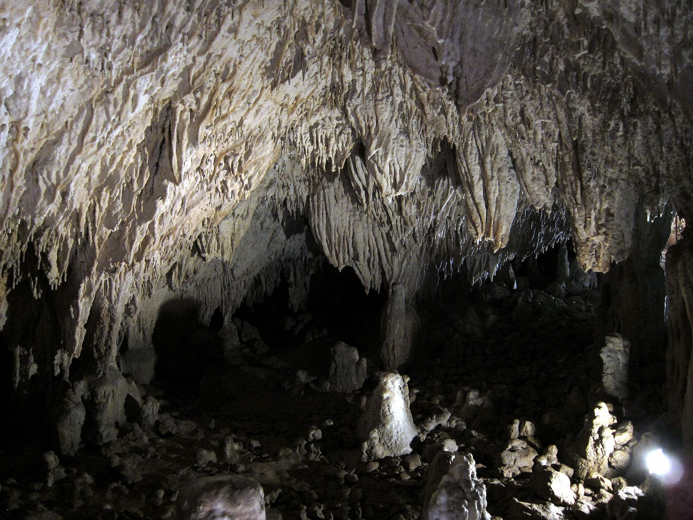
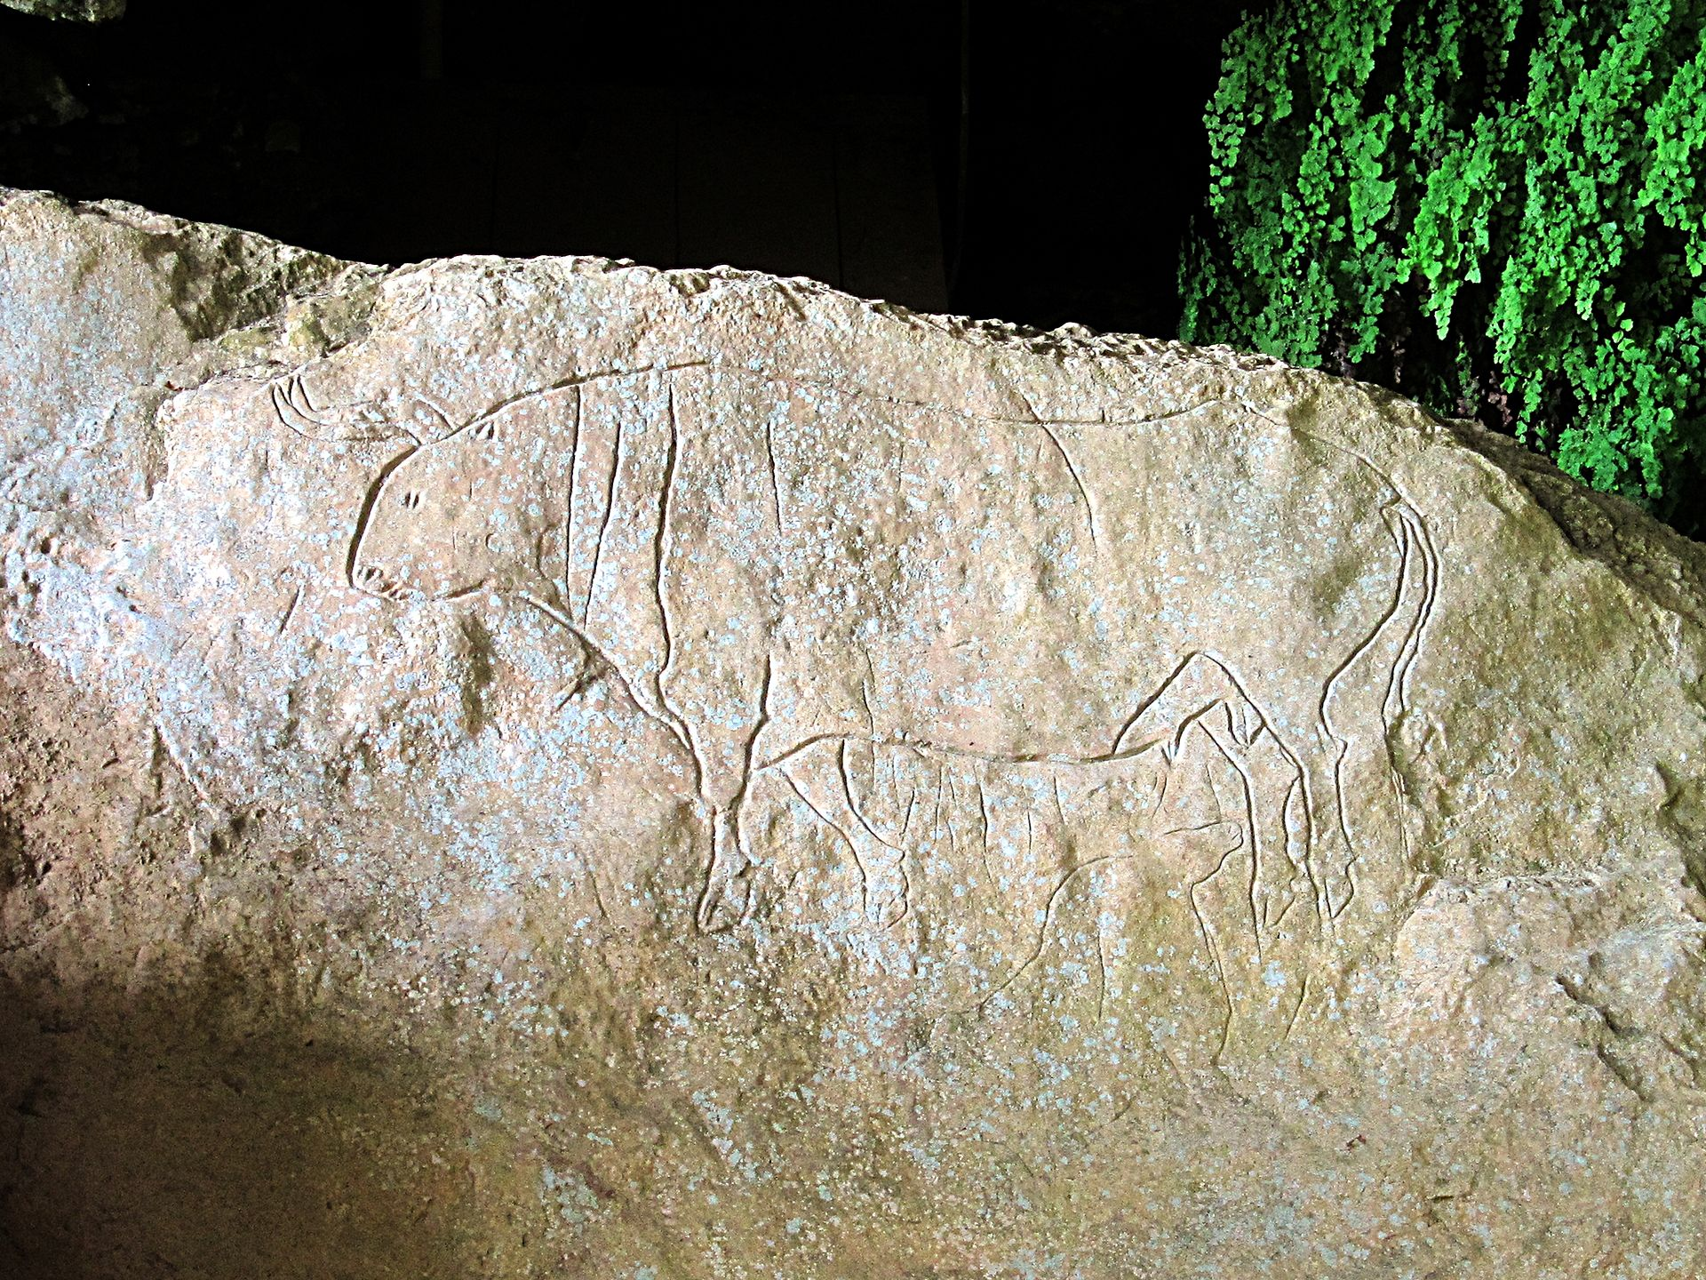
Romito Cave, Papasidero (CS)
The bull engraved at the mouth of the cave

Slide 4
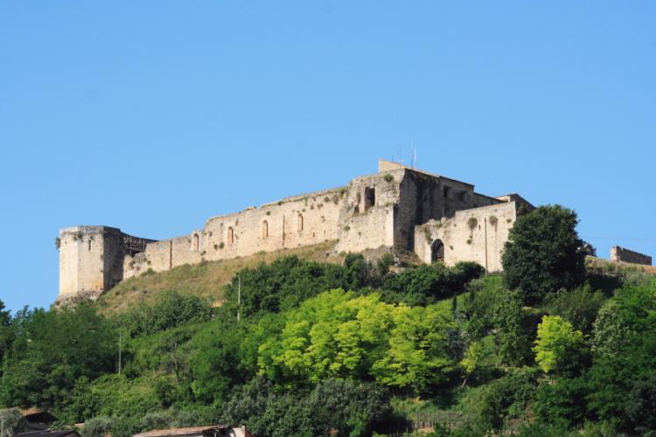
Swabian-Norman Castle (CS)

Slide 5
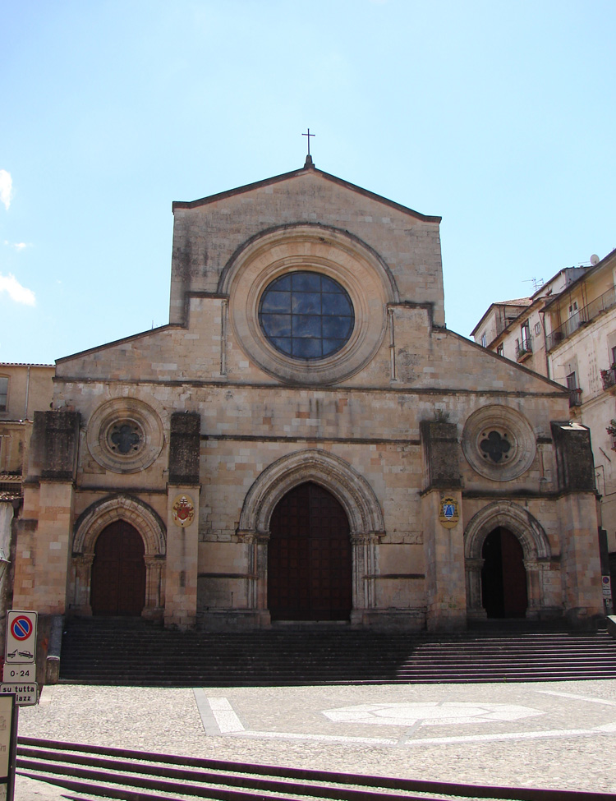
The Cathedral of Santa Maria Assunta in Cosenza. On 12 October 2011 it was recognized as a witness of peace culture heritage by UNESCO.
800 years have passed since its consecration
in 1222

Slide 6
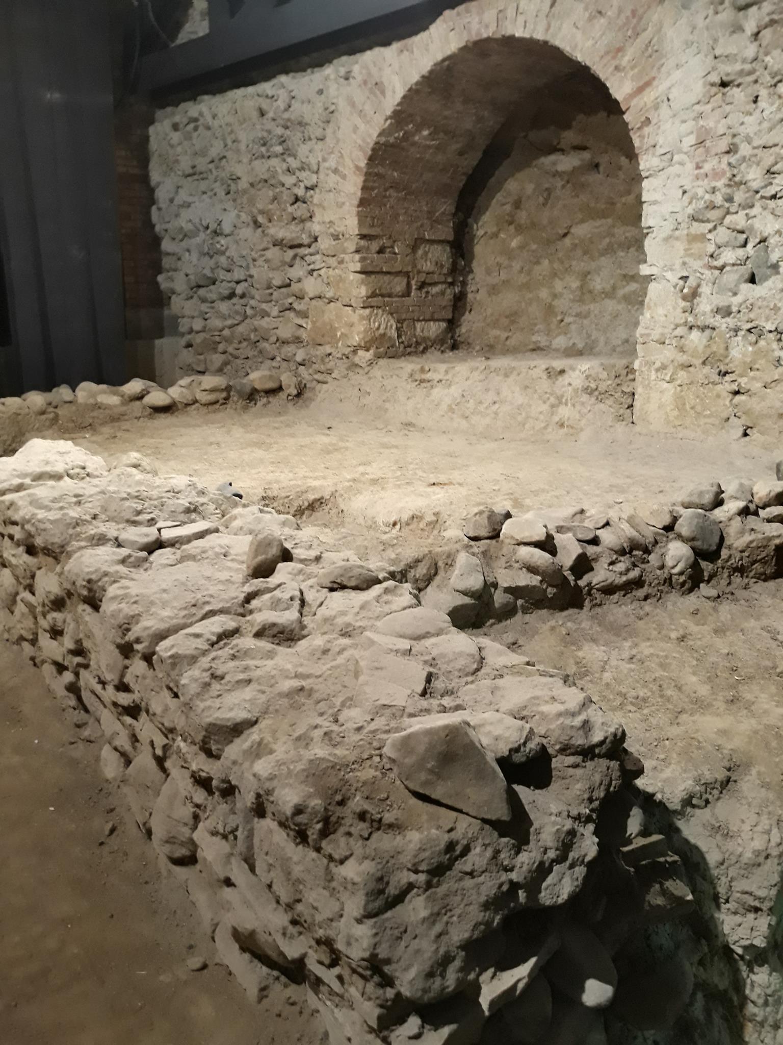
Piazzetta Toscano: The most important archeological site in Cosenza

Slide 7
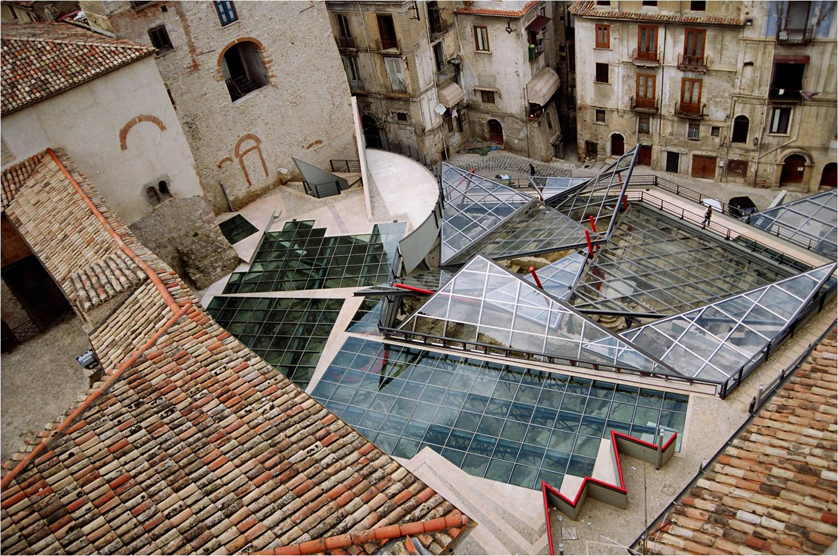
Piazzetta Toscano after redevelopment works

Slide 8
The Codex Purpureus Rossanensis is a Greek manuscript from the 6th century, kept in Rossano in the Diocesan and Codex museum. It contains a Gospel book with texts by Matthew and Mark. The adjective "Purpureus» refers to its reddish pages. The Codex contains a series of miniatures that make it one of the oldest illuminated manuscripts of the New Testament preserved.

Slide 9
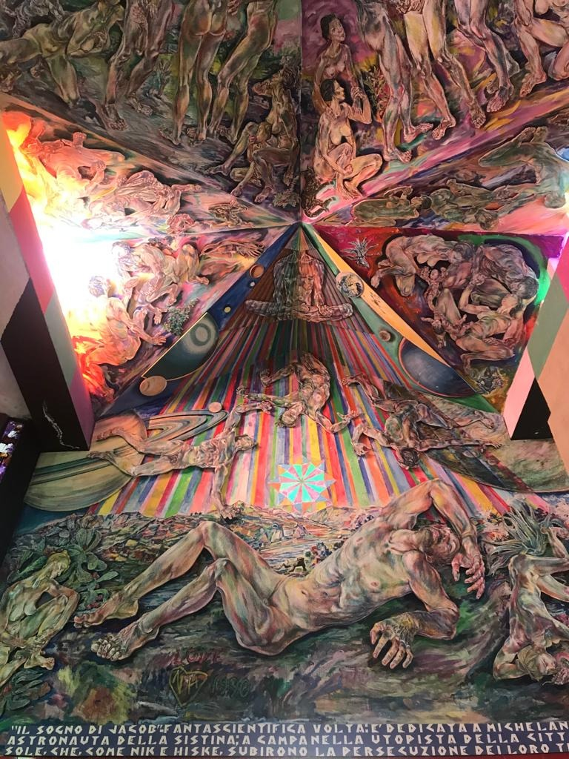
It’s known as the Calabrian Sistine Chapel, the great artwork of Nik Spatari and Hiske Maas. We can find it at the MUSABA park-museum of contemporary art located in the monastery of Santa Barbara in Mammola (RC)

