Slide 1
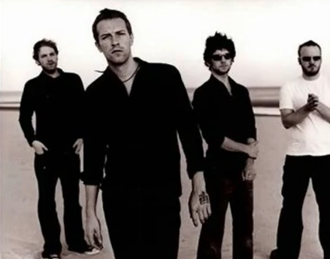
Cause you're a sky Cause you're a sky full of stars I'm going to give you my heart Cause you're a sky Cause you're a sky full of stars And cause you light up the path

Slide 2
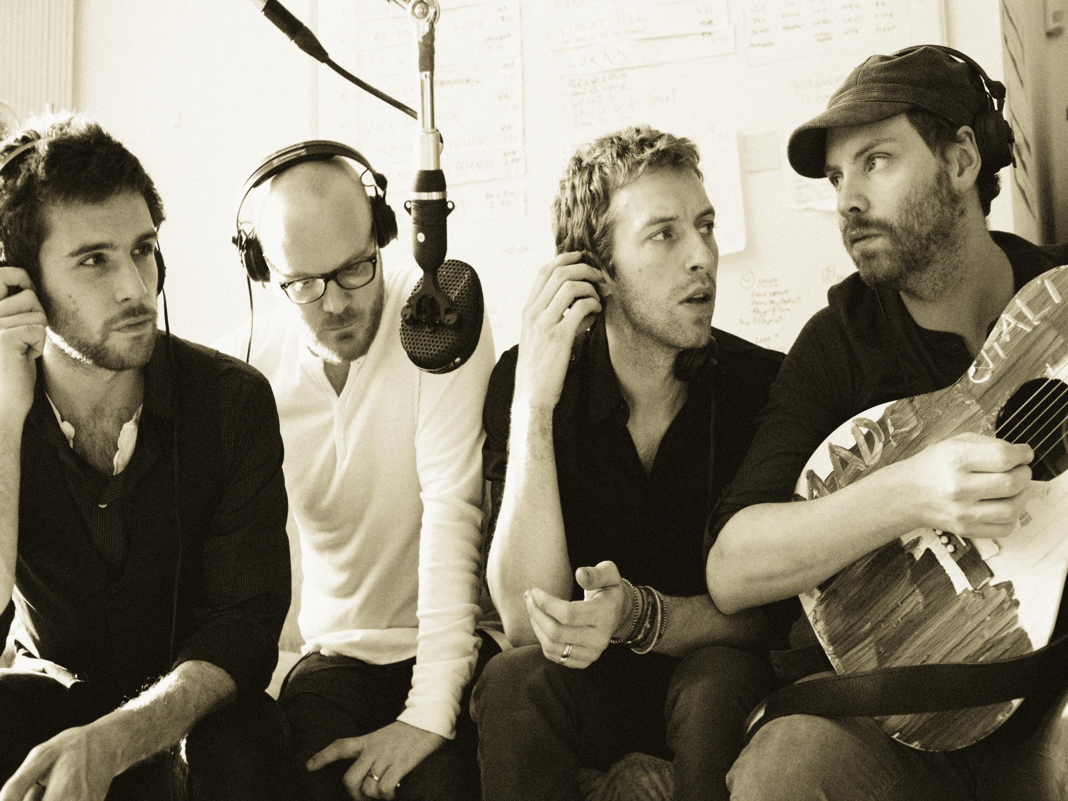
I don't care, go on and tear me apart I don't care if you do Cause in a sky Cause in a sky full of stars I think I see you I think I saw you

Slide 3
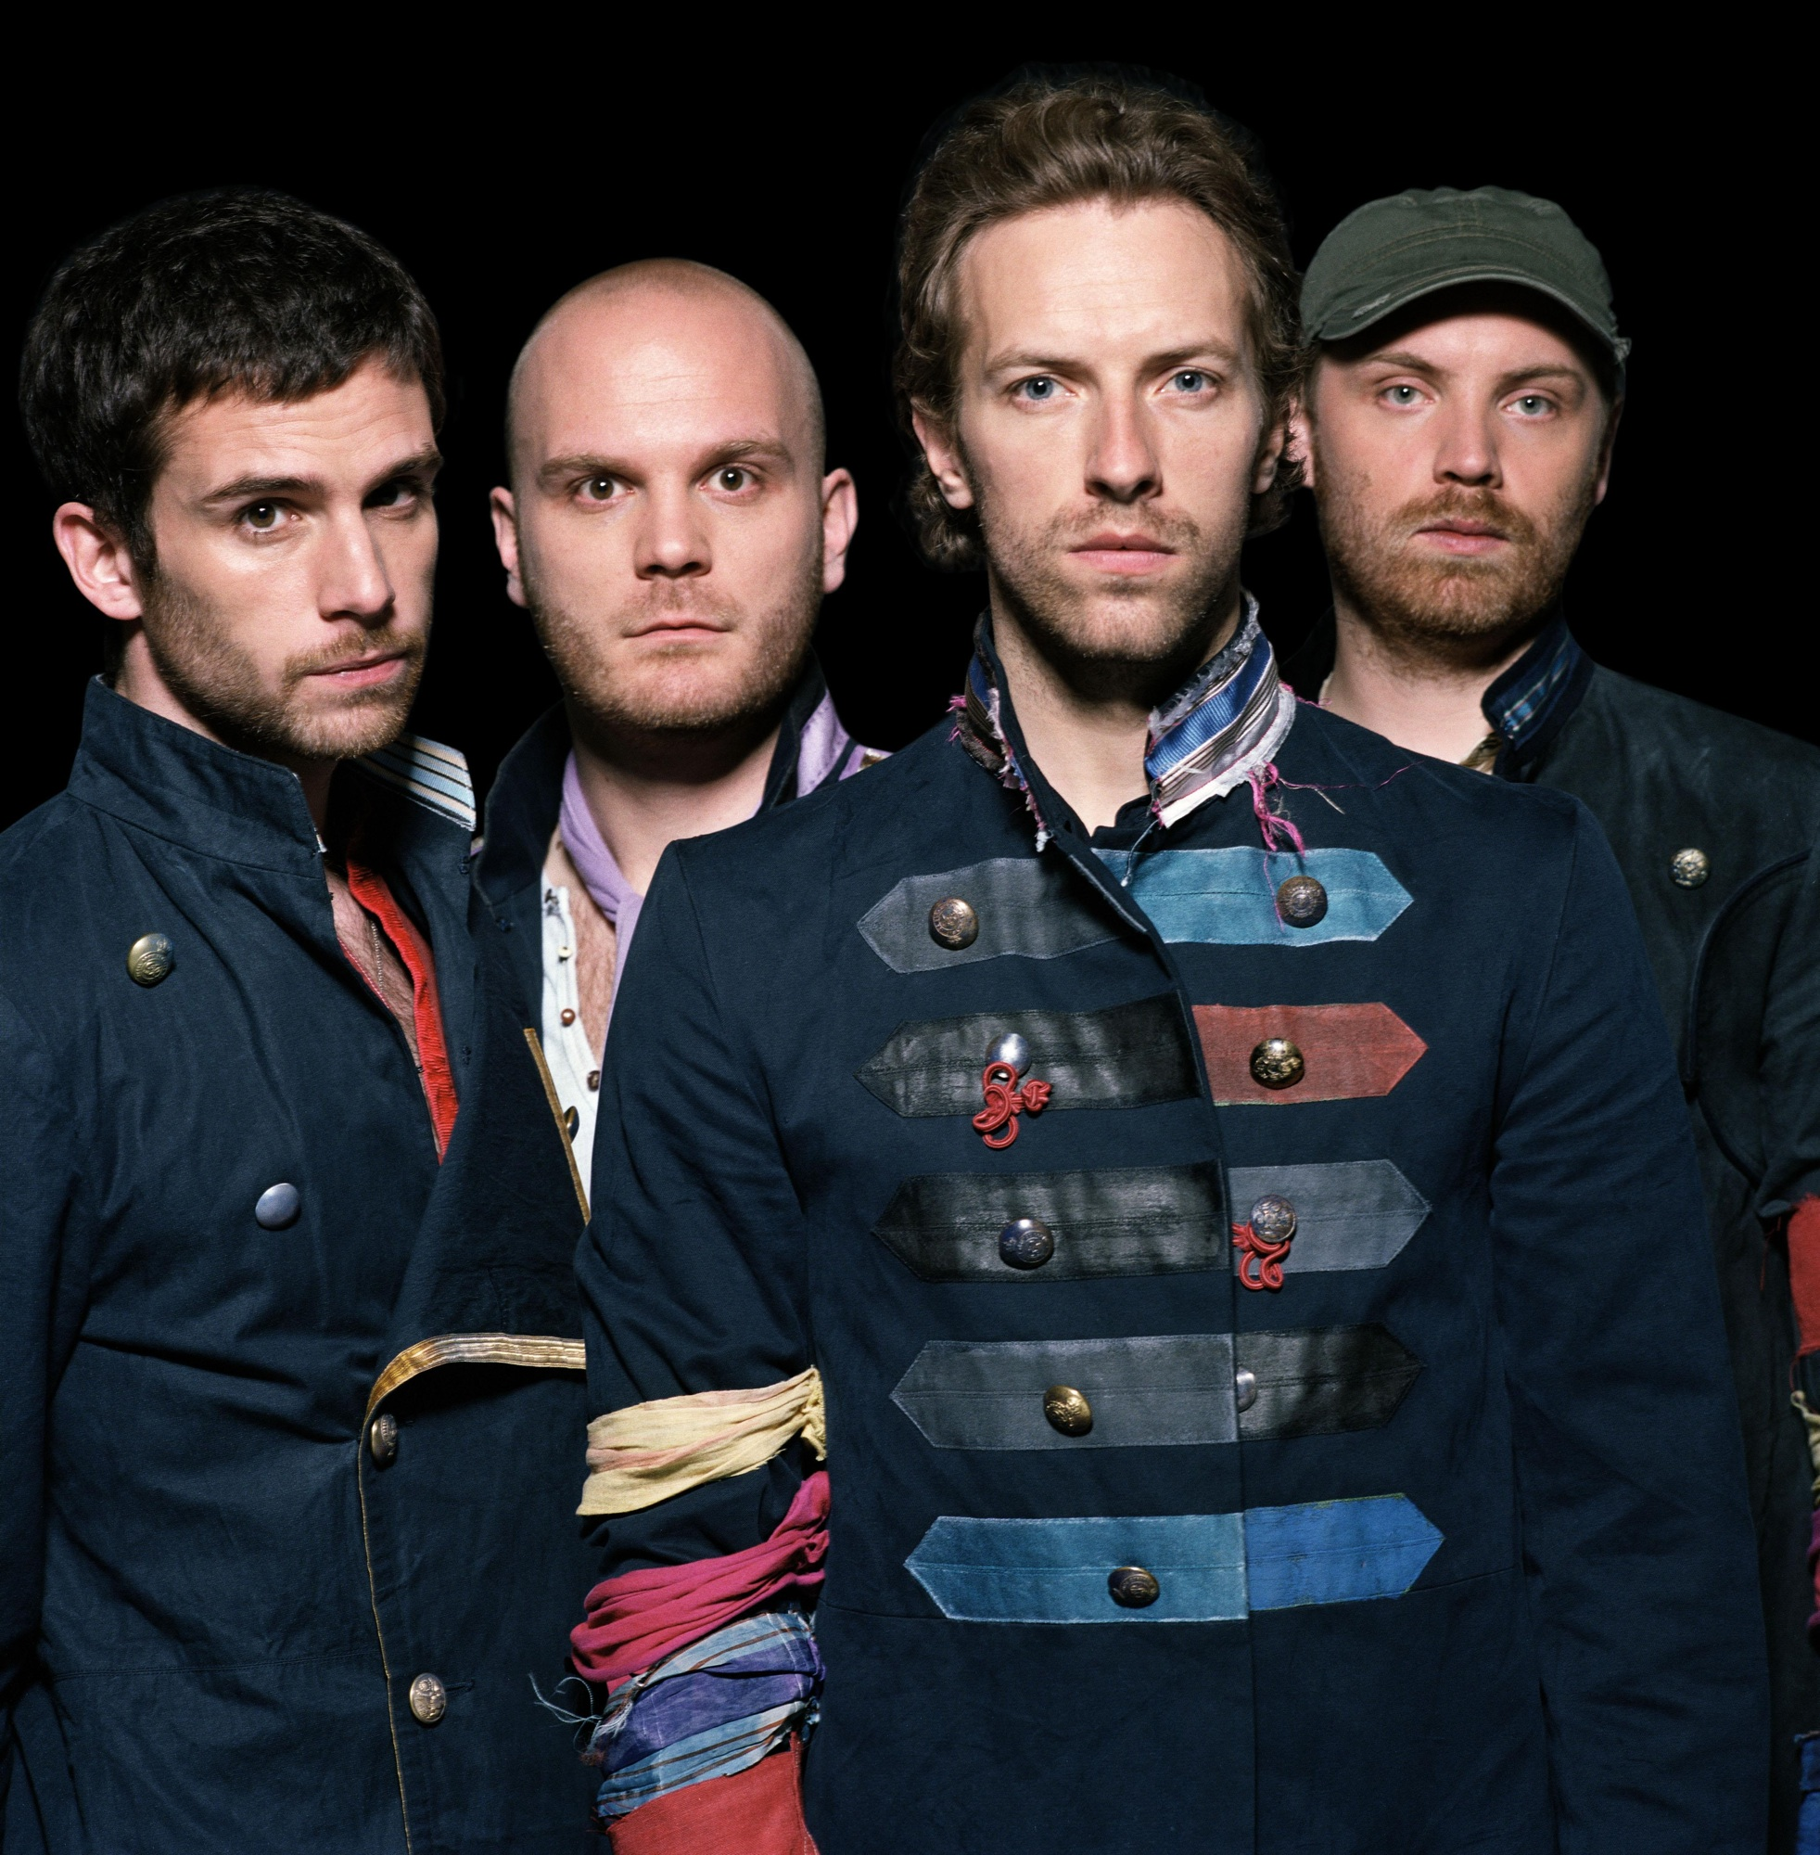
Cause you're a sky Cause you're a sky full of stars I want to die in your arms, arms Cause you get lighter the more it gets dark I'm going to give you my heart

Slide 4
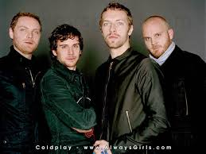
And I don't care, go on and tear me apart I don't care if you do Cause in a sky Cause in a sky full of stars I think I see you

Slide 5
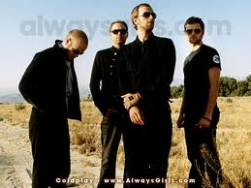
Because you're a sky You're a sky full of stars Such a Heavenly view Such a Heavenly view

