Slide 1
Design of national forest programme processes in South-East European countries Avdibegović Mersudin, Lovrić Marko, Lovrić Nataša, Marić Bruno, Nonić Dragan, Pezdevšek Malovrh Špela, Radosavljević Aleksandar, Stojanovska Makedonka
Cost Action FP1207 “Orchestrating forest-related policy analysis in Europe”
WG-1 Workshop, Prague, 12th - 13th November

Slide 2

From
former Yu-Union
to
European Union

Slide 3
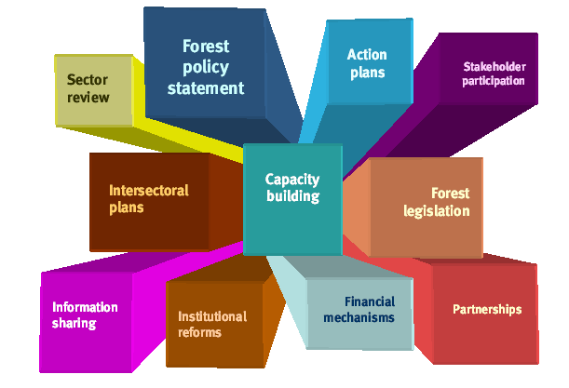
“National forest programme” – commonly agreed framework in pursuit of sustainable forest management and generic expression for a wide range of approaches towards forest policy formulation, planning and implementation at the subnational and national levels

Slide 4
Nfp process overview per countries
 | Country
 | Croatia | Fed. B-H | Macedonia | Serbia | Slovenia
Started | 2002 | 2008 | 2004 | 2003 | 2005
Ended/ accepted | 2003 | Not yet | 2006 | 2006 | 2007
Process title | National forest policy & strategy | Forestry program | Strategy of SFM | Development of forest sector | Forest for Future
Resulted in docs | National forest policy and strategy | Forest policy & Forest strategy (expected) | Strategy of SFM | Forest development strategy (2006) Forest development program | Resolution on NFP
Financing body | Government of the Netherlands | The World Bank and the Government of Fed. B-H | FAO | FAO, Finnish Ministry of foreign affairs, Government of Serbia | Responsible Ministry
Implementing body | World Bank office in Croatia | Responsible Federal Ministry | Responsible Ministry | Responsible Ministry | Responsible Ministry
Remarks | Low implement. | Long process, expected to be completed in 2014 | Low implement. | Ongoing process | Low implement.

Slide 5
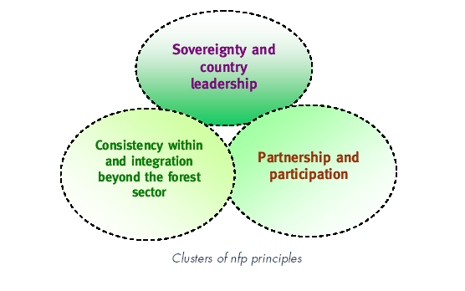
Clusters of nfp principles
Gggggg

Slide 6
METHODOLOGY
Research question:
Which factors did influence the practical implementation of the NFP documents?
Assumption:
Practical implementation of the NFP document is dependent upon its content and the conditions within which it was made
Independent variables → Dependent variable
Adherence to NFP principles
Presence of discourse
Advocacy coalition framework
Practical implementation
of the documents

Slide 7
THEORETICAL FRAMEWORK
Adherence to NFP principles (Glück and Humpreyes, 2002):
a. Public participation
- were all the relevant parties involved?
- what level of participation was achieved –scales of participation (Arnstein, 1969; IAPP, 2000; OECD, 2002)
b. Inter-sectoral coordination
What were the sectors involved in the process? In which way?
c. Decentralization
What levels of decision making (national/regional/local) were included in the process? In which way?
d. Long-term, iterative planning
Was it a “one-time event” or it is a long-term policy platform?
It is based on evaluation of previously set goals?

Slide 8
THEORETICAL FRAMEWORK
2. NFP as a discursive institution (Schanz, 2002) ; discourse as a type of communicative action (Habermas, 1984)
Questions:
- Equal information available to all the participants of the process
All the participants to the process had shared understanding of the issues that were discussed
- No actor(s) had a monopoly on the correct interpretation of the issues that were discussed
The procedural aspects of the process were known to the participants of the process
All the claims of the participant put to the same validity checks
- The goals of the process were jointly defined by its participants

Slide 9
THEORETICAL FRAMEWORK
3. Advocacy coalition framework (Sabatier, I986)
Beliefs of the stakeholders
Power (first and second face of power) over the NFP process
NFP as an negotiated agreement through a professional forum?
Elements that facilitate it: a hurting stalemate, effective leadership, consensus based decision rules, diverse funding, duration of process and commitment of members, a focus on empirical issues, building trust, and lack of alternative venues

Slide 10



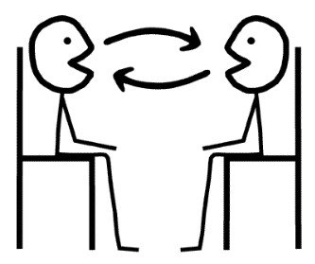
Embedded case-study design
cases: Countries, context: Ex-Yu
prospective case study design (Bitektine, 2008)
Research techniques: document analysis,
face to face interviews & content analysis

Slide 11
PRELIMINARY RESULTS
The principles of NFP:
- Broad participation, usually on the level of consultation
- Moderate intersectorality
- Low decentralization
- Moderate iterativity
The elements of discourse:
- Centralized expertise, different understandings of issues
- Unequal access to information
- Monopolized interpretation of claims
Advocacy coalition framework:
- strong “central forestry coalition”
- power misbalance
- low presence of elements that facilitate negotiated agreements
And practical implementation?
LOW

Slide 12
THANK YOU

