Slide 1


Forests Conflicts and Social Sustainability: An Integrated Forest Management Approach
Publication Presentation:
COST ORCHESTRA - Orchestrating forest-related policy analysis in Europe
Nana Bonsu PhD Candidate
Date: 12th November 2013
Notes:
Someone asked me Why this Topic ?
What I told that person was - IFM is an emerging concept addressing multistakeholder approach in forest decision-making processes (which is my area of interest) – However, I believe before we get to IFM, Forest conflicts an area which is least studied, and Social Sustainability an area often overlooked in the Sustainability discourse must be studied.

Slide 2
Presentation Outline
Background and Objectives
Motivation and Problem Statement
Sustainable Forest Management versus Integrated Forest Management
Research Overview and Questions
Material and Methods: Conceptual, Analytical and Theoretical Approaches
Overview of Preliminary Results & Multistakeholder Scenario
Future Work
Conclusion

Slide 3
Background and Definitions
Theoretical Background
Theory and Policy Linkages
Sustainable forest management: Involves the balancing of ecological, social, and economic values to meet society’s objectives over the long term.
Social Sustainability: How individuals, communities and societies live with each other and set out to achieve the objectives of development models, which they have chosen for themselves taking also into account the physical boundaries of their places and planet earth as a whole. Colantonio (2009)
Forest Conflicts: Attributes in forest governance and management, especially when dealing with multi-objective management and multi- stakeholders with competing interests. McDermott et al. (2010)
Integrated Forest Management: Land use decision-making process in which all interested parties, large and small, collaboratively considers all forest values (timber, water, wildlife etc..) and decide on how the land and its resources should be used and managed in a sustainable fashion (CCFM, 2006; Kreutzwiser and Wright, 1988)
Notes:
Sustainable forest management (SFM) involves the balancing of ecological, social, and economic values to meet society’s objectives over the long term.

Slide 4
Objectives of Study
Examine key issues in forest resource conflicts manifesting within Irish forest landscapes using Western Peatlands and Newmarket as case studies;
Explore the contemporary causes of forest resource conflicts and the approaches used in managing conflicting situations;
Identify forest stakeholder objectives, interest/values and the power relations amongst stakeholders resulting in conflicts; and
Understand current negotiation, consultation and mediation patterns used in managing forest conflict situations including how the outcome becomes operational and acceptable at the forest landscape.
Notes:
The linkages between theory and policy, now aim to:

Slide 5
Overall Research Methodology
Case Studies Approach (to enable an in-depth/bottom-up approach and comprehensive analysis of each of the forest landscape under investigation)
Qualitative Study (Interviews, Secondary Sources and Desk Study)
Stakeholder Analysis (Identifying and interviewing Forest Actors ( Forest Owner's (public &private) and Stakeholders, and via snowballing technique).
Multistakeholder Participatory Workshops
A combination of Qualitative and Quantitative Scenario Analysis

Slide 6
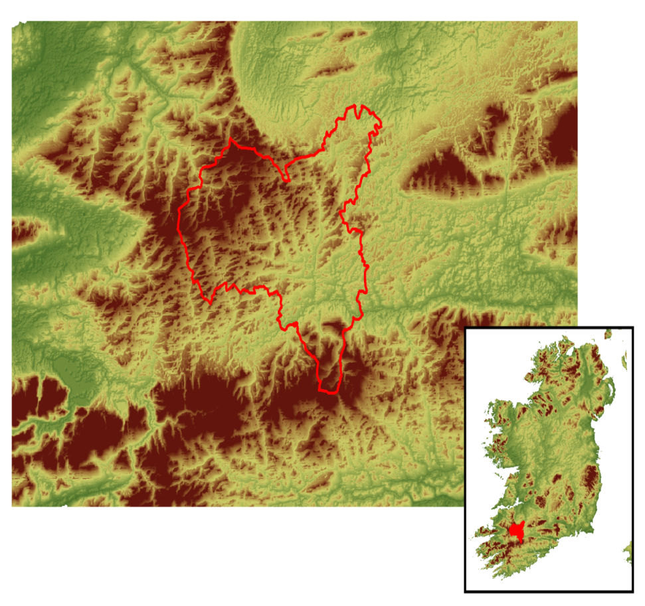
Case Study Areas
Newmarket Case Study
Western Peatlands Case Study
South-West Region of Ireland
Western Region of Ireland
Notes:
Both cases represents a site type – afforested in the 1950s and 1960s with the objectives to achieve similar goals i.e. employment generation and viability of timber production. However, since the forests in these areas have been established conflicts have emerged in both CS for different reasons.

Slide 7
Key Characteristics of Case Studies & Why?
Newmarket
Western Peatlands
Experienced High level of afforestation since 1980s, as a result:
Conflicts and growing local community concern regarding afforestation and land use views;
Previous studies showing strong anti-forestry views and public awareness of forestry;
Special Protection Areas (SPA) and Special Area of Conservation (SAC) sites due to high presence of Hen Harrier and Fresh Water Pearl Mussel
Forests planted in 60s and 70s on peatlands (it is perceived that, at that time, the environmental value of peatland was not appreciated in the way it is today) :
Forests are now recognised to be in environmentally sensitive areas;
Many forests considered to be ‘in the wrong place’ i.e. given the change of emphasis to the forest landscape, biodiversity, conservation, water quality and carbon sequestration;
Case Study is nationally and internationally important in terms of water quality, biodiversity and landscape.
Notes:
Newmarket: e.g. Lands converted from agricultural use to forests and afforestation forced land prices up which meant it was more difficult for farmers in the area who wished to extend their holdings to do so
Western Peatlands: An economic viable forestry (as one pillar of sustainable forest management) is incoherent with replanting on land where forestry is uneconomic (low yield, high management costs on peat land). It is perceived that, at that time, the environmental value of peatland was not appreciated in the way it is today

Slide 8
Motivation and Problem Statement
Notes:
The motivation of this study, set to look at the practice of SFM within forest landscapes and how the dimensions of SFM are equally prioritised, considering the societal conflicting demands from the forests …

Slide 9
SFM versus IFM in Conflict Context
Addresses the Economic, Environmental and Social dimensions of forest management
Decision-making process and policies are Landscape based
Forest resource conflict/discourses are identified, addressed and incorporated in decision-making processes
Addresses multi-purpose forestry, and stakeholder participatory approach in forest policies and programmes at landscape level
Forest actors (owners and stakeholders) values and interests including other forest emerging are addressed and managed so as to achieve trade-offs
Bottom-up approach in decision making process.
Addresses the Economic, Environmental and Social dimensions of forest management
Decision-making processes and forest management policies/programmes are not typically landscape based, but rather the National and International policy goals which reflect at the landscape level
Addresses multi-purpose forestry and stakeholder participation through consultation process e.g. Dept. of Agric. and Public forest owners consultation with stakeholders
Forest actors (owners and stakeholders) values and interests may be addressed or ignored;
Appears to be more of a top-down approach in decision-making process.

Slide 10
Research Overview and Questions
Notes:
So with the idea of IMF, and the INTEGRAL conceptual framework, I begun to wonder … ? (questions in the ?)
Phase 1: Where 26 interviews were conducted with multi-stakeholder groups in both case study; (13 in Newmarket and 14 Western Peatlands)
Phase 2: A multi-stakeholder workshop was conducted in both case studies, (as it was a multi-stakeholder participatory scenario construction the stakeholder numbers were targeted between 6-9 experts that could robustly analyse the societal conflicting factors in relation to forest development. Phase 3: Is yet to be carried out, but it will involve more multi-stakeholder groups in a participatory ‘Backcasting’ workshop style…

Slide 11
Methods: Conceptual &Analytical Approaches
Phase 1(Help gathered stories and narratives around stakeholders’ views on forest conflicts and conflict management strategies)
Notes:
Stakeholders Objectives/Interests: Understanding forest stakeholders personal views on local and national forest objectives and their interests @ forest landscapes is crucial… Stakeholders Relationship: Understanding the relationships between forest stakeholder and others, help uncover the organizations, groups or individuals that forest actors cooperate, partner or may have conflicting relations; Policy constitutes important structural factors that influence forest management. The coherence of policy addressing forest issues is especially important for effective forest policy implementation.
Forests can supply a range of ecosystem services. The demand for these service influence forest management practices in the landscape and can contribute to forest conflicts;
In understanding the public opinion and discourses that might lead to forest conflicts, becomes imperative to know what kind of discussions normally evolve within the public domain, the source of these discussions; the key people involved in these discussions

Slide 12
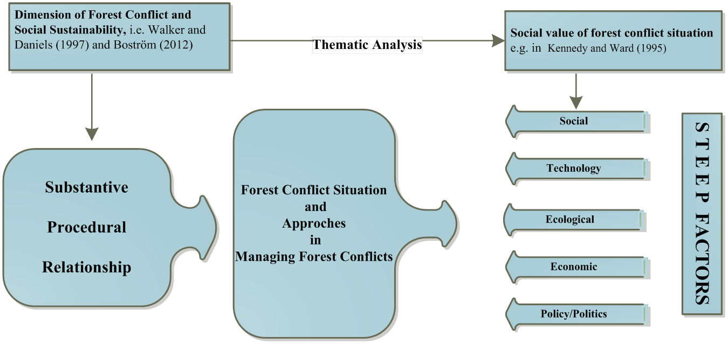
Theoretical Approach in Analysing Data
Notes:
Analysing conflicting situations among forest stakeholders is a prerequisite in developing approaches to resolving them either through participatory, consultation or other means. Following the qualitative data that were gathered, understanding forest resource conflict situations covers several aspects encompassing the ‘what’ (objectives, interests, issues, values); ‘who’ (forest actors and stakeholders); ‘where’ (landscape area and forest type); ‘how’ (decision-making process, mediation patterns, action); whom; (decision makers).
Most often, this requires both a material analysis of the basis for resource use and a social analysis of the relevant stakeholders involved. Kennedy and Ward (1995) interacting systems in which natural/forest resource values originate
and are communicated to society.; and Walker and Daniels (1997) stated that in natural resources management, the nature of any conflict situation/approach in managing them is a result of the substantive, procedural and relationship dimensions of the natural resource at stake

Slide 13
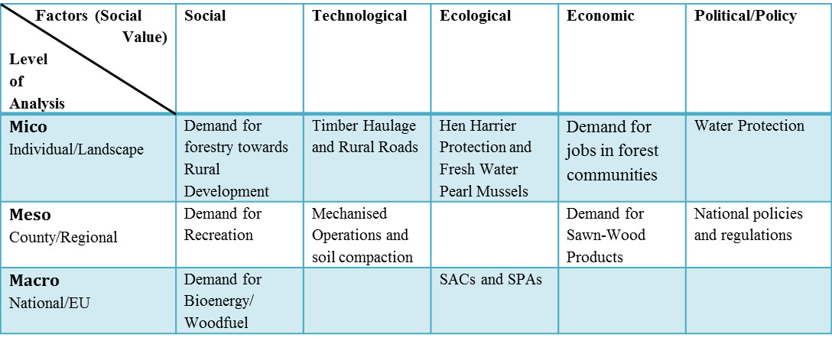
Preliminary Results: Reconstructing Forest Conflicts
Dimension of Forest Conflicts
Social Facets/Value in STEEP
Substantive Conflicts: conflicts between forest stakeholder groups with different interests and objectives (e.g. forest planting vs. water protection); Conflicts between the provision of different ecosystem services (e.g. biodiversity vs. timber production);
Procedural Conflicts: conflicts on structural issues such as forest regulations and policies that impact forest development e.g. licensing vs. forest production; forestry vs. certification.
Relationship Conflicts: conflicts on decision making process; mediation patterns; networks and forest policies development. E.g. Coillte consultation process; Irish Farmers Association Strategic Policy Committees.
Notes:
With reflection on state-of the art theories and frameworks, forest conflicts could be viewed and analysed as…

Slide 14
Multistakeholder & Expert Participatory Workshop : Influencing & Conflicting Factors – Phase 2
Newmarket
Western Peatlands
Climate Change
Common Agriculture Policy
Public Participation
Discontinuing monoculture afforestation
Rural Development
Demand for Sawn-Wood Products
Demand for Woodfuel/Bioenergy
Forest Certification
Forest Policies & Regulations
Fresh Water Pearl Mussel
Hen Harrier Protection
Private Forest Owner’s Knowledge & Skill
Afforestation Premium
Private Forest Owners Knowledge & Skills
Out-Migration
Demand Recreation
Rural Development
Forest Certification
IT &GIS
Demand for Woodfuel/Bioenergy
Water Protection
Forest Regulations
SFM
Availability of Premiums
Sawn Wood
Economic Viability

Slide 15
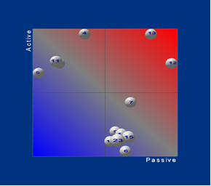
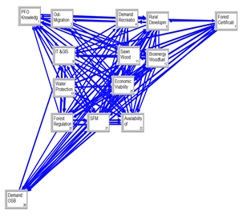
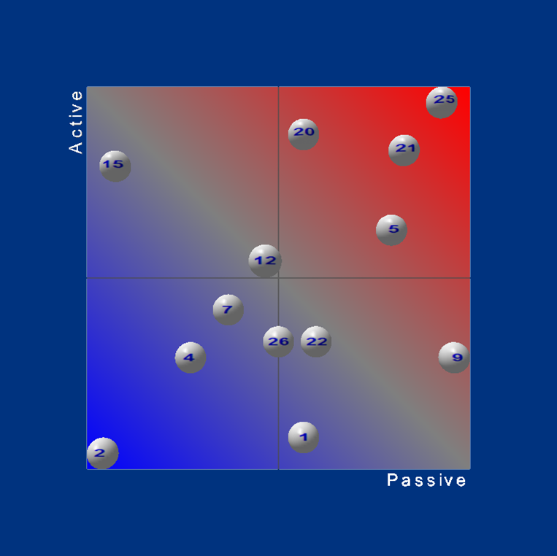
Results – Structural Analysis of Key Factors & How they influence each other: Using the Parmenides EIDOS DSS
Newmarket
Western Peatlands
Notes:
By using the Parmenides Software for the Structural Analysis, these ‘white balls’ shows how these key and some conflicting factors’ influence each other.
Active: Influence forestry development but are not themselves influenced by other factors; It is not surprising that particularly these areas are active, for instance water protection (in Western Peatlands) or Demand for woodfuel in Newmarket will always have great impact on other factors, while it is difficult for others to impact them.
Relay factors: In the top right square factors are factors influence forestry development but are also influenced by other factors - Thus, the relay/ambivalent area is the most interesting area seen from the scenario perspective, leaving multiple options for developing interesting scenarios.
Passive: Influenced strongly by other factors; which implies that they are dependent on other incidents before their impact can change.
Buffering or Lazy factors: Little influence/not dependent.

Slide 16
Multistakeholder Important Factors for Scenarios
(Now and Future)
Western Peatlands
Newmarket
Economic Viability ( 25)
Sustainable Forest Management (21)
Forest policies and Regulations (20)
Rural Development (5)
Forest Certification (7)
Water Protection (15)
Demand for Bioenergy/Woodfuel ( 12)
Forest Policies and Regulations ( 13)
Forest Certification (12)
Climate Change (4)
Discontinuing Monoculture Afforestation (7)
Common Agriculture Policy (5)
Demand for Sawn Wood Products (10)
Demand for Bioenergy/Woodfuel (11)
Notes:
In summary, due to how active or passive a conflicting factor evolved, these were the factors selected for future scenarios development…

Slide 17
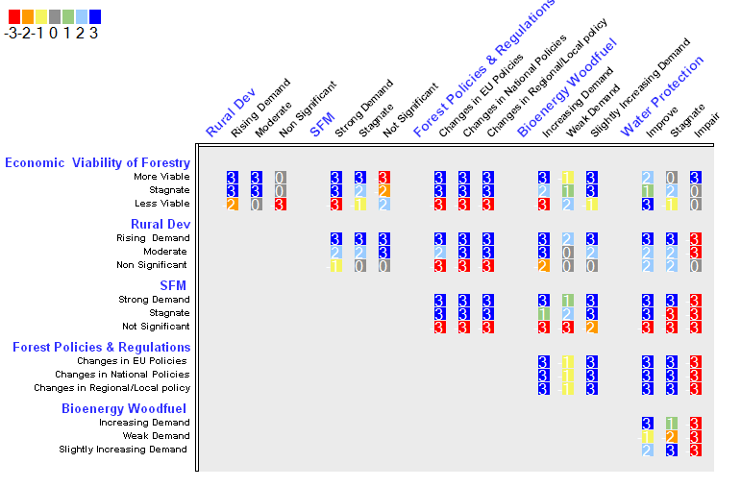
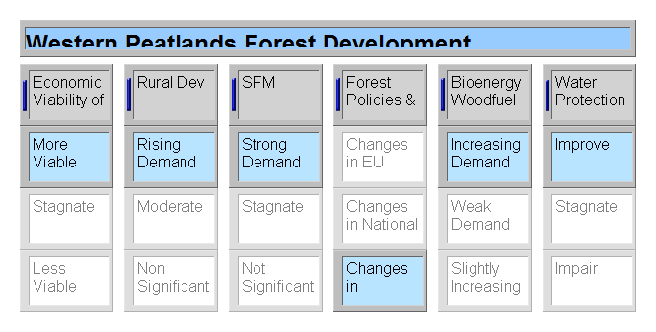
E.g.: Multistakeholder Participatory Option Development & Scenario
Economic & Rural Development Scenario
Notes:
The Parmenides decision support too, can do a lot. This is a Consistency Matrix showing possible scenarios that could be developed for the Western Peatlands CS. It shows the degree of consistency between the identified conflicting demands and their manifestations (determined by stakeholders). This process quantifies the extent of trade-offs between two conflicting alternatives. For example, a strong logical fit is assumed between changes in Local forest policies and increasing demand for Woodfuel. For each intersection, a consistency rating on a scale from -3 to +3 was assigned, depending on how well the two alternatives coexist: - +3 means the highest degree of fit (the two alternatives go together very well). - 0 means no fit between the alternatives. - -3 means the highest degree of friction (the two alternatives can hardly co-exist).

Slide 18
Future Work
Thematic Analysis of data sets (for paper publication).
Backcasting exercises: What multi-stakeholders would want to achieve and by means of what steps?
Further Analysis
Impact analysis: What opportunities and risks are linked to the situation described in the scenario?;
Stakeholder analysis: What do the scenario developments mean for the multi-stakeholder groups?;
Evaluation of current strategies against the background of scenarios;

Slide 19
Conclusion
At forest landscape levels, future forest policies may require identifying the societal conflicting demands and using participatory multi-stakeholder approach (with the aid of decision support software) to assess opportunities and trade-offs for a pro-active sustainability design in forest resources decision-making.
Need for a systematic study of the linkages between theory, policy and practice at EU level.
A typology for social sustainability assessment of SFM – dealing with the structural, procedural and relationship issues i.e. The sustainability dimension needs to be explored, framed, filled with content and should be interpreted from time to time at landscape levels – looking at opportunities that could integrate, and simultaneously work for social, economic and environmental goals.
Notes:
e.g. forest related resources contributing to those types of jobs that people in rural areas prefer related to future demands i.e. income and employment opportunities through the LEADER approach.

Slide 20


