Slide 1
Evaluation of policy tools supporting small scale forest owners associations in the Czech Republic and Slovakia
Michal Hrib, Vilém Jarský, Zuzana Dobšinská

Slide 2
Introduction to the issue discussed
Workshop WG1 – FP 1207 ORCHESTRA
Prague, 12 November, 2013
Analysing changes in in the structure of forest ownership after the restitution process in two countries – Slovakia and the Czech Republic – with focus on the formation of small scale forest owners associations (FOAs).
Reasons for comparison:
Common history of the two countries
Similar problems arising after their separation in 1993
Process of re-privatisation and restitutions of the state-owned estates (forests) to their former owners after 1989

Slide 3
Outline of the presentation
Theoretical background
- provided by the policy analysis and governance theory
Methodology
- combining forest policy documents analysis and interviews with FAOs representatives
- confronting the results with the questionnaire survey carried out among small scale forest owners
- examining their attitudes to the forming of associations

Slide 4
Outline of the presentation
Results of the research
- Forest Policy Tools
legal/administration
information sources
economic tools
- Survey results and survey analysis

Slide 5
Outline of the presentation
Conclusions
- low interest in association forming
- inefficient economic tools
- most tools aimed at “active owners”
- how to “activate” inactive owners

Slide 6
Theoretical background
Development in Czechoslovakia after 1989 to1993
Re-privatisation process based on the Act No 229/1991 Coll. On ownership relations to land and other farm estates, which was legally binding in both countries of the then federation, the term “land” relating to forests as well.
Municipalities and other non-state entities received their property on the basis of specialist acts, e.g. the Act No 172/1990, Coll. On the conveyance of property to the ownership of municipalities.

Slide 7
Theoretical background
Development after the creation of two separate states since 1 January 1993
Situation in Slovakia
Restitution process of the forest estates has been conditioned by the creation of the so-called estate associations following the Act No 181/1995 Coll. On estate associations, or by the formation of association following the Civil Code.
If the above was not the case, estates could be returned by the state providing the small scale owner had his geometric plan made on behalf of his own expenses.
In essence, the restitution process was terminated in 1998, however, the final stage has slowed down markedly due to small areas of forests with problematic structure and identification in the terrain.

Slide 8
Theoretical background
Situation in the Czech Republic
- Re-privatisation is conditioned neither by the size of estates nor fees or expanses because those are covered by the state.
- Restitution process was to a great extent terminated in the end of the 90s, with the exception of church estates (forests). The church restitutions were approved in 2012 (Act No 248/2012 Coll.)

Slide 9
Theoretical background
The restitution process resulted in a high number of small scale owners whose estates (forests) amounted to a small area of land (forest) only.
The following tables compare numbers of publicly owned and privately owned forests in 2000.

Slide 10
Theoretical background Source: TBFRA2000 – Temperate and Boreal Forest Resources Assessment: Forest resources of Europe, CIS, North America, Australia, Japan and New Zealand, Main Report, ISSN 1020-2269. ISBN 92-1-116735-3. United Nations, New York and Geneva, 2000
Number of forest estates in public ownership based on size categories
Size category | Czech Republic | Slovak Republic
up to 10 ha | 2 522 | 78
11 – 20 ha | 511 | 100
21 – 50 ha | 651 | 116
51 – 100 ha | 388 | 58
101 – 500 ha | 327 | 104
501 – 10 000 ha | 65 | 104
10, 001 – 100, 000 ha | 102 | 9
over 100, 000 ha | 0 | 4
Number of forest estates in private ownership based on size categories
Size category | Czech Republic | Slovak Repubic
up to 3 ha | 119 443 | 10 000
3 – 5 ha | 10 954 | 14 620
6 – 10 ha | 4 530 | 489
11 – 20 ha | 1 124 | 474
21 – 50 ha | 660 | 892
51 – 100 ha | 132 | 785
101 – 500 ha | 389 | 1 222
501 – 10, 000 ha | 27 | 100
over 10, 000 ha | 1 | 77

Slide 11
Theoretical background
Main objective for forming small scale forest associations consists in overcoming structural disadvantages of small scale private ownership and thus improving the economy of wood production and supporting social forest functions.

Slide 12
Methodology
Forest legislation and forest policy documents were analysed and FAOs representatives were interviewed. The results of the analysis and interviews were subsequently confronted with the questionnaire survey carried out among small scale forest owners, which revealed their attitudes towards association forming. The research combined the following empirical methods:
- identifying relevant political science theories,
- verifying their formal elements with a document analysis and
- verifying their informal elements using expert interviews.

Slide 13
Methodology
The following table presents the analysed legislation and policy documents regarding small scale FOAs in Slovakia. It has to be noted that the issue of FOAs formation is not only on the forest policy agenda but it is also one of the rural development policy objectives.

Slide 14
Methodology FOAs Legislation Analysis in Slovakia
Document | Year of acceptance | Association support | Financial support
Act on forests | 1977 | no | no
Act on forests | 2005 | State supports associations of owners, in particular owners with small area State supports foundations of economically independent associations, or associations with areas capable of sustainable management in forests | no
Decree issued by the Ministry of Agriculture 806/2004 | 2004 | Forest owners with area up to 50 ha forming associations with legal entity | Payment per ha differentiated according to the size of associated estates
Act No 274/2006 | 2006 | Forest owners with area up to 50 ha forming associations with legal entity, advisory services and education, activity of regional associations of forest users and owners | no
543/2007 | 2007 | no | no
320/2011 | 2011 | no | no

Slide 15
Methodology
Questionnaire survey
In Slovakia, the questionnaire survey was carried our between January and September 2013 with 800 respondents being interviewed. The sample was biased because all of the respondents were forest owners. The response rate was 45% (361).
In the Czech Republic, the questionnaire survey was carried out in two regions, Central Bohemia and “Vysočina” region, with 390 and 241 respondents respectively.
In Central Bohemia region, 220 physical persons were questioned and 170 municipalities.
In Vysočina region, 198 physical persons were questioned and 43 municipalities.
The physical persons’ response rate was 36% for Central Bohemia.

Slide 16
Results of the research
Individual Forest Ownership in the Czech Republic
The significant problem is the fragmentation of private forest property, which does not give preconditions to efficient forest management of this land.
The term “small scale owner”, or the owner of a small area, is not defined by current legislation. The term can only be found in appendices to individual acts on state budget of the Czech Republic, which amend rules for providing financial subsidies. The maximum limit for the support of small scale owners amounts to 300 ha.
As a result, the state has explicitly declared in Paragraph 46, Act No 289/1995 Coll. Forest law, to support associations of small scale forest owners into viable units.
- At present, there are many small scale owners associations with roots well before 1948.
- Some associations are related to the ongoing restitution and privatisation processes.

Slide 17
Results of the research
Beside small scale owner associations there exist a number of different professional organizations, e.g. Czech Forestry Professional Association established in 1990).
Common situation
- when small scale owners are associated in the local associations and at the same time are members (either as individuals or a local association) of associatitons at a national level.

Slide 18
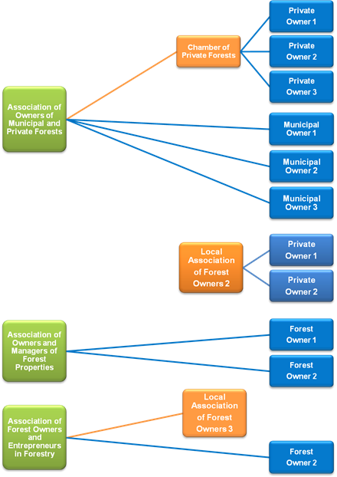
Results of the research General Organizational Scheme for FOAs inm the Czech Republic

Slide 19
Results of the research
SVOL (The Association of Municipal and Private Forest Owners in the Czech Republic) is a voluntary non profit making organization associating non state forest owners and managers.
SVOL´s mission:
to participate in forming forestry policy and to advocate respecting property rights and ensuring balance among all aspects of forest management in related legal regulations.
to draw attention to social, economical and environmental benefits of community and private forest properties for stability and development of country areas.
to participate in improving expert standards of management of forest properties and to advocate sustainable ways of forest management, among other things by supporting PEFC certification of forests.
to increase prestige of forest staff and to promote consumption of wood as a renewable resource.
to contribute by organising joint business mechanisms to long-term supplier-customer relations, the steadiness of the markets and higher appreciation of the wood produced.
At present SVOL represents more than 1,100 non-state forest owners (communities, towns, private forests, forest co-operatives, unions of small-scale owners) managing c. 377,000 hectares of woodlands which are cca 14 % of the total forest area in the Czech Republic.
Municipalities and forest associations are represented in SVOL directly, as opposed to individual small scale forest owners, who are represented in SVOL by private forests chamber.

Slide 20
Results of the research
Forms of associations as business organizations
When forming associations with legal entity small scale owners can make use of the following legal forms: limited partnership, limited liability company, joint stock company, cooperative (at present there are 47 forest cooperatives), civil associations, municipal associations, community interest company, interest association of legal persons.
For forest associations the Czech Republic does not have any corresponding legal entity.

Slide 21
Results of the research
Forest Ownership in Slovakia
Legal forms in non-state sector are represented by land fellowships with or without legal subjectivity, which are non-existent in the Czech Republic. Over the decades there has been an increase in non-state forest owners due to successfully returned owners. According to the forestry statistics database, there are over 57,000 individual forest owners. Individual private forest land tenure ranges between 0.01 ha and 1,320 ha of forest land.
Many non-state subjects started their business without any financial support, mechanization or technical support as well as administration and technical equipment for forest production and access to the market.
Many FOAs were established due to common problems with restitution of the same type of estate on the basis of ownership. The first non-state owners association – Association of private, associated and communal forests was set up in 1991, in 2005 renamed as Slovak association of non-state forest owners. Its purpose was to coordinate forestry area, however, it did not succeed.
At present there are four important FOAs at a country level, with the total forest area of 536, 000 ha. Non-state forest owners, who do not belong into any association account for 264, 000 ha or 33%.

Slide 22
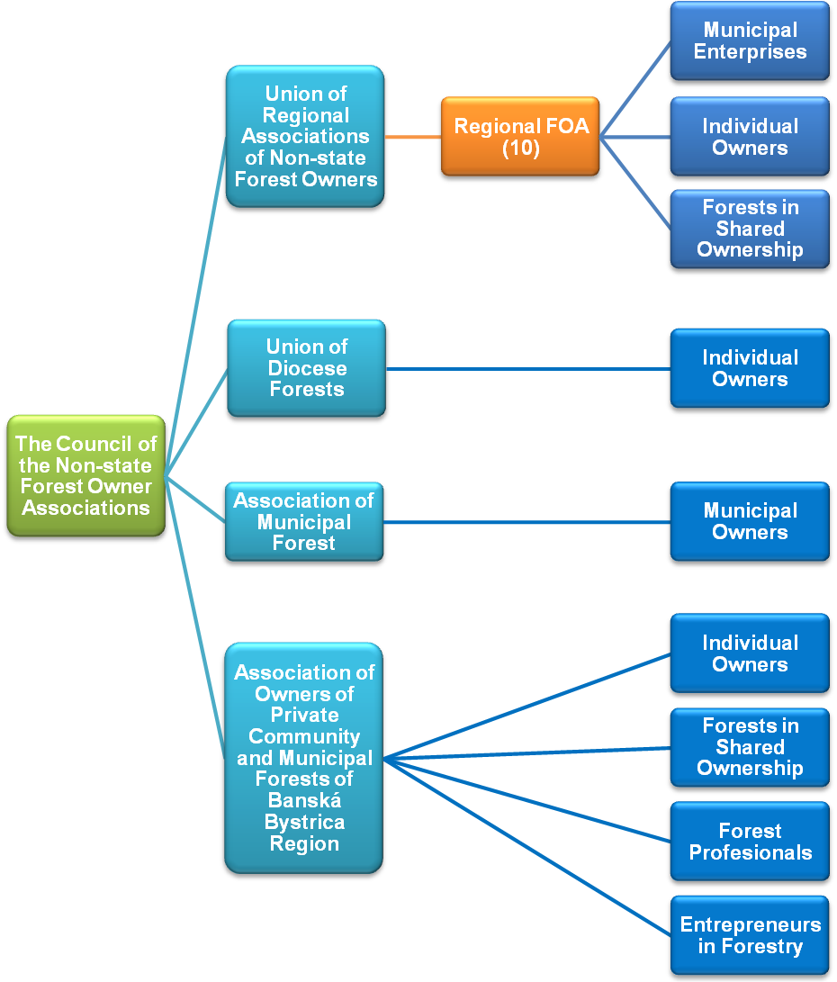
Results of the research National FAOs Organizational Scheme

Slide 23
Results of the research
Forest Policy instruments supporting small scale FOAs formation
Situation in the Czech Republic
- The state has promoted the establishment of the interest groups by national incentives for forest owners associations. The support came from the state budget (till 2005)or from the regions (from 2005).
- Subsidies for the association forming were in the form of aid to the management of common property and the amount of aid depended on the size of the associated property and the size of share. Party responsible for such contributions till 2005 was the Ministry of Agriculture and since 2005 the competence has been transferred to a regional level . Each region can decide whether the support will be provided or not for that given year.

Slide 24
Results of the research
The table below present the data from 1996. In this year the new forest act came to power stating the support for the FOA).
Before 1996, special support measures for forest management were needed - less than 250 ha.
Year | 1996 | 1997 | 1998 | 1999 | 2000 | 2001 | 2002 | 2003 | 2004 | 2005 | 2006 | 2007 | 2008 | 2009
Million CZK | 1.1 | 1.2 | 2.2 | 3.1 | 3.4 | 3.7 | 3.8 | 3.8 | 4 | 2.7 | 3 | 1.3 | 1.3 | 1.4

Slide 25
Results of the research
With the accession to the EU in 2004 the possibility to support associations from the European EAGGF rose. However, the possibility remained completely unfulfilled; for the related sub-measure not a single application was submitted between 2004 and 2006. The problem was caused by the insufficient legal definition of associations, as the absolute majority of the Czech FOAs did not suit the prescribed characteristics.

Slide 26
Results of the research
Situation in Slovakia
There were several regulatory instruments supporting small scale FOAs, most of them remaining only declaratory, referring to follow-up implementing legislation enacted.
Only the Ministry regulation 806/2004 stated specific financial instruments for association support in the form of direct hectare payments depending on the size of associated forest property.
Strategic policy documents also declare the importance of advisory services in addressing small scale forest owners; however, practical measures are missing.
There exists financial incentive in the form of sate aid covering costs for organizing seminars and courses for private forest owners but none of them aimed at promoting associations of small scale forest owners.
Attention is paid to promoting small scale forest owners associations on forest policy level, yet it lacks detailed analysis that would recommend an appropriate mixture of support instruments.
To conclude, the state support to small scale FOAs is ineffective as none of the FOAs claimed sate support for associating. This is a negative result of forced cooperatives’ c formations in the socialist era. The regional and national FOA s were created from bottom-up.

Slide 27
Conclusions
The survey results among forest owners in the Central Bohemia region reveal that their attitude towards associating is not negative.
To improve the attitude of small scale forest owners, better awareness and information flow is necessary, providing more information on possibilities and advantages of associations.
Moreover, a form of association, supported by the act on forests as it is a practice in other developed countries, should be offered.
Last but not least, the policy of the state should change so that financial benefits to small scale forest owners associations are paid. Forest statute does amend such contributions at least partially, regions, however, do not pay them.

Slide 28
Conclusions
What suitable legal forms should be employed when forming small scale forest owners associations? The question of legal, administration or economic tools remains a question for further discussion.
As J. Frič once described the pre-war situation:
“Forest associations appear infrequently and temporarily as an infection in a rather regular period of negotiations between different institution and corporations, dealing with forestry issues. And in the meantime, the associations rest in peace and quiet. All of a sudden there come an explorer. who others of the new problem with forest associations. Immediately, meetings are held where statements are issued that something inevitable must happen. But nothing happens. Forest associations, decorated with new resolutions and decrees fall back into their sleep. And the history repeats…”

Slide 29

Thank you for your attention.

Slide 30
References
Bouriaud, L., 2006: Ownership and property rights – factors relevant for innovation and enterprise development in small-scale forestry. In: Niskanen, A., ed., 2006. Issues affecting enterprise development in the forest sector in Europe. University of Joensuu, Faculty of Forestry, Research Notes 169. 406 p., pp. 58-70
FAO, 2012. Review of forest owners’ organizations in selected Eastern European countries, by G. Weiss, I. Gudurić and B. Wolfslehner. Forestry Policy and Institutions Working Paper No. 30. Rome.
Glück, P. 1976. Die Rolle der Verbände in der theoretischen Forst- und Holzwirtschaftspolitik. Wien. 225 p.
Glück, P., Avdibegović, M., Čabaravdić, A., Nonić, D., Petrovic, N., Posavec, S., Stojanovska, M., 2010: The preconditions for the formation of private forest owners’ interest associations in the western Balkan region. Forest Policy and Economics, 12: 250–263.
Glück, P., Avdibegović, M., Čabaravdić, A., Nonić, D., Petrovic, N., Posavec, S. and Stojanovska, M., 2011: Private forest owners in the western Balkans – ready for the formation of interest associations. EFI Research Report No. 25. Joensuu, Finland, EFI.
Golos, P., Geszprych, M., 2005: Small-scale Forestry in Poland – Results of the Project on the Forest Accontancy Data Network. In: Small Scale Forestry in a Changing Environment: International Symposium, May 30 – June 4, 2005, Vilnius, Lithuania, s. 185
Harrison, S., Herbohn, J., Niskanen, A. (2002). Non-industrial, smallholder, small-scale and family forestry: What’s in a name? Small scale Forest Economics, Management and Policy, 1, 1_11.
Herbohn, J. Small-scale Forestry – Is it simply a smaller version of Industrial (Large-scale) Multiple Use Foresty? In: Proceedings of IUFRO 3.08 Conference hosted by Galway-Mayo Institute of Technology, Galway, Ireland. 18-23th June, 2006
Ioras, F., Abrudan, I. (2006): The Romanian forestry sector: privatisation facts. International Forestry Review, 8(3), 361-367.
Krott, M.: Analysesatz f✓r Privatwaldpolitik der Staatsforstverwaltung, In: Beziehungen der Staatsforstverwaltung zu privaten Waldeigent✓mern und deren Verbänden, Matraf✓red 1996, s. 5 – 9
Medved, M. Matijašič, M., Rok, P., 2010: Private property conditions of Slovenian forests in 2010. Pleriminary results. In: Medved, M. (ed.): Small Scale Forestry in a Changing World : Opportunities and Challenges and the Role of Extension and Technology Transfer : Proceedings of the conference, 6-12 June 2010, Bled, Slovenia [CD-ROM]. Ljubljana, Slovenian Forestry Institute : Slovenian Forest Service. 2010, s. 452-472.
Medved, M., 2005: Statistical Research of Forest Management of Private Family Forests in Slovenia. In: Small.scale Forestry in a Changing Environmnet: International Symposium, May 30 – June 4, 2005, Vilnius, Lithuania, s.
Mendes C., A., Stefanek, B., Feliciano, D., Mizaraite, D., Nonic, D., Kitchoukov, E., Nybakk, E., Duduman, G., Weiss, G., Nichiforel, L., Stoyanova, M., Mäkinen, P., Alves, R., Milijic, V., Sarvasova, Z., 2011: Institutional innovation in European private forestry: the emergence of forest owners’ organizations. In G. Weiss, D. Pettenella, P. Ollonqvist and B. Slee, eds. Innovation in forestry: territorial and value chain relationships, pp. 68–86. Wallingford, UK, CAB International.
Mizaraite, D., Mizaras, S. 2005a. Empirically based grouping of private forest owners in Lithuania. Baltic Forestry, 11(1): 80–87.
Mizaraite, D., Mizaras, S. 2005b. The formation of small-scale forestry in countries with economies in transition: observations from Lithuania. Small-scale Forest Economies, Management and Policy, 4: 437–450.
Nichiforel, L., Schanz, H., 2009: Property rights distribution and entrepreneurial rent- seeking in Romanian forestry: a perspective of private forest European Journal of Forest Research, DOI 10.1007/s10342-009-0337-8, Springer-Verlag.
Nonic, D., Bliss, J.C., Milijic, V., Petrovic, N., Avdibegovic, M., Mataruga, M., 2011: Challenges of Organizing Private Forest Owners in Serbia. Small-scale forestry (10)4:435-455
Pivoriūnas, A. Lazdinis, M. 2004. Needs of private forest owners in the context of changing political system: Lithuania as a case study. Small-scale Forestry, 3(2): 191–202.
Tykkä, S., Weiss, G., Nichiforel, l., Nedelkovic, j., Dobšinská, Z., 2010: Innovation and Sustainability in Forestry in Central and Eastern Europe: Challenges and Perspectives (SUSI-CEE). European Forest Institute. Central-East European Regional Office (EFICEEC) Austria

