Slide 1
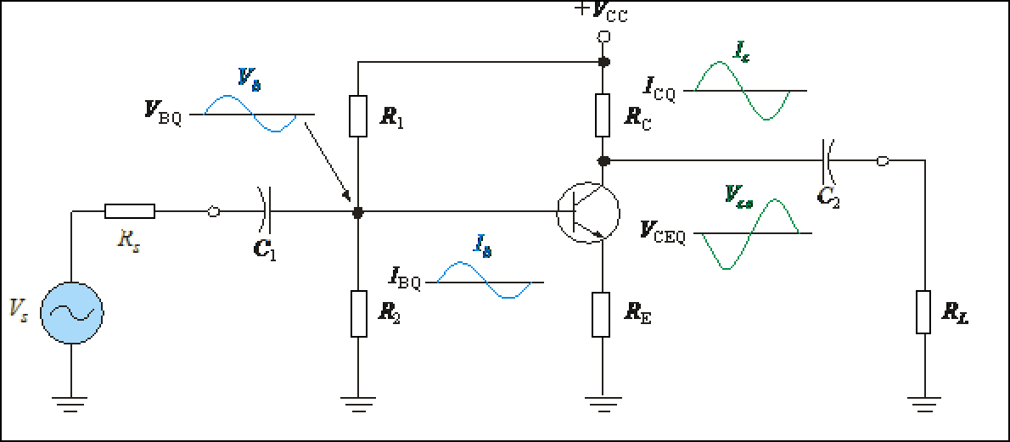
Linear amplifier
A linear amplifier produces an replica of the input signal at the output.
For the amplifier shown, notice that the voltage waveform is inverted between the input and output but has the same shape.

