Slide 1
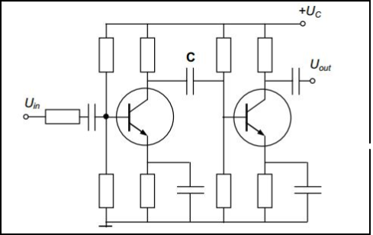
Two-stage amplifier
To improve amplifier performance, stages are often cascaded where the output of one drives another.

Slide 2
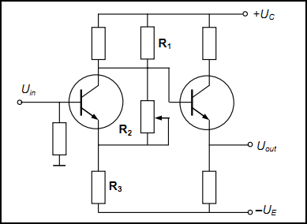
Two stage dc amplifier
A circuit of direct-coupled two-stage dc amplifier:
The capacitor between the stages shown in previous slide decreases the signal and shifts its phase. It is the main reason of the frequency limiting in the ac amplifiers.
It needs an additional place in the amplifier design. Moreover, there are a lot of applications without ac signals.
As a result, the maximum power and amplitude of the signal is obtained

