Slide 1
MyResearch
Module 3 – Search Strategies & Techniques
Fall 2013
Giovanna Badia
Tara Mawhinney
Umma Tamima

Slide 2
MyResearch for Science and Engineering: Teaching Team
Giovanna Badia, Liaison Librarian
(Chemical Engineering, Mining and Materials Engineering, Earth and Planetary Sciences)
Tara Mawhinney, Liaison Librarian
(Civil Engineering and Applied Mechanics, Mechanical Engineering, Atmospheric and Oceanic Sciences)
Umma Tamima, Graduate Student
(Civil Engineering and Applied Mechanics)

Slide 3
Outline
Map out your research project
Use alerting services to stay ahead
Notes:
We are going to add another layer of sophistication in our search for publications

Slide 4
Concept Mapping
concept 1
relationship
concept 2
Notes:
Before we dive into a database and start searching we need to figure out what we already know about a topic and what our information need is.
To do that we are going to use concept mapping, which is a technique for organizing information with a with a strong theoretical background, and one that we teach faculty when they are designing or redesigning their curriculum.
Concept mapping is a lot like brainstorming or mind mapping but it is a little more structured.
This is the simplest concept map with 2 concepts and a relationship
The relationship is what sets it apart form other forms of mapping – concepts themselves do not demonstrate understanding – need those relationships. It turns out that it is really hard to fake a map.
Once you have a concept map, you can use it as a communication tool – as a visual representation it is a great presentation tool, and you can add more information to it.

Slide 5
Research Topic
Is bamboo a workable material for construction?
Notes:
For example, if our research question is: Is bamboo a workable material for construction?
We could map this by pulling out the main concepts:
Bamboo / construction

Slide 6
Concept Mapping
bamboo
used for
construction
Notes:
Relationship = used for
You can make a map with pen and paper, or with sticky notes, but to make it easier we are going to use a software called CmapTools
CmapTools is free to download and makes it easy to move concepts around and share our maps online by providing free server space
Can attach documents and link to websites
It is installed on these computers – the link is on the MyReasearch guide for download
Everyone open it up – make a new map – copy this map (do it with them)

Slide 7



Concept Mapping Exercise

Slide 8
Concept Mapping
bamboo
used for
construction
Notes:
Relationship = used for
You can make a map with pen and paper, or with sticky notes, but to make it easier we are going to use a software called CmapTools
CmapTools is free to download and makes it easy to move concepts around and share our maps online by providing free server space
It is installed on these computers – the link is on the MyReasearch guide for download
Everyone open it up – make a new map – copy this map (do it with them)

Slide 9
Research Topic
The graduate researcher is investigating engineering considerations for Mars rover landing safety, including hazards, elevation, and latitude. Hazards the researcher is concentrating on are rocks and wind.
Notes:
How do you pick a safe spot to land on mars

Slide 10
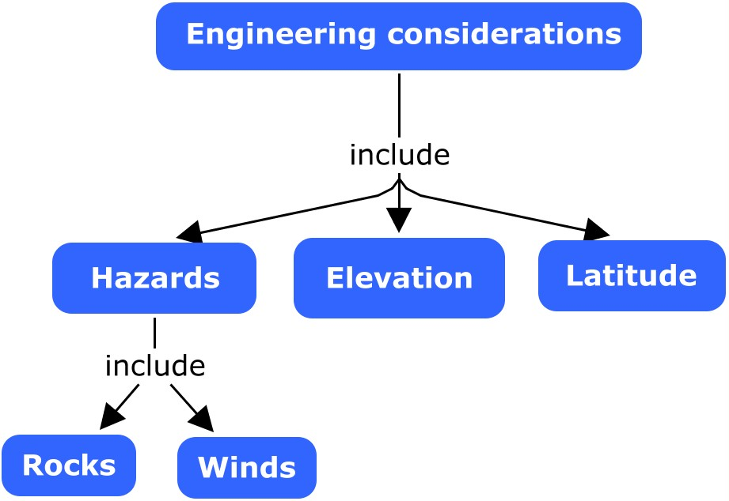
Mars Landing Safety
Adapted from: electra.ihmc.us:80/servlet/SBReadResourceServlet?rid=1025200001891_479194863_1440&partName=htmltext
Notes:
Does everyone have a map that looks like this??
Show the NASA table of contents

Slide 11
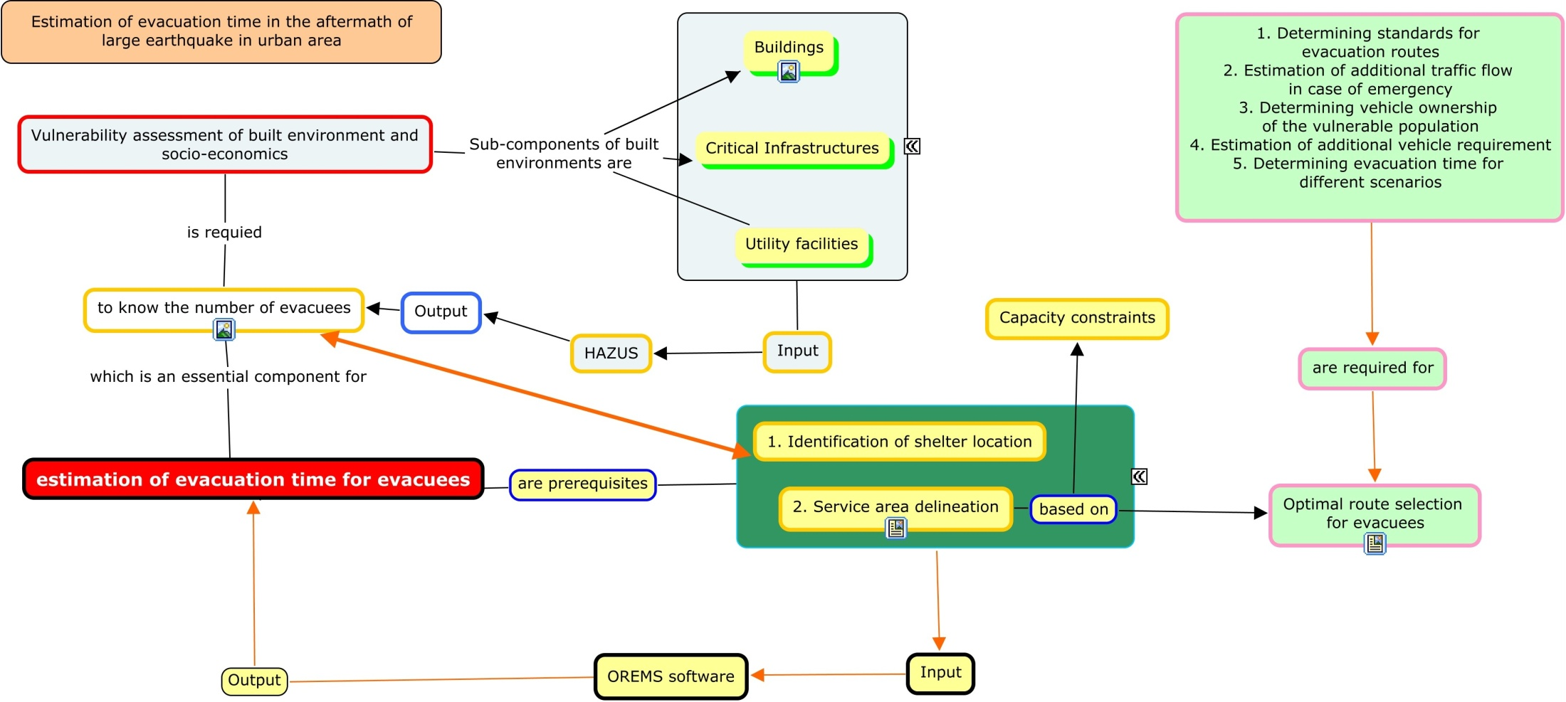
Umma’s Concept Map

Slide 12
Umma’s Research Topic
“Evacuation time after a large earthquake in an urban area”
Umma’s concept map:
bit.ly/UmmaConceptMap

Slide 13
Concept Mapping Exercise
Step 1: Define your research topic.
Step 2: Create a concept map with CmapTools.
Step 3: Get feedback.
Step 4: Save your concept map.

Slide 14
Mars Landing Safety
Adapted from: electra.ihmc.us:80/servlet/SBReadResourceServlet?rid=1025200001891_479194863_1440&partName=htmltext
hazard*
OR
wind*
rock*
Notes:
Run a search to find more info on hazards

Slide 15
Search Strategy
Mars
AND
land*
AND
hazard* OR rock* OR wind*
Notes:
Keep concepts separate!
Scopus or web of science?

Slide 16
Search Strategy – One Line
Mars AND land* AND (hazard* OR rock* OR wind*)
Notes:
If you only had one line

Slide 17
Quotation Marks
  Use for phrase searching
  Example: “Mars land*”
Notes:
Retrieves Mars landing, Mars land rovers, Mars landscape, etc.

Slide 18
Which Database Do I Choose?
Multidisciplinary
Web of Science
Scopus
Google Scholar
Subject specific
Compendex/Inspec
Aerospace Database
Materials Research Database
SciFinder
GeoRef
Environmental Sciences & Pollution Management
Notes:
There are more than just the large databases – you can also find some subject specific databases
Go to guide – subject guides

Slide 19
Break…

Slide 20
Outline
Map out your research project
Use alerting services to stay ahead
Notes:
We are going to look at how to set up alerting services to stay ahead with your research.

Slide 21
Staying Ahead: Alerting Services by Database
Database | Alerting service (via email)
Web of Science
Scopus
Compendex/ Inspec
Google Scholar
Notes:
The 5 databases we discussed (GS to search grey literature and books; we do not know the publications it covers)
Many offer RSS feeds where you read new content in your feed reader, but also can receive news by e-mail if you prefer receiving alerts in your inbox
Web of Science, Scopus, and Google Scholar offer citation & search alerts
DEMO (Compendex)
Mars AND land* AND (hazard* OR rock* OR wind*)
also show how to rename a feed and delete a feed
DEMO (Web of Science)
Mojzsis, SJ et al. Evidence for life on Earth before 3,800 million years ago. Nature. 1996;384(6604):55-59.
Title > Create Citation Alert > log-in
(20)
20

Slide 22
Staying Ahead: Activity
  Set up email search alerts
  in two databases.
Notes:
15 minute activity
35
(15)

Slide 23
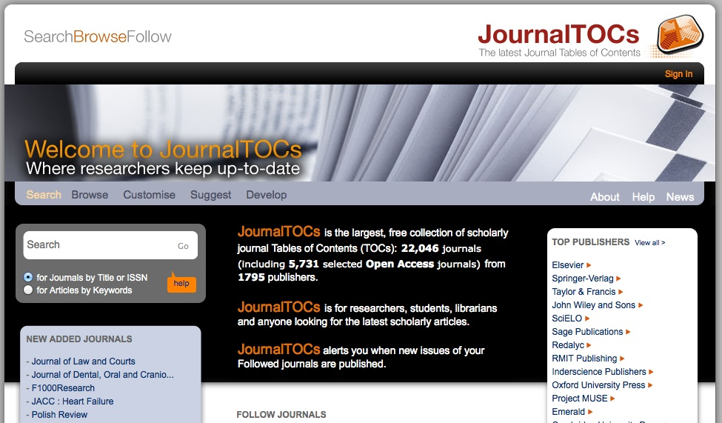
Staying Ahead: Alerting Services for Journals

Slide 24
Feedback
Survey (url is case sensitive):
bit.ly/MyResearchMcGill

