Slide 1
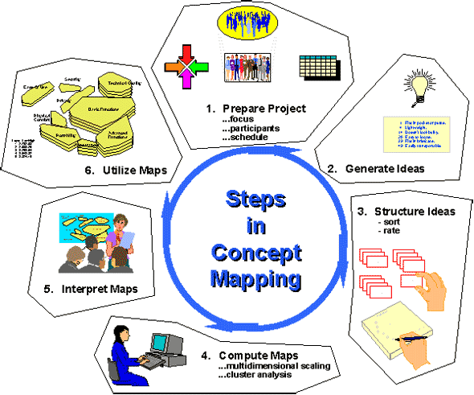
Concept Maps

Slide 2
Definitions of concept maps
A concept map is a way of representing relationships between ideas, images, or words in the same way that a sentence diagram represents the grammar of a sentence, a road map represents the locations of highways and towns, and a circuit diagram represents the workings of an electrical appliance

Slide 3
Concept maps, according to the Center for Applied Special Technology (CAST), visually illustrate relationships among words, concepts and facts.
A concept map is a diagram that explores a central idea by visually linking it in a logical fashion to bubbles of subtopics, steps, points and consequences, some of which link to each other while some don't

Slide 4
Main advantages of Concept Maps
Help students/ individuals to brainstorm and generate new ideas
Encouraging students/individuals to discover new concepts and the propositions that connect them
Allow students/individuals to clearly communicate ideas, thoughts and information
Help students/individuals to integrate new concepts with older concepts
Enabling students /individuals to gain enhanced knowledge of any topic and evaluate the information

Slide 5
How to create a concept map
1. Identify the topic/issue one requires to work on
2. Sit down and think/research the topic/issue
3.Plot ideas and information gathered in a sequential manner to form a map. (Create linking phrases and words)

