Slide 1
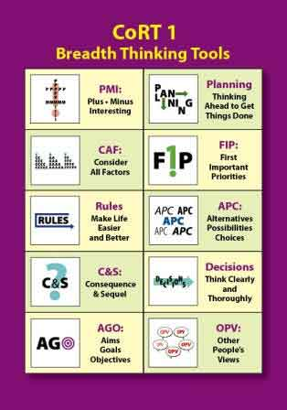
Critical thinking tools.
The use of CoRT Tools in everyday life.

Slide 2
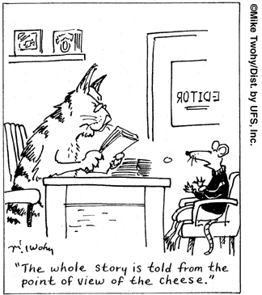
What is critical thinking?
Critical thinking is the process of thinking in a certain way. Critical thinking is the process of thinking clearly, with accuracy and precision; of thinking carefully, with logic and depth; and of thinking open-mindedly, by examining points of view and acknowledging assumptions and biases within a given viewpoint

Slide 3
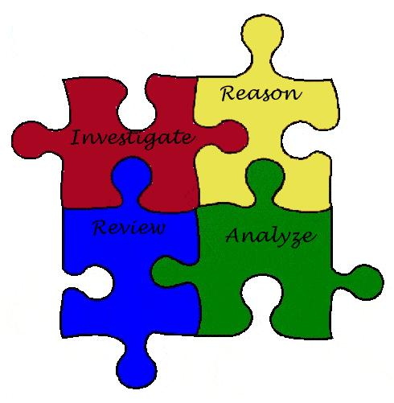
Critical thinking steps
1. Collect information required
2. Evaluate information collected
3. Using logic draw your conclusion
4. Evaluate your logical conclusion

Slide 4
Why use CoRT thinking tools?
CoRT Thinking allows us to focus attention directly on different aspects of thinking and crystallise these processes into definite concepts and tools that can be used deliberately to move our thinking along. CoRT1 is sometimes described as Directional Thinking, as well as Breadth Thinking. (Blue sky skillshttp://blueskyskills.co.uk/tools/cort accessed 8th June 2013)

Slide 5
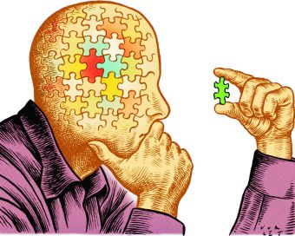
The importance of CoRT tools.
CoRT Tools are used to help broaden a persons perception beyond the obvious reasoning.
CoRT Tools helps individuals to see beyond ones normal reasoning. The further investigation and thinking about a problem/topic/issue.

Slide 6
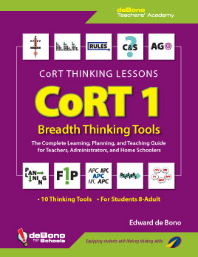
CoRT Tools
CAF - Consider All Factors
P.M.I – Plus, Minus and Interesting
A.P.C – Alternative, Positive , Choices
FIP – First important Priorities
O.P.V- Other People’s Views
A.G.O- Aims, Goals, Objectives
C and S – Consequence and Sequel

Slide 7
The concept map
CAF – Consider All Factors Tool was used when preparing the concept map used in this presentation around the topic waste.
CAF consists of considering all the factors that affect the individual or society and then formulating an idea.

