Slide 1
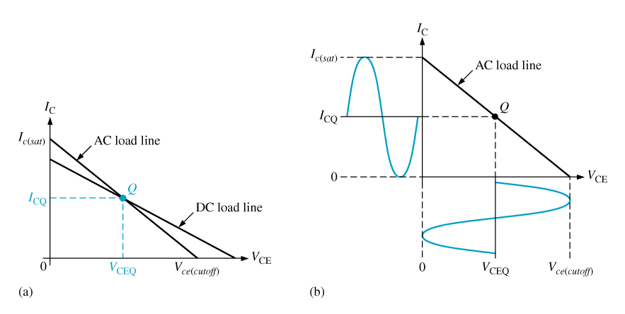
Class A amplifier:
An amplifier with a transistor that conducts during the entire 360º of the input signal cycle.
Optimum class A operation is obtained by designing an amplifier so that its Q point is centered on the ac load line

Slide 2
Class A Relationships
Power Gain
DC Quiescent Power
Output Power

Slide 3
Class A Amplifier Efficiency
Efficiency: The ratio of the signal power supplied to the load to the power drawn from the dc supply. By formula,
The maximum efficiency of a capacitively coupled load is:
In practice, the efficiency of a class A amplifier is usually around 10%.
The low efficiency of class A power amplifiers limits their usefulness to
small power applications that require only a few watts of load power.

