Slide 1
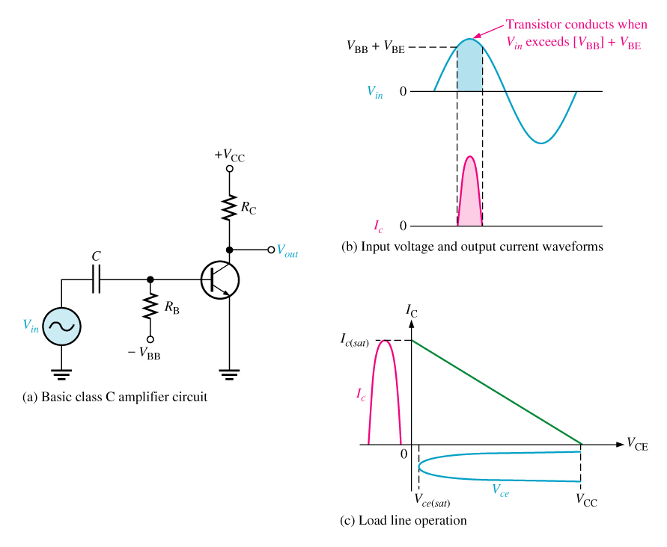
Class C amplifier
An amplifier having a single transistor that conducts for fewer than 180º of the ac input cycle.

Slide 2
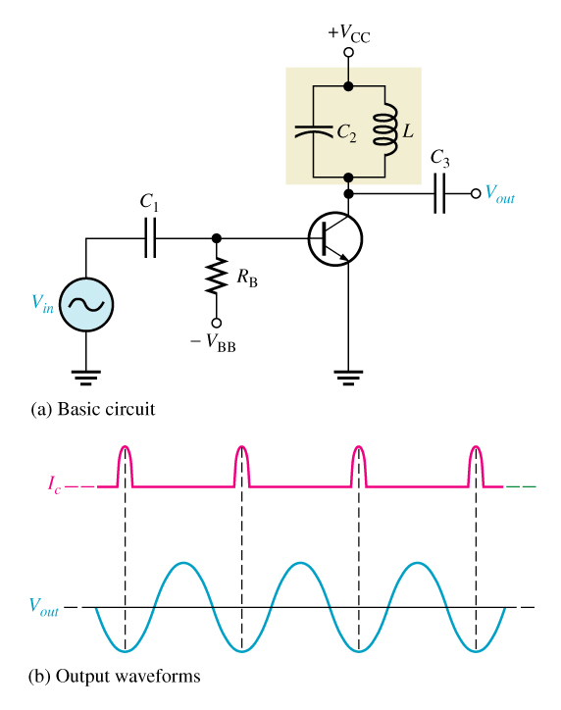
A Tuned Class C Amplifier
The LC circuit in a class C amplifier is used to select the input frequency that is amplified.

