Slide 1
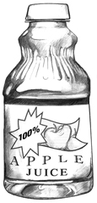
Questions with how much and how many
How much
How Any
We use "How many“ with countable or plural objects. Example: How many books do you have?
We use "How much" with a non-countable or singular object. Example: How much juice is left? We use "How much" for questions asking about ONE object. Example: How much does the book cost?

