Slide 1
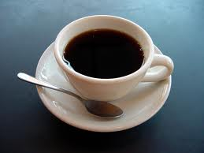
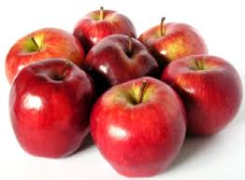
Making questions with: How much and How many
We use how much with uncountable nouns.
Example:
How much coffee do you drink?
We use how many with countable nouns.
Example:
How many apples are there?
Notes:
Presented by: Gisela Patricia Cedeño López.

