Slide 1


Slide 2
Propagation Delay
The Problem:
  Propagation Delay
    Cause: UART buffers the transmissions
Constraints:
  Transmission Time
    Current delay: ~250 ms per byte
    Desired delay: <100 ms per byte
The Solution:
Custom Y-Cable (RX/TX)
  Cheap
  Reduced transmission time (~5 ms per byte)
Andrew Habegger

Slide 3
Transmission Errors
The Problem:
  Transmission Errors
    Cause: line impedance
    Error occurrence: widespread, intermittent noise
Constraints:
  Module Count
    Error condition: >6 connections
    Required count: 7 connections
The Solution:
Better RS485 converters
  No firmware changes
  Up 32 connections per line
Andrew Habegger

Slide 4
Transmission Errors (Continued)
Heading
The Problem:
  Transmission Errors
    Cause: line impedance
    Error occurrence: widespread, intermittent noise
Constraints:
  Error Detection
    Current Detection: 0 bits
    Desired Detection: 2 bits
The Solution:
Extended Hamming (8, 4)
  1 error detectable
  3 errors correctable
Andrew Habegger

Slide 5
Application Architecture v3.1
Eunyoung Shin

Slide 6
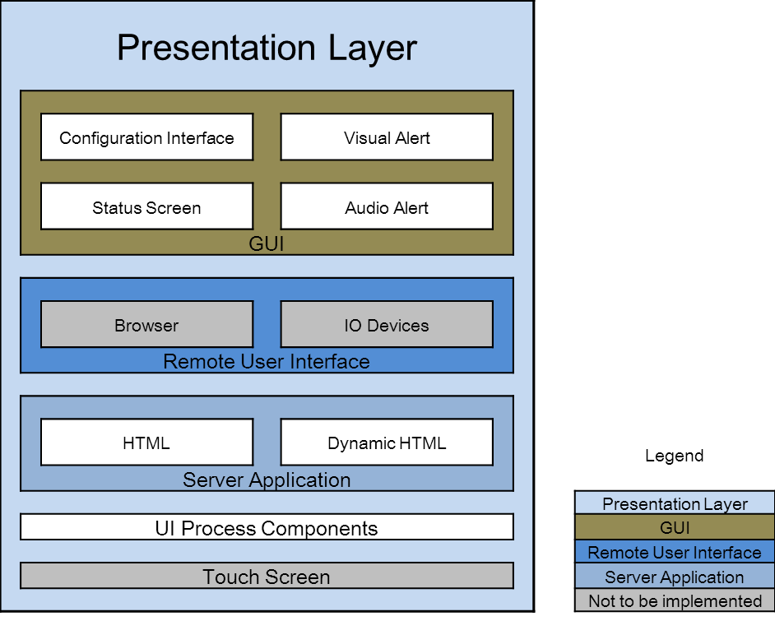
Application Architecture v4.0
Eunyoung Shin

Slide 7
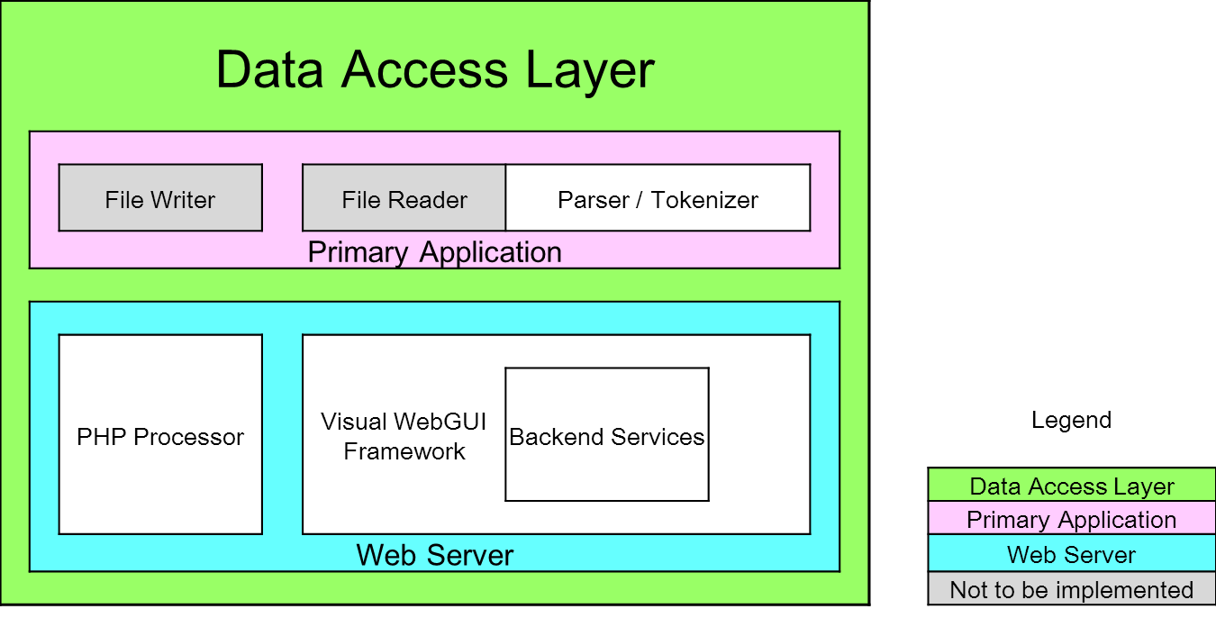
Application Architecture v4.0
Eunyoung Shin

Slide 8
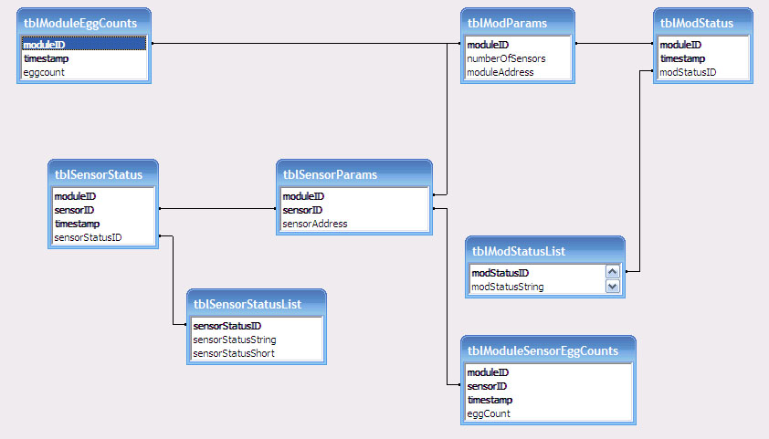
Database Structure
Mark Parker

Slide 9
Database Structure
Indexed on individual module, individual sensor, and timestamp.
Data stored:
  Hardware parameters (currently module/sensor counts and addresses)
  Module status
  Sensor status
  Egg counts per sensor and per module
Mark Parker

Slide 10
DB Design Tradeoffs
Benefits
  Efficient distribution of data.
    Minimum of replication.
  Scales without reworking.
Mark Parker

Slide 11
DB Design Tradeoffs
  Potential issues
  Size will grow quickly.
  Complex queries.
  May not keep up with updates (‘thrashing’).
Mark Parker

Slide 12
Purpose of Gantt chart is
Help you to plan out the tasks that need to be completed
Give you a basis for scheduling when these tasks will be carried out
Allow you to plan the allocation of resources needed to complete the project, and
Help you to work out the critical path for a project where you must complete it by a particular date.
Sun young Park

Slide 13
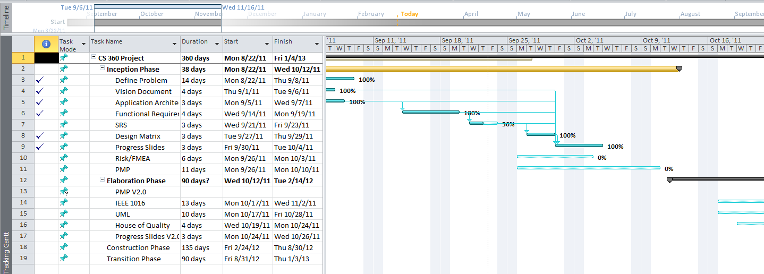
Current Gantt Chart
Sun young Park

Slide 14
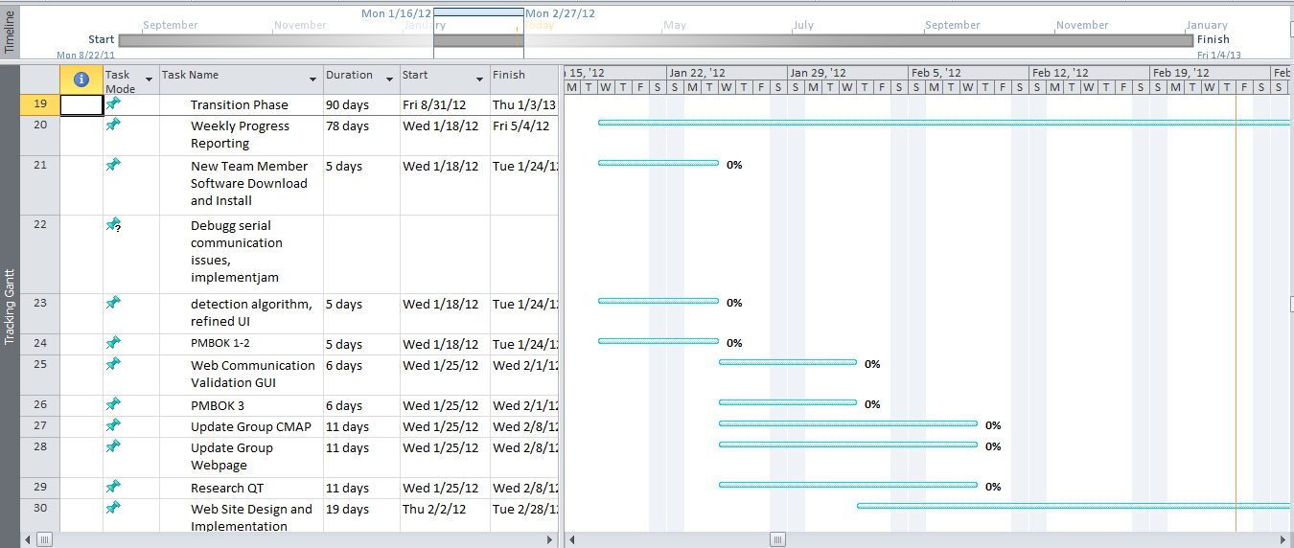
Changed Gantt Chart
Sun young Park

Slide 15
Finding the best tool for the job…
The Problem:
Traditionally, web designing and web development are distinctly different fields; designers will create mock designs with graphics rendering tools, or environments for fast client validation. But these tools lack functional capabilities and the graphics libraries that are included in actual web use (e.g. pull-down menus, combo-boxes, and date pickers).
The Solution:
Utilize Visual WebGUI to fast prototype page design AND functionality in classic .NET visual form-based designer.
Matthew Rasler

Slide 16
Visual WebGUI
What is Visual WebGUI?
A platform for rapid development incorporated with an SDK wich is integrative to Microsoft Visual Studio, enabling productive, secure and desktop-like Rich Internet Applications with a very small footprint comparatively to IIS based CMSs.
Beyond designing…
The result is a functional web page; so no design translation needs to be made, decoupling design from development.
Functional Aspect:
A military grade secure, ultra small, fast, extensible web site, supported by all major browsers, because no code is generated at runtime, especially in access to the client.
Completely interactive with any ASP .NET or any other web technology, by use of an AJAX like operational structure.
Matthew Rasler

Slide 17
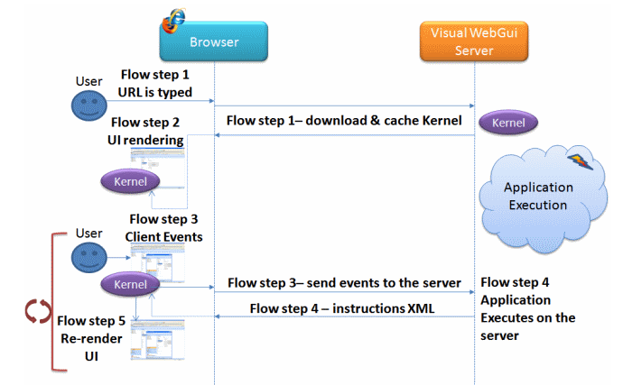
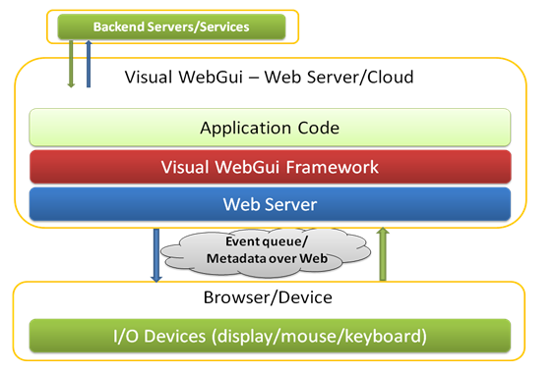
Visual WebGUI
How it works:
Development in Visual Studio, utilizing Wysiwyg visual editor and C#, compile and deploy application to web server; IIS handles the rest.
Matthew Rasler

Slide 18
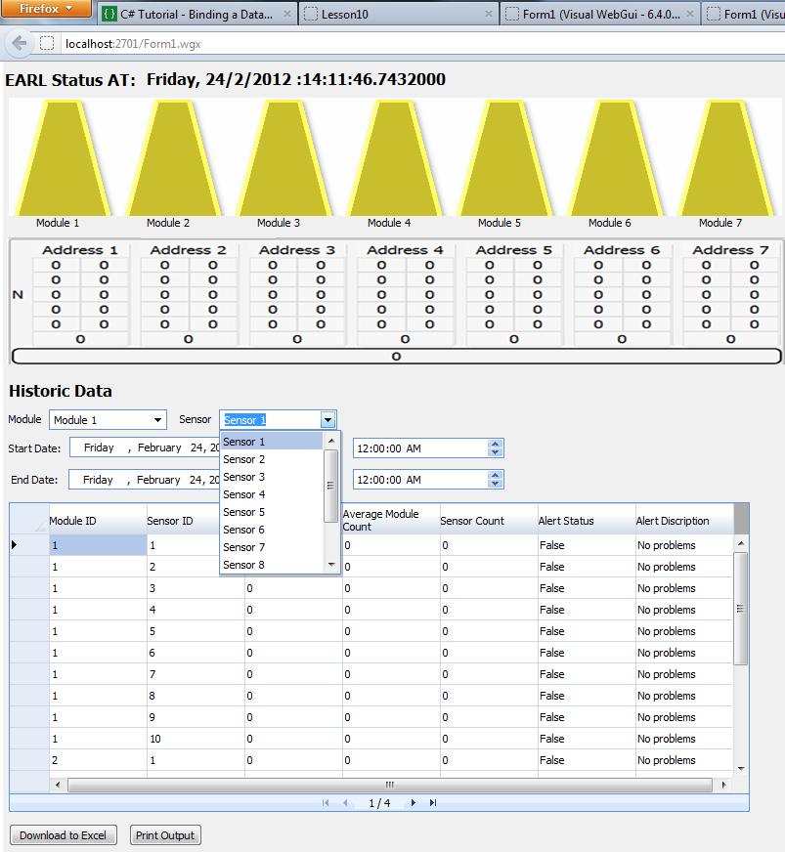
EARL Website
Matthew Rasler

Slide 19
Live Demonstration
Andrew Habegger

Slide 20


