Slide 1
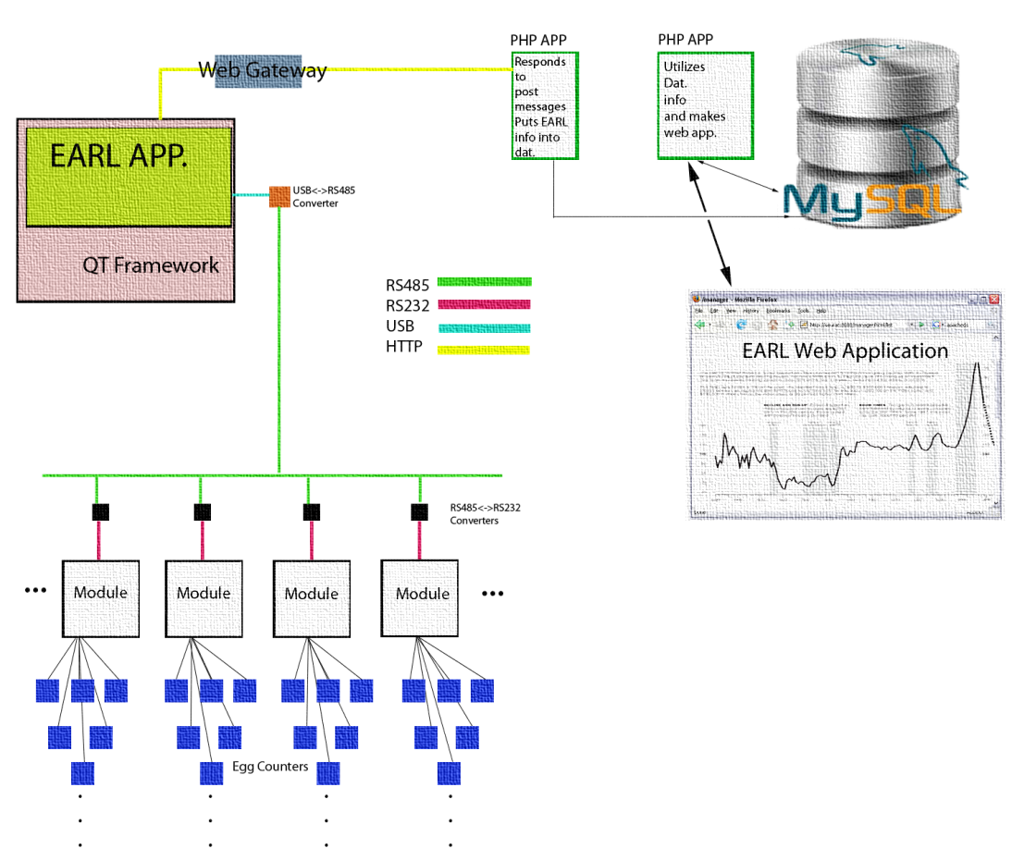

Slide 3
Communicating from the Primary Application to the Web Application
Matthew Raslerr

Slide 4
Communicating Between Primary Application and Web Application
From QT-> Utilize QNetworkAccessManager in QtNetwork Library
Written in C++
Utilizes QT Signals and Slots to “alert” Network Access Manager of important information that has changed in the state of the system
Makes an HTTP connection, that encodes variables and values in the HTTP string
Variables are key=value pairs (POST values)
Ex: http://www.mysite.com/index.html?userid=joe&password=guessme
Calls a PHP script as the URL, which processes the key=value pairs and sends them to a database
Matthew Rasler

Slide 5
Communicating Between Primary Application and Web Application
Benefits of Approach:
Implements a generic method that is machine independent, small, fast, and requires only network connection (HTTP)
Abstracts development and compartmentalizes concepts
One developer writes pure C++/QT code (Me)
Another developer writes pure PHP code (Mark)
QT Network Library greatly simplifies development
Challenges:
Learn QT quirks
Signals and Slots
Hardships of learning any new language/IDE
Created an application to test methodology and code
Matthew Rasler

Slide 6


