Slide 1
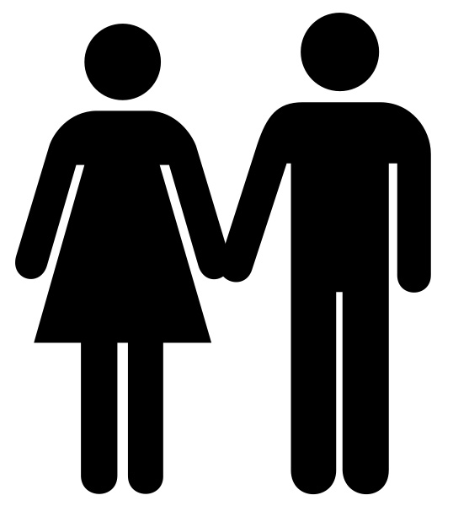
Most species have two sexes: male and female. Each sex has its own unique reproductive system.

Slide 2
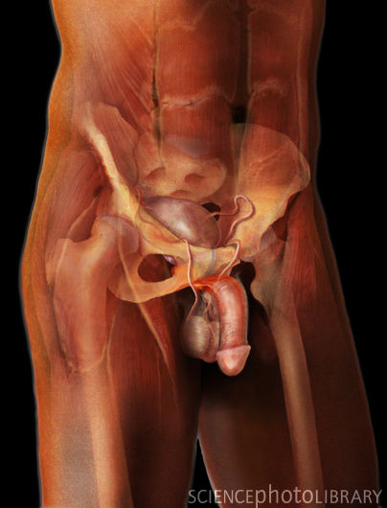
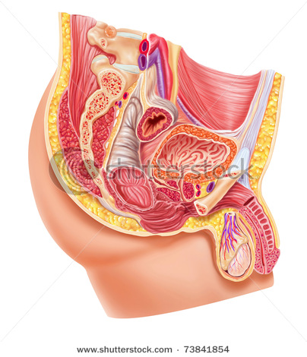
Male Reproductive System
By:
Arauz, Yiralis
Caballero, Guerson
Castillo, Belychy
Vega, Gerardo
Vega, Jean

Slide 3
Table of Contents
Introduction, The Male Reproductive System
What the Male Reproductive System Do?
Parts and Functions
Diseases
End

Slide 4
General
Dependent on hormones
Sperm production
Table of contents

Slide 5
Definition
Development at puberty
The Sperm
The Fertilization
Table of contents

Slide 6
What does the Male Reproductive System Do?
The male sex organs work together to produce and release semen into the reproductive system of the female during sexual intercourse.

Slide 7
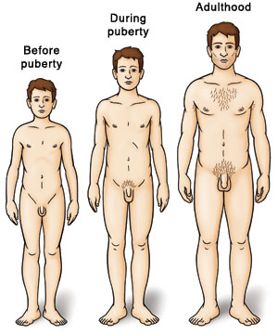
The Stages of Puberty
The first stage:
the scrotum and testes grow larger.
Next:
the penis becomes longer, and the seminal vesicles and prostate gland grow.
Finally:
Hair begins to appear in the pubic area and later it grows on the face and underarms.

Slide 8
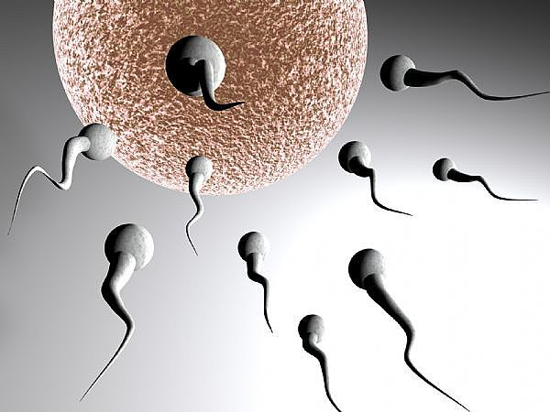
The Sperm
Sperm develop in the testicles within a system of tiny tubes called the seminiferous tubules.

Slide 9
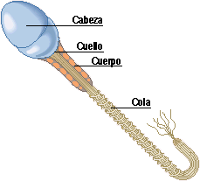
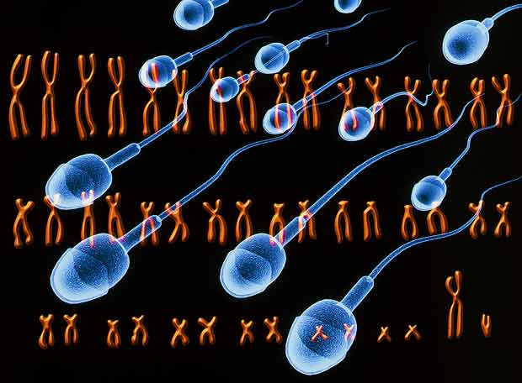
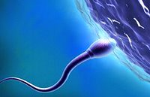
The head contains genetic material (genes). The sperm use their tails to push themselves into the epididymis.

Slide 10
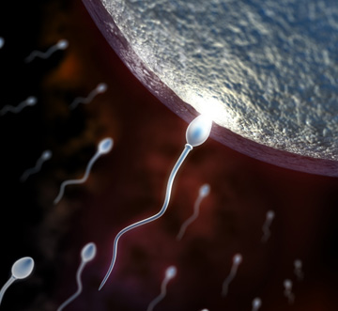
The Fertilization
When the male ejaculates during intercourse, semen is deposited into the female's vagina.

Slide 11
The Male Reproductive System
The main anatomically male sex organs are the penis and the testes

Slide 12
Click here for a front angle view

Slide 13
Click here for a side angle view
Continue

Slide 14
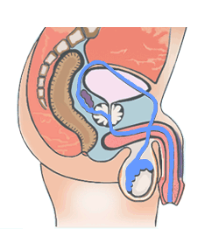
Anatomy Basic Structure
The Vas Deferens
Penis
Testicle
Urethra
The Scrotum

Slide 15
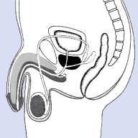
The Vas Deferens
What role does the vas deferens?
Transport the semen.
What is the vas deferens?
It is a muscular tube that passes by the testes that transports sperm.

Slide 16
The Testicles
What role do the testicles?
Co-producers of sperm.
Producers of sex hormones.
What are the testicles?
The testicles are the male gonads, comprise the most important part of this system.

Slide 17
The Scrotum
What are the functions of the scrotum?
Regular temperature.
What is the scrotum?
It is a pouch that protrudes from the pelvis, where hang the testicles and epididymis.

Slide 18
The penis
What role does the penis?
Reproductive function.
How is shaped penis?
The penis is a cylindrical organ containing erectile tissue spongy bodies contains three full length into the penis.

Slide 19
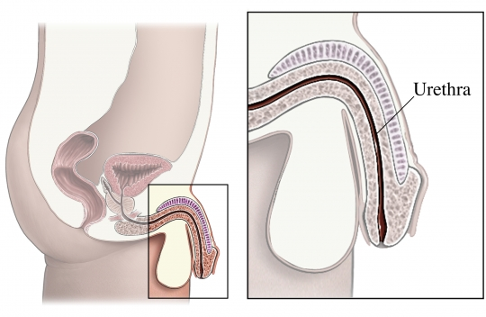
Urethra
Regions of the urethra
Prostatic urethra –surrounded by prostate
Membranous urethra – from prostatic urethra to penis
Spongy (penile) urethra – runs the length of the penis

Slide 20
Anatomy Basic Structure, accessory organs
Seminal
Vesicles
Prostate
Bulbourethral
gland

Slide 21
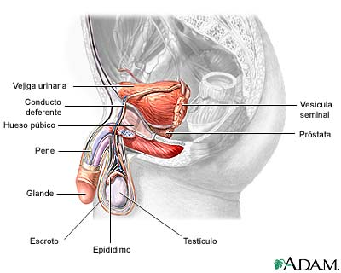
Accessory organs
Seminal vesicle
Prostate gland
Bulbourethral gland
Table of contents

Slide 22
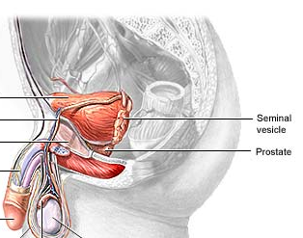
Seminal Vesicles
Located at the base of the bladder
Produces a thick, yellowish secretion (60% of semen)
Fructose (sugar)
Vitamin C
Prostaglandins
Other substances that nourish and activate sperm

Slide 23
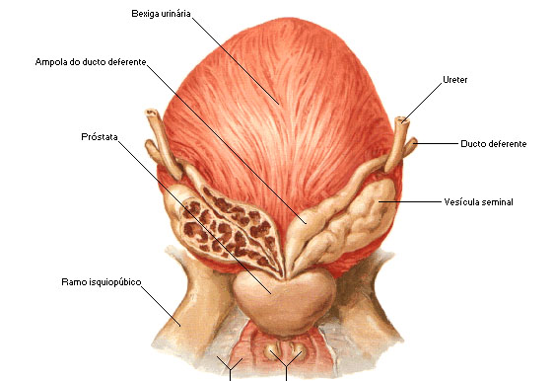
Prostate Gland
Encircles the upper part of the urethra
Secretes a milky fluid
Helps to activate sperm
Enters the urethra through several small ducts

Slide 24
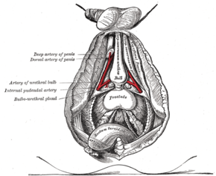
Bulbourethral Glands
Pea-sized gland inferior to the prostate
Produces a thick, clear mucus
Cleanses the urethra of acidic urine
Serves as a lubricant during sexual intercourse
Secreted into the penile urethra
Table of contents

Slide 25
Male Reproductive System Diseases.

Slide 26
Male Reproductive System Diseases.
Varicocele
Testicular Cancer.
Testicular Trauma.
Table of contents

Slide 27
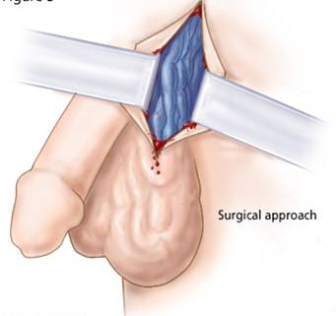
Varicocele.
This is a varicose vein in the network of veins that run from the testicles.

Slide 28
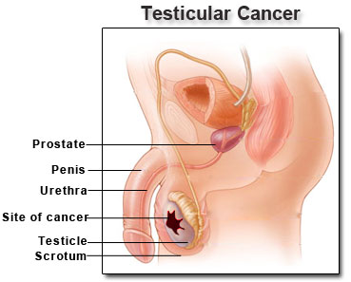
Testicular Cancer.
This is one of the most common cancers in men younger than 40.

Slide 29
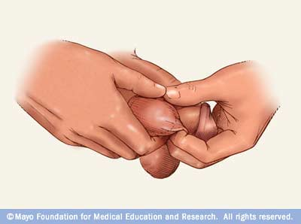
Testicular Trauma.
Even a mild injury to the testicles can cause severe pain, bruising, or swelling. Most testicular injuries occur when the testicles are struck, hit, kicked, or crushed.
Continue

Slide 30
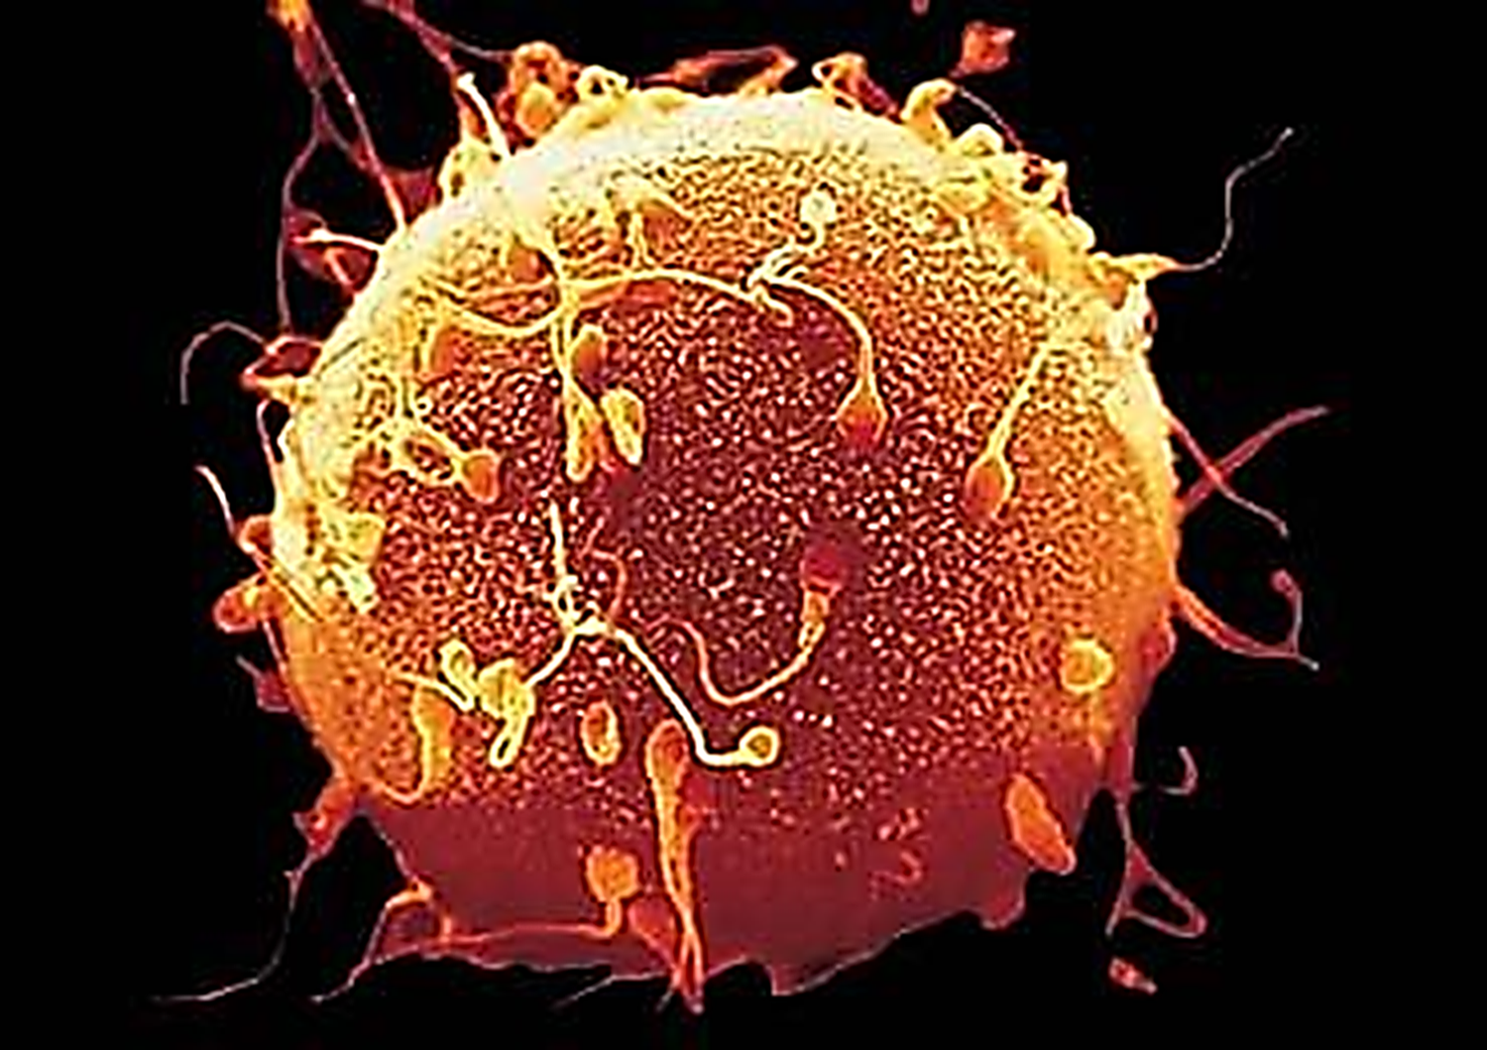
Table of contents
Thanks You

