Slide 1
The Egg Flow Communicator Group
Progress Report
9/22/2011-10/25/2011
Prepared by Matthew Rasler, Andrew Habegger, Mark Parker

Slide 2
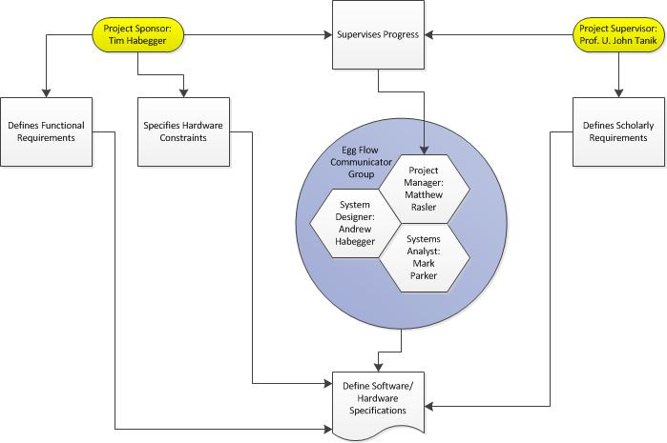
Project Management Plan V1.0 Internal Structure
Sponsor/
Customer/ Tim Habegger, Proprietor of
Hardware Developer- Habegger Poultry
Project Supervisor- Professor Tanik
Project Manager/
Low Level Programmer/
Assistant Application Architect/
System Analyst Backup- Matthew Rasler
Assistant Project Manager
System Designer/
Hardware Developer/
Customer Interface- Andrew Habegger
Assistant System Designer
System Analyst/
Programmer- Mark Parker

Slide 3
Project Management Plan V1.0 Deliverables
Deliverable | Recipients | Delivery Date | Delivery Method | Comments
Module Driver Software | Development Team and Sponsor | November, 2012 | Software provided | Includes both on Module PBASIC software and PC communication driver
Programmed Hardware Module Prototype | Development Team and Sponsor | November, 2012 | Hardware provided | Pre-Requisite is Module Driver Software
Programmed Hardware Modules | Customer/Sponsor | May, 2012 | Integrate into existing components | Pre-Requisites are Module Driver Software and Module Prototype
Application Architecture | Project Team/Program Manager | 9/7/2011 | Email/Cmap | Assigned to Andrew Habegger/ Backups: Mark Parker and Matthew Rasler
GUI | Customer/Sponsor | May, 2012 | Integrate into existing components | Pre-Requisite is Module Driver Software
Vision Document | Project Team/Program Manager | 9/16/2011 | Email/Cmap | Sections Distributed amongst team members by Project Manager
SRS V1.0 | Project Team/Program Manager | 9/23/2011 | Email/Cmap | Assigned to Matthew Rasler/Mark Parker
SRS v2.0 | Project Team/Program Manager | 9/25/2011 | Email/Cmap | Sections Distributed amongst team members by Project Manager
FR-DP Decomposition | Project Team/Program Manager | 9/29/2011 | Email/Cmap | Sections Distributed amongst team members by Project Manager
Design Matrix | Project Team/Program Manager | 9/29/2011 | Email/Cmap | Assigned to Project Manager
FMEA/RISK Report | Project Team/Program Manager | 10/3/2011 | Email/Cmap | Accomplished by group during team meeting
PMP V1.0 | Project Team/Program Manager | 10/10/2011 | Email/Cmap | Assigned to Matthew Rasler/Andrew Habegger

Slide 4
Project Management Plan V2.0 Deliverables
Version 2
PMP V2.0(this) | Project Team/Program Manager | 10/19/2011 | Email/Cmap | Assigned to Matthew Rasler/Andrew Habegger
IEEE 1016 | Project Team/Program Manager | 10/31/2011 | Email/Cmap | Assigned toMatthew Rasler/Mark Parker
UML Diagram | Project Team/Program Manager | 10/25/2011 | Email/Cmap | Assigned to Andrew Habegger/Matthew Rasler
House Of Quality | Project Team/Program Manager | 10/25/2011 | Email/Cmap | Assigned to Mark Parker/Matthew Rasler
Communication, Tracking, and Reporting Plan
Type of Communication | Communication Schedule | Typical Communication Mechanism | Who Initiates | Recipient
Status Report | every Friday | team meeting face to face | Project Manager | Project Team
Schedule and Effort Tracking Report | weekly | Email/CMap/Basecamp | Project Manager | Program Manager
Project Review | At infrequent intervals | In class and via email | Program Manager/Project Sponsor | Project Team
Requirement Changes | as changes are approved | Via client interface | Project Sponsor | Project Team
Information or Knowledge Collected | When information or knowledge is collected | Team meeting face to face and email | Team Member | Other Team Members

Slide 5
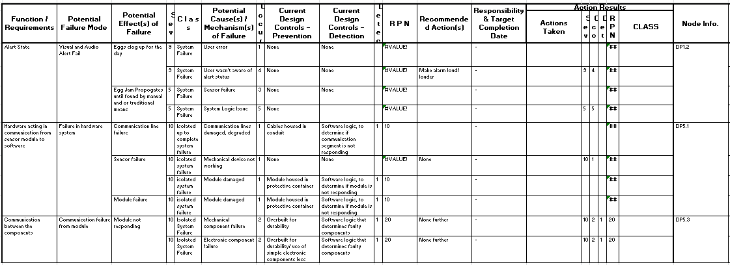
FMEA/RISK

Slide 6
Hardware Constraining Software Specifications
Why?
Specific Hardware Requires Specific Software
Specific Software Requires Specific Staff-Training, Staffing to Appropriate, and Factors in to Feasibility Assessment
Factors:
Microcontroller runs PBASIC
Communication Channel to UART driven by C
Communication Standards are defined by Communication Protocols RS232, RS485, USB
Elaborating:
Revisit and Revise Application Architecture
Revisit and Revise Design Matrix
Revisit and Revise SRS, involving newly defined constraints
Dedicate Training Time for Software Education

Slide 7
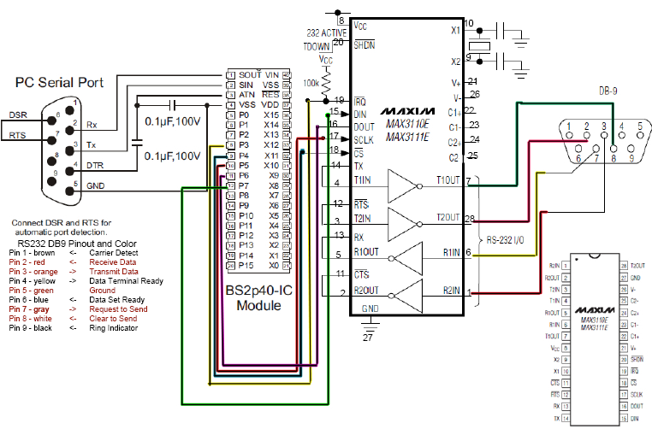
Hardware Constraining Software Specifications

Slide 8
House Of Quality (QFD)

Slide 9
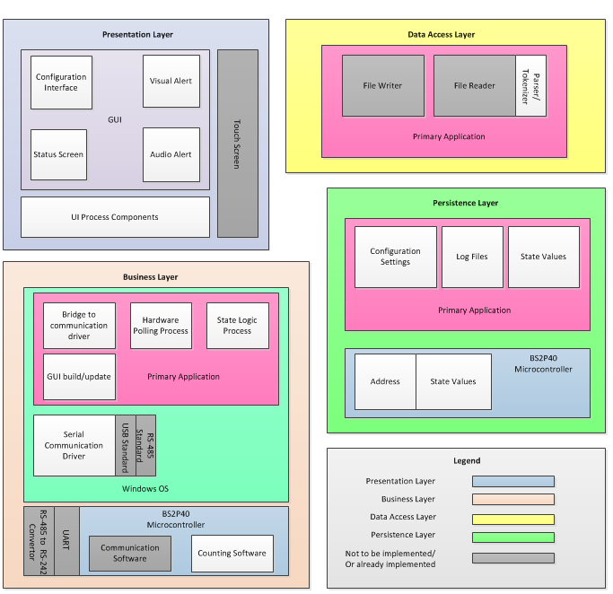
Application Architecture V3.0 With Refined Functional Requirements

Slide 10
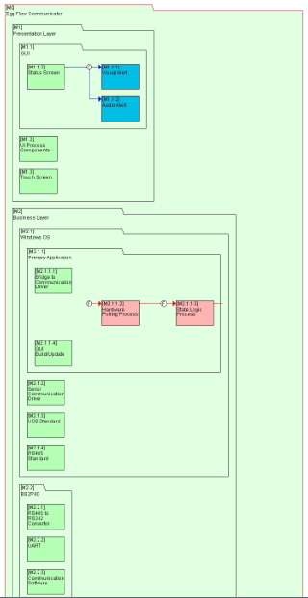
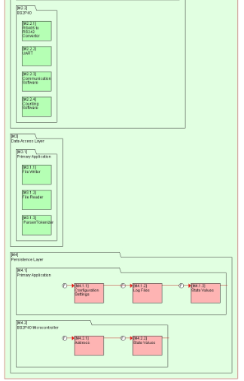
Systems Architecture

Slide 11
UML

