Slide 1
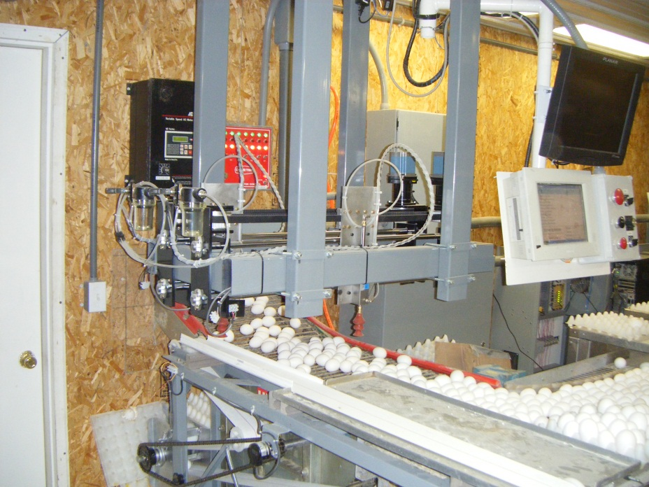
The Egg Flow Communicator
Matthew Rasler
Andrew Habbeger
Mark Parker

Slide 2
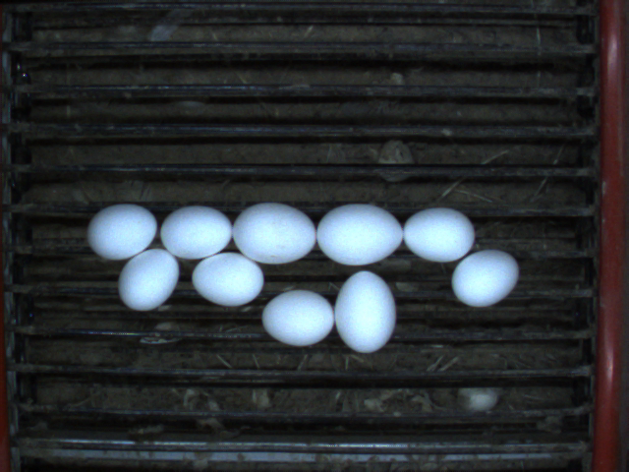

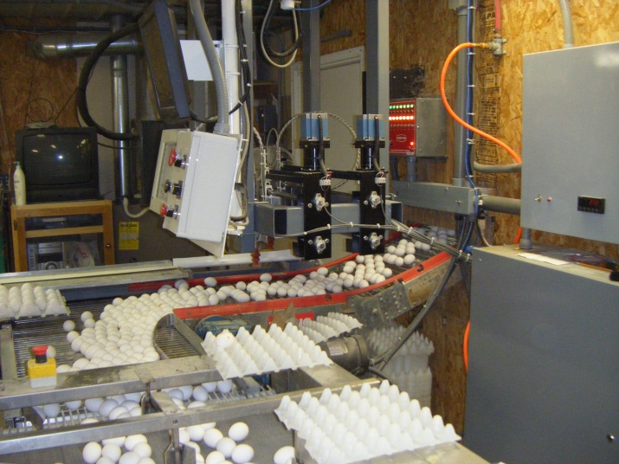
The Problem
Automation in the poultry industry
has allowed farmers to replace farm
hands with a conveyor system to collect
eggs.
Saves time
Saves $$
However, conveyance can stop due to
mechanical issues or a system overload
(egg-jam). Users are often remote and
unaware of the problem.
Loss of time locating issue
Potential loss of product

Slide 3
The Problem (Continued)
Line Failure Condition
  One or more inputs unresponsive
  Other inputs on the same collector are responsive
Collector Failure Condition
  All inputs on a single collector are unresponsive
  Other collectors are responsive
Module Failure Condition
  One or more modules unresponsive
  Other modules are responsive
System Failure Condition
  All modules are unresponsive

Slide 4
Our Proposal
Create a system to automate the determination and mitigation of abnormal conveyor flow.
  Monitor multiple conveyor lines.
  Automatically determine the presence and location of a jam.
  Alert operator to the presence and location of the jam in real time.
    Audio alert - presence of jam
    Visual alert – presence and location of jam

Slide 5
Benefits
Reduces overhead (labor costs)
Reduces time lost to finding jams
Reduces product loss

Slide 6
Stakeholders
Tim Habegger/Habegger Farms: sponsor, end user/client, systems specifications
Professor John Tanik: instructor and overseer
Matthew Rasler: Project leader
Andrew Habegger, Mark Parker: Project team
Poultry industry at large: potential end users/clients

Slide 7
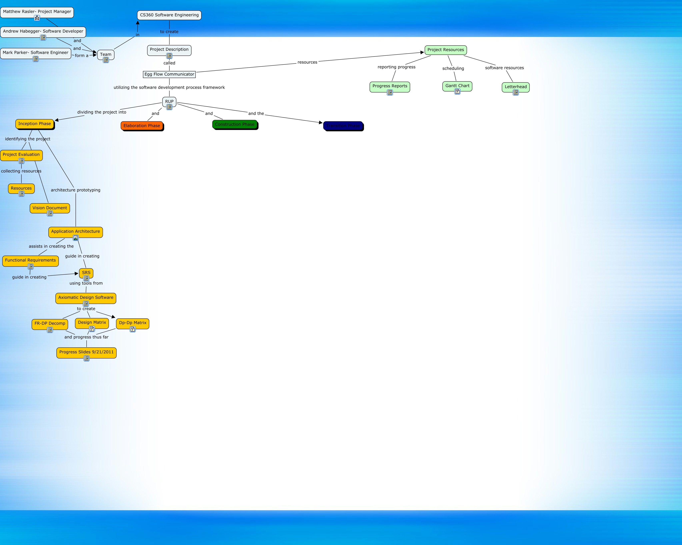
Roadmap to Success

Slide 8
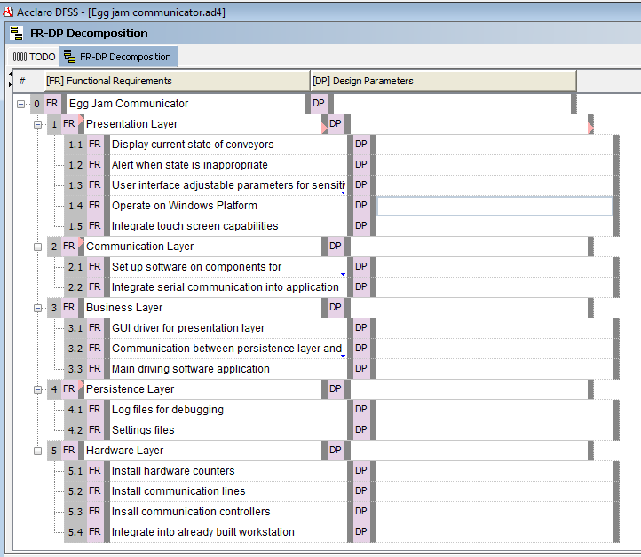
Functional Requirements
Demarcating the Client’s Needs into Functional Components

Slide 9
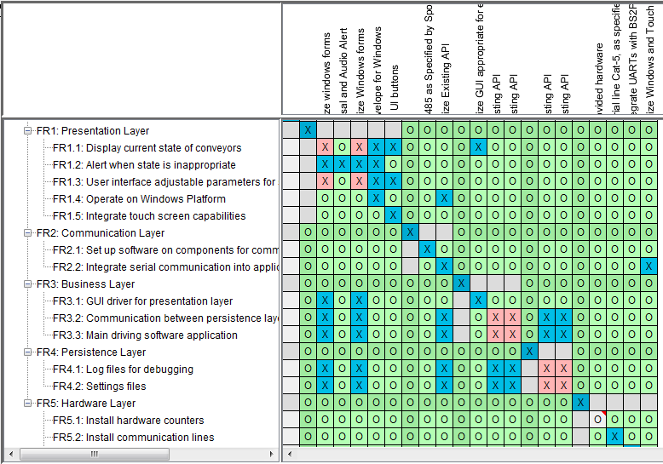
Design Matrix
Utilizing Technology for Organization and Efficiency

Slide 10
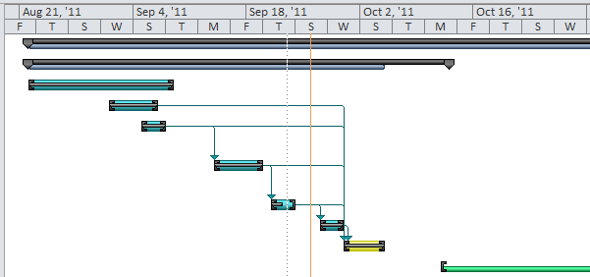
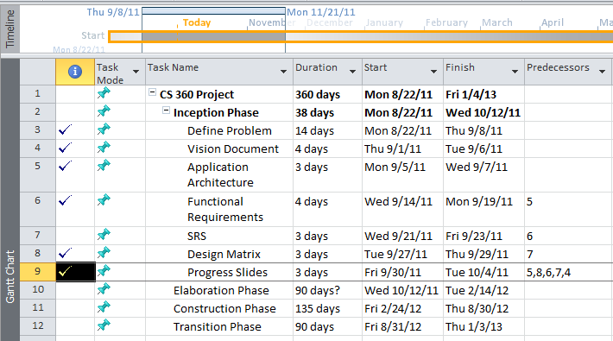
Scheduling Tasks
Microsoft Project’s
Gantt Charting

Slide 11
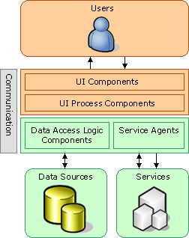
Application Architecture
Components (Sponsor Req.)
  Desktop /w Touch Screen
    Presentation Layer
  RS485 Trunk Line
    Communication Layer
  BS2P40 /w UART
    Hardware Layer

Slide 12
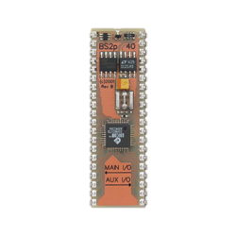
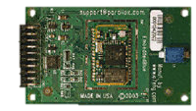
FR-DP: Sponsor Requirements
GUI
  Windows Platform
  Touchscreen input
BS2P40
  24-pin microprocessor
  16 I/O
  Serial communication
Universal asynchronous receiver/transmitter
  Buffers serial communication

Slide 13
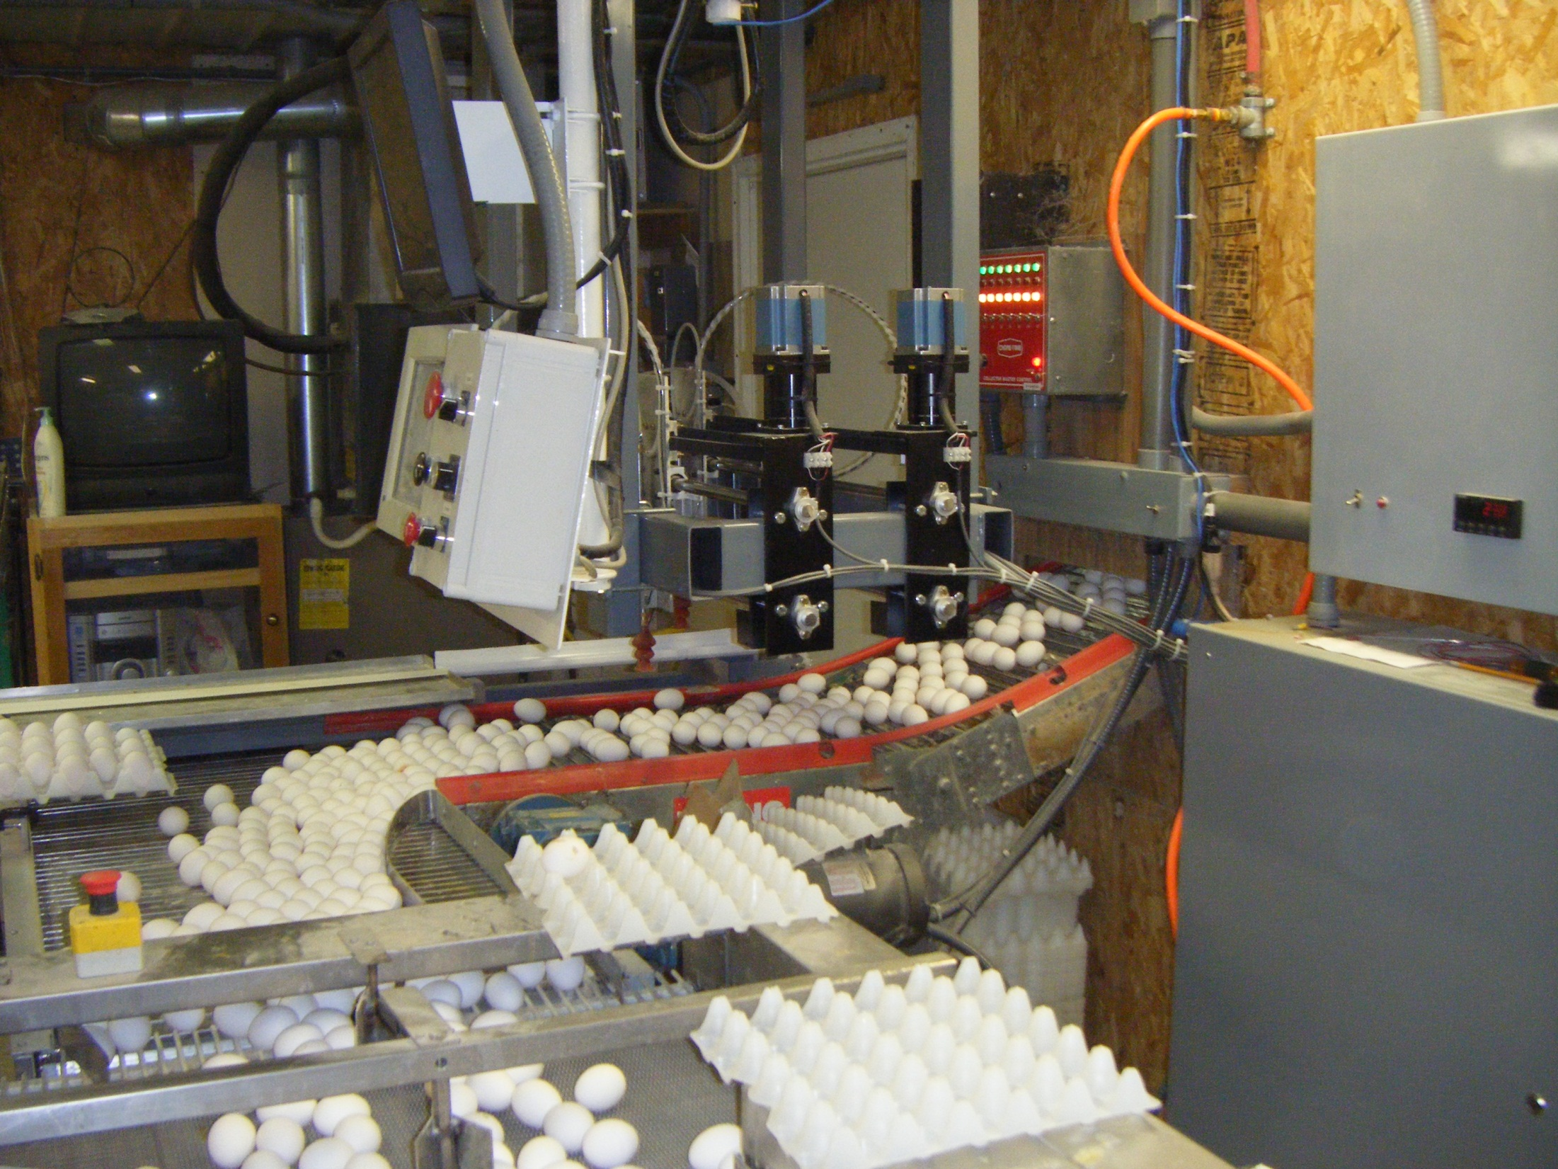
Thank You.

