Slide 2
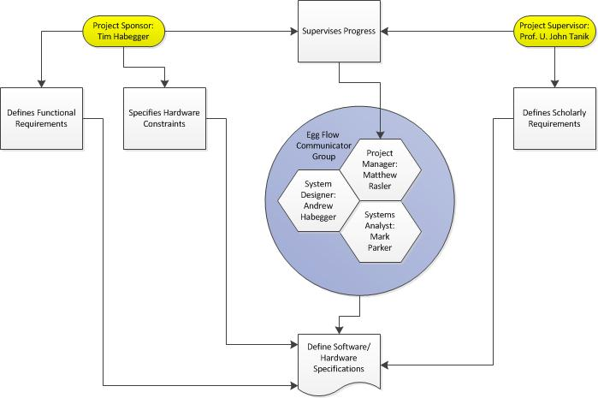
Project Management Plan
Structure Deliverables Risk Analysis
Sponsor/
Customer/ Tim Habegger
Hardware Developer-
Project Supervisor- Professor Tanik
Project Manager/
Low Level Programmer/
Assistant Application Architect/
System Analyst Backup- Matthew Rasler
Assistant Project Manager
System Designer/
Hardware Developer/
Customer Interface- Andrew Habegger
Assistant System Designer
System Analyst/
Programmer- Mark Parker

Slide 3
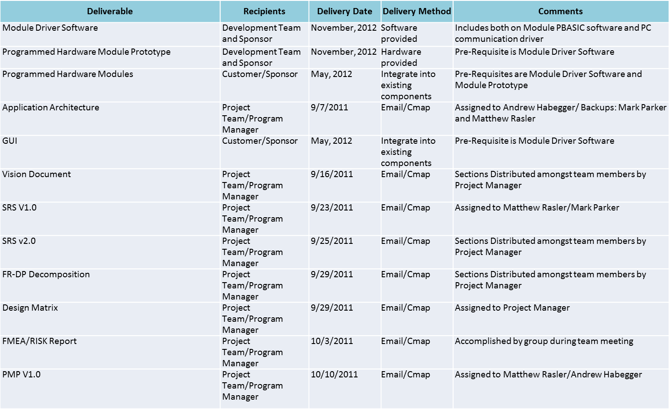
Project Management Plan
Structure Deliverables Risk Analysis

Slide 4
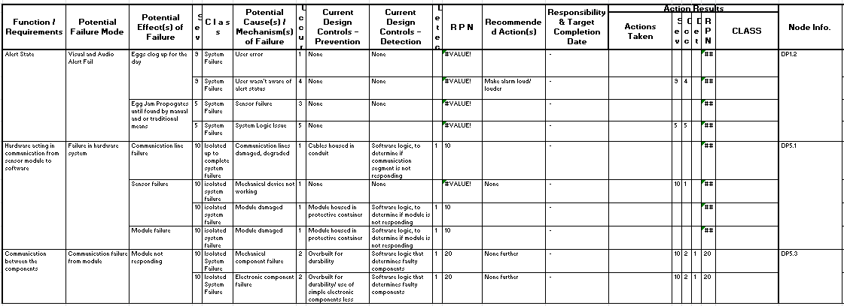
Project Management Plan
Structure Deliverables Risk Analysis

Slide 6
Elaboration
Specifications Diagram Quality Assessment
Why?
Specific Hardware Requires Specific Software
Specific Software Requires Specific Staff-Training, Staffing to Appropriate, and Factors in to Feasibility Assessment
Factors:
Microcontroller runs PBASIC
Communication Channel to UART driven by C
Communication Standards are defined by Communication Protocols RS232, RS485, USB
Elaborating:
Revisit and Revise Application Architecture
Revisit and Revise Design Matrix
Revisit and Revise SRS, involving newly defined constraints
Dedicate Training Time for Software Education

Slide 7
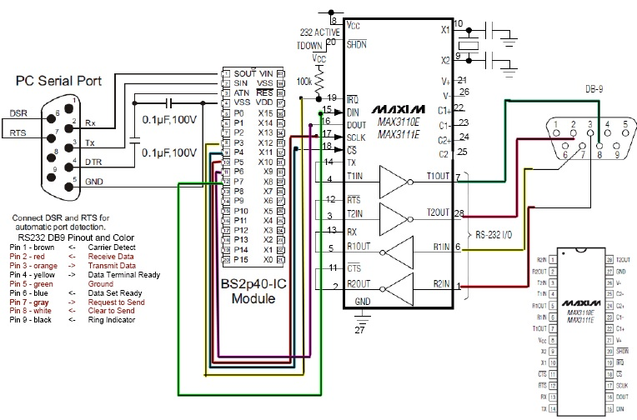
Elaboration
Specifications Diagram Quality Assessment
Microprocessor Serial Port: Programs microprocessor
Microprocessor:
PBASIC
UART port:
Relays chars to PC (C driver)
UART: char buffer

Slide 8
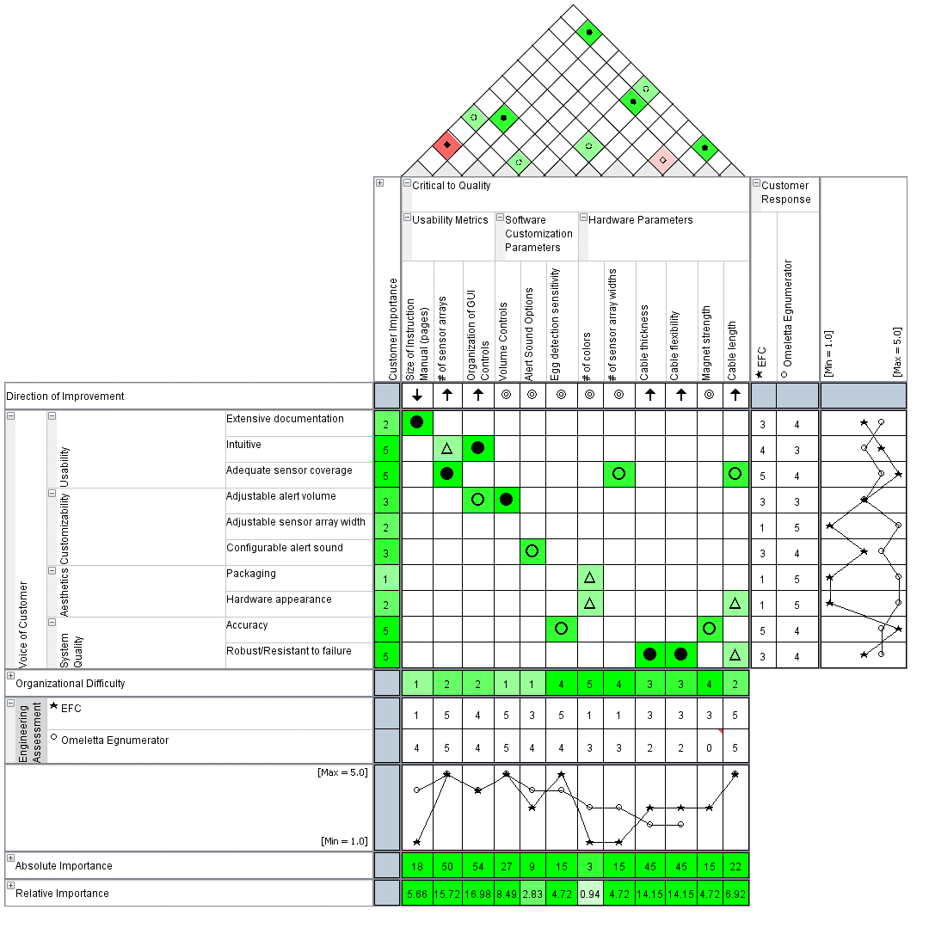
Elaboration
Specifications Diagram Quality Assessment
Competition: Omeletta Egnumerator
Areas to improve:
GUI layout
# of sensor arrays
Cable Quality
QFD Issues:
Difficult to reconfigure
Options from handout not available or named differently

Slide 10
Architecture
Software Application System
Defining Language Specifications and How to Communicate Effectively Between Them
Primary Application (High Level Language, C++/Java)
PBASIC Microcontroller Driver
C
Communications Driver
PutChar ( char c )
{
EnQueue ( txqueue, c );
/* enable the transmit-buffer-empty interrupt */
config = config | 0x0800; /* set the TM bit */
config = config | 0xC000; /* set bits 15 and 14 */
MAX3110E ( config );
}
/* High level interface routine to get a character from the MAX3110E .
** Wait for a character to be received, if necessary.
*/
char GetChar ( )
{
while ( IsQueueEmpty ( rxqueue ) )
/* wait for data to be received */ ;
return DeQueue ( rxqueue );
}
/* Configure the MAX3110E with the specified baud rate. */
ConfigureMAX3110E ( int baud_rate_index )…

Slide 11
Architecture
Software Application System

Slide 12
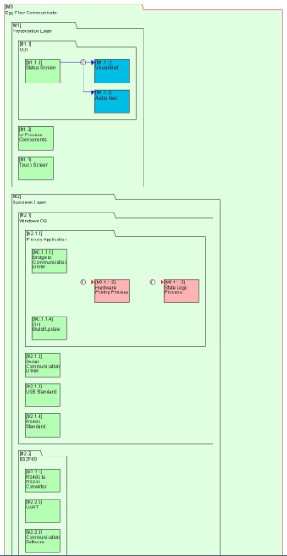
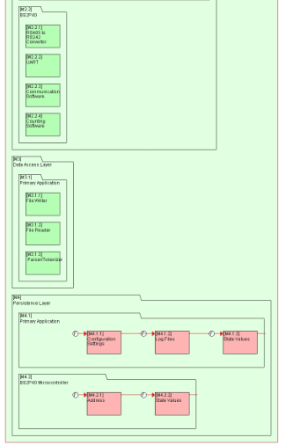
Architecture
Software Application System

Slide 14
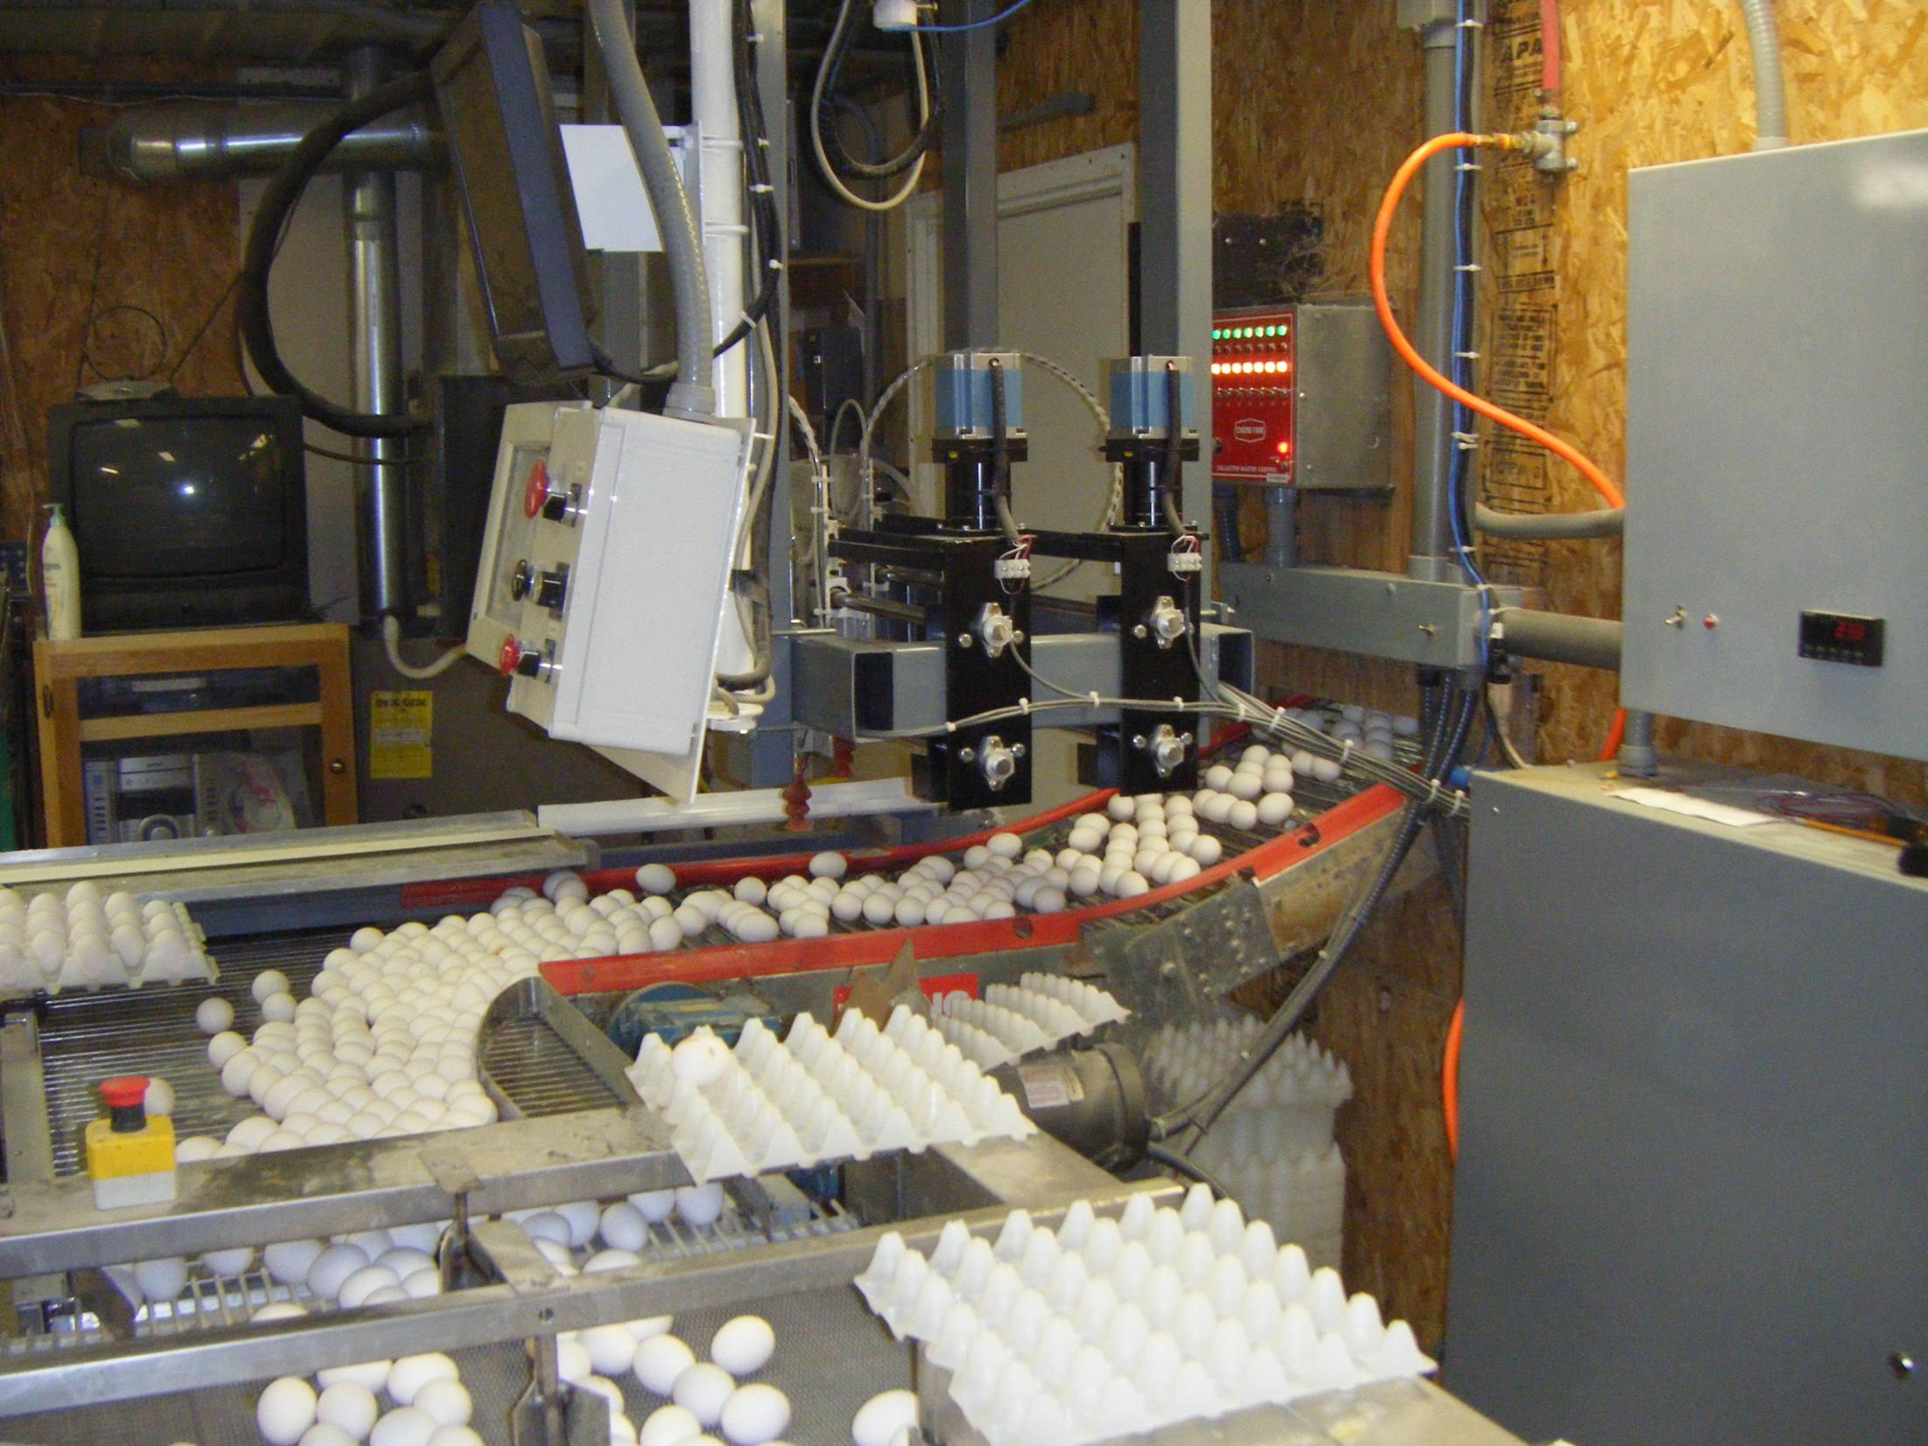
Thank You.

