Slide 1
UNIVERSIDAD AUTONOMA DE CHIRIQUI FACULTAD DE MEDICINA ESCUELA DE EMERGENCIA MEDICA SUBJECT: SCIENTIFIC ENGLISH ABREVATION: 120B INSTRUCTOR: MARISOL BARRAZA .M.S.C. GROUP PRESENTATION PROJECT: HEART ATTACK STUDENTS: LEZCANO HESLIN 4-763-101 CARRERA MAKIR 4-767-1900 BLAndford JOSÉ 1-730-867 BLANdford AZRIEL 1-730-868 DATE: NOVEMBER 15

Slide 2
TABLE OF CONTENT
GLOSSARY…………………………...............................3
HEART ATTACK DEFINITION…………….………..…………4
CAUSE OF A HEART ATTACK.……..…….…………….…..5
TREATMENTS FOR A HEART ATTACK..….……….……6
SIGNS AND SYMTOMS OF A HEART ATTACK.….…7
FIRST AID FOR A HEART ATTACK…………………..…..8
CPR………………………………………………..……….............9
EQUITMENT AND MEDICATION FOR A HEART ATTACK………………………………………………..……………..10
SUGGESTIONS AND PREVENTIONS FOR A HEART ATTACK………………………………………………………………..11
BIBLIOGRAPHY…………………………………………………….12

Slide 3
GLOSSARY
Heart Attack: ataque al corazón.
Vital nourishment: alimentación vital.
Deprived of blood: privar la sangre.
Leading cause of death: principal causa de muerte.
Cardiac arrest: detención del corazón.
Heaving pain: dolor considerable o muy fuerte.
Chest pain: dolor de pecho.
Tightness: opresión.
Fullness chest pain: dolor completo del pecho.
Shortness of breath: falta de aliento.
Cruching pain: dolor al aplastante.
Sweating: sudoración.

Slide 4
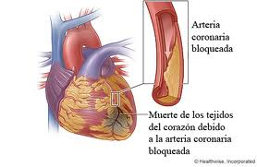
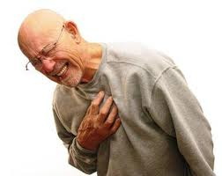
Heart Attack Definition
It is an obstruction of one or more blood vessels that supply blood to the heart.

Slide 5
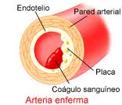
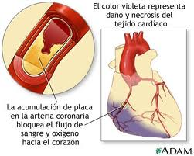
Cause of a Heart Attack
Blocked blood vessels.
The heart stops and the victim suffers a cardiac arrest.

Slide 6
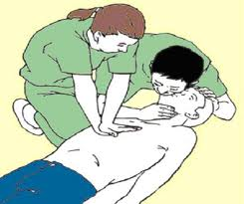
Treatment for a heart attack
C.P.R

Slide 7
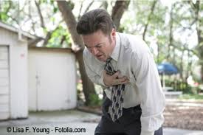
Signs and symptoms of a heart attack
Victim describes aching , crushing and heavy pain.
The pain maybe located in the center of the chest.
Sweating
Nausea
Shortnees of breath

Slide 8
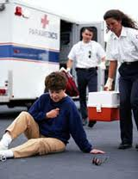
First aid for a heart attack
Recognize the signs and symptoms of a heart attack.
Confort and reassure the victim.
If the victim becomes unconsius, be prepared to perform C.P.R.

Slide 9
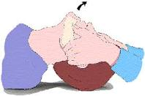
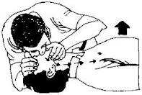
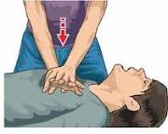
C.P.R
Open the airway.
2 blows.
30 compressions each 5 cycles for 2 minutes.
them check the pulse.

Slide 10
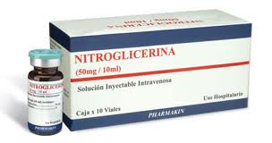
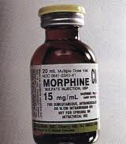
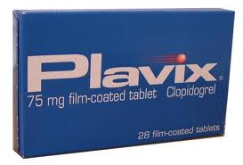
Equipment and medication for a heart attack
Nitroglicerine (chest pain)
Morphine (chest pain)
Clopidrogel (anticoagulant)
Warfarine (anticoagulant)

Slide 11
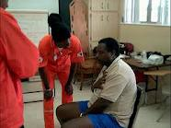
Suggestions and preventions for a heart attack
The rescuer must constantly reassure the victim.
Keep victim calm.
Rescuer must be relaxed.

Slide 13
Bibliography
http://www.survival-center.com/firstaid/heart.htm
www.heartmut.gov.
www.metdoctor.com.uk
http://es.wikipedia.org/wiki/Reanimaci%C3%B3n_cardiopulmonar
http://www.nlm.nih.gov/medlineplus/spanish/ency/article/000010.htm

Slide 14
THANKS

