Slide 1
UNIVERSIDAD AUTONOMA DE CHIRIQUI FACULTY OF MEDICINE EMERGENCY MEDICAL SCHOOL SUBJECT: SCIENTIFIC ENGLISH ABBREVIATION: 120B INSTRUCTOR: MARISOL BARRAZA M.Sc. GROUP MEMBERS: ANIELKA, JARAMILLO ID; 4-761-328 PATRICIO, LIZONDRO ID;4-776-439 ZULLIRETH, QUINTERO ID: 4-763-849 GROUP PROJEC: OBSTRUCTION IN THE AIRWAY DATE: NOVEMBER 14, 2011

Slide 2
INDEX
GLOSSARY………………………………………………………………………….…........1
OBSTRUCTION IN THE AIRWAY……………………………………………….…..2
OBSTRUCTED AIRWAY SIGNS AND SIPMTOMS………………….……….…3
INCOMPLETE OR PARTIAL OBSTRUCTION ……………………………………3.1
COMPLETE OR TOTAL OBSTRUCTION………………………………………....3.2
CONSCIOUS VICTIMS …………………………………………………………….…….3.4
UNCONSCIOUS VICTIMS ……………………………………………………….…….3.5
CAUSES……………………………………………………………………………………..….4
FIRST AID TREATMENT………………………………………………………............5
TREATMENT FOR INFANT………………………………………………………………6
HEIMLICH MANEUVER………………………….…………………………….…………7
BIBLIOGRAPHY………………………………………………………………….............8

Slide 3
GLOSSARY
AIRWAY OBSTRUCTIONS: OBSTRUCCIÓN DE LAS VÍAS RESPIRATORIAS.
EMERGENCY TREATMENT: TRATAMIENTO DE EMERGENCIAS.
MECHANICS OF HANDLING: MECÁNICAS DE MANEJO.
EXCHANGE OF AIR: INTERCAMBIO DE AIRE.
ENCOURAGE THE VICTIM: ANIMAR A LA VICTIMA.
HEIMLICH MANEUVER: MANIOBRA DE HEIMLICH.
VICTIM´S WAIST: CINTURA DE LA VÍCTIMA.
ABOVE THE NAVEL: ENCIMA DEL OMBLIGO.
BREAST BONE: PUNTA INFERIOR DEL ESTERNÓN.
ELBOWS OUT: CODOS HACIA FUERA.
QUICK, UPWARD THRUSTS: COMPRESIONES RAPIDAS HACIA ARRIBA.
FOREIGN OBJECT: OBJETO EXTRAÑO.

Slide 4
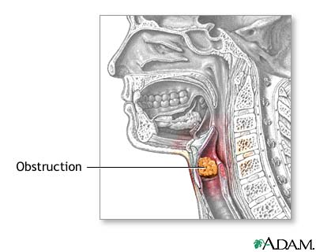
OBSTRUCTION IN THE AIRWAY
Is when something keeps the air from moving in and out of the airways in your lungs.
Is a respiratory problem caused by increased resistance in the bronchioles that reduces the amount of air inhaled in each breath and the oxygen that reaches the pulmonary arteries.

Slide 5
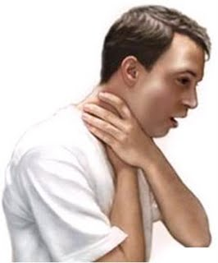
OBSTRUCTED AIRWAY SIGNS AND SYPMTOMS
Conscious and Unconscious Victims
(Victimas Consientes y Inconscientes)

Slide 6
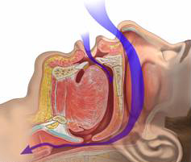
PARTIAL OBSTRUCTION
Breathing is labored.
Breathing may be noisy.
Some escape of air can be felt from the mouth.

Slide 7
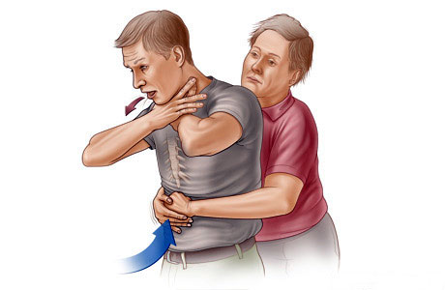
COMPLETE OBSTRUCTION
There may be efforts at breathing.
There is no sound of breathing.
There is no escape of air from nose and/or mouth.

Slide 8
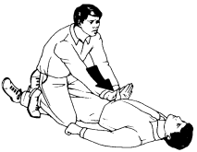
CONSCIOUS VICTIMS
In conscious patients may occurs see:
Coughing.
Wheezing.
Shortness of breath.
Desperately grab at their neck.
Cannot speak or cry out.
Face turns blue from lack of oxygen.

Slide 9
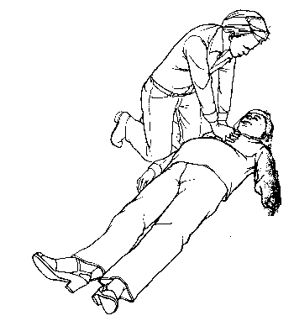
UNCONSCIOUS VICTIMS
Rise and fall of the chest and air exchange through the nose and/or mouth.
The person's face turns blue (cyanosis) from lack of oxygen.

Slide 10
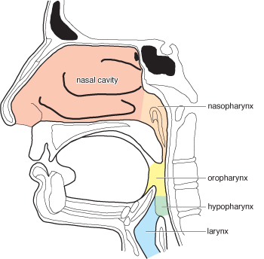
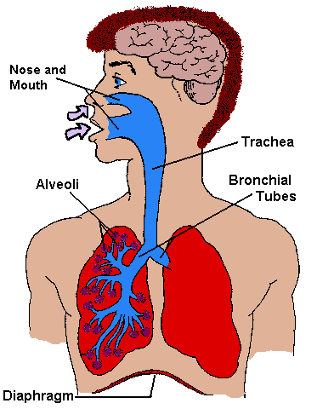
CAUSES OF OBSTRUCTION IN THE AIRWAY
Upper Airway:
Tongue (due to unconsciousness)
Soft tissue swelling.
Blood, vomit.
Direct injury.
Larynx (voice box):
Foreign material, direct injury, soft tissue swelling.
Lower Airway:
Secretions, or edema blood.
Bronchospasm.
Aspiration of gastric contents.

Slide 11
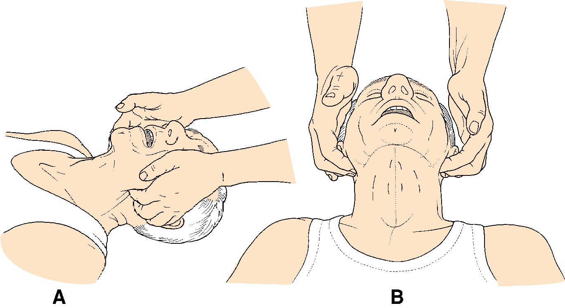
FIRST AID TREATMENT
If the person has a complete obstruction and is unable to speak or breathe, the Heimlich maneuver may be lifesaving.
Maintain a clear and open airway.
Monitor breathing and circulation.
Monitor vital signs.
Cover the victim with a blanket.

Slide 12
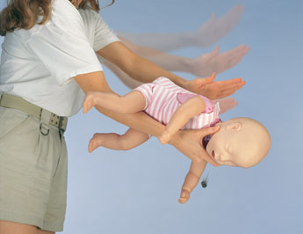
TREATMENT FOR INFANTS
Hold the infant with the head in your hand, and the spine along your forearm and the head below the rest of the body.
Compress the chest 5 times.
Switch the infant to your other forearm.
Perform 5 back blows, keeping the infant's head below the rest of the body.
Continue until the obstruction is cleared, or the infant goes unconscious.

Slide 13
HEIMLICH MANEUVER
Stand behind the victim.
Wrap your arms around the victim's waist.
Make a fist with one hand and place the thumb side of the fist against the victim's abdomen.
Grasp your fist with your other hand, with elbows out, and press your fist into the victim's abdomen with quick, upward thrusts.
Repeat thrusts until foreign object is cleared or the victim becomes unconscious.

Slide 14
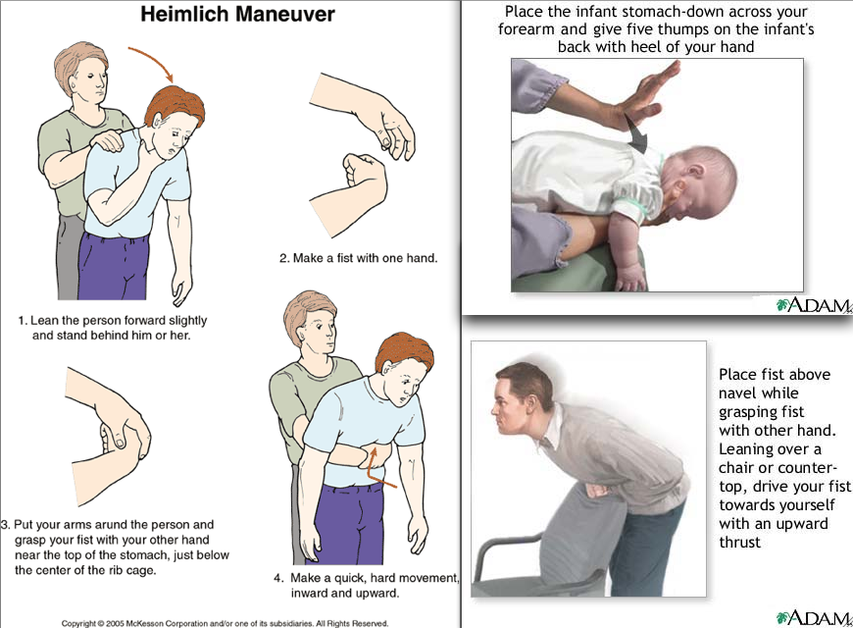
HEIMLICH MANEUVER

Slide 15
HEIMLICH MANEUVER

Slide 17
BIBLIOGRAPHY
First Aid/Obstructed Airway: http://en.wikibooks.org/
http://en.wikibooks.org/wiki/First_Aid/Obstructed_Airway
Acute upper airway obstruction http://www.nlm.nih.gov/medlineplus/ency/article/000067.htm
Complete and Partial airway obstruction
http://www.tpub.com/content/medical/10669c/css/10669-c_88.htm

