Slide 1
Academic Measurement and Achievement Mentor (AMAM)
by
Monica Gloudemans
and
Ekaterina Schwartz
http://cmapspublic.ihmc.us/rid=1JTCC9LZ9-23JK550-33YZ/ACS560.cmap

Slide 2
Motivation
Low statewide ISTEP pass rates for 2011
http://www.doe.in.gov/assessment/2011/docs/2011_istep_results_overview.pdf
Need to improve student performance
http://www.informationweek.com/news/government/leadership/231601689

Slide 3
Vision
A web-based application
to engage students, parents and support persons
to promote a student’s mastery of the Indiana state academic standards.
Product features
age-appropriate rich user interface
adaptive, iterative assessments in 4 subject areas:
English/Language Arts
Mathematics
Social Studies
Science
immediate, confidential feedback
tutorial and enrichment resources linked to standards
progress and achievement reports

Slide 4
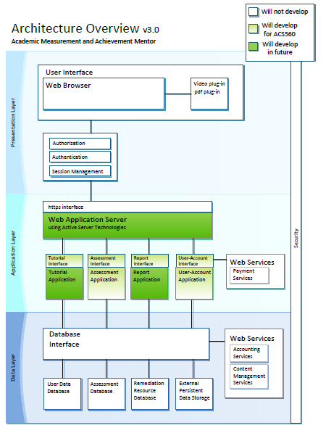
Application Architecture

Slide 5
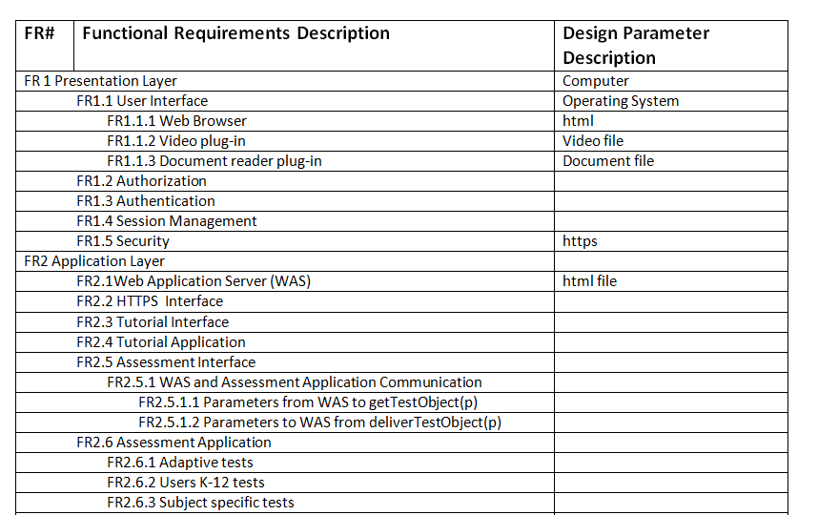
Functional Requirements

Slide 6
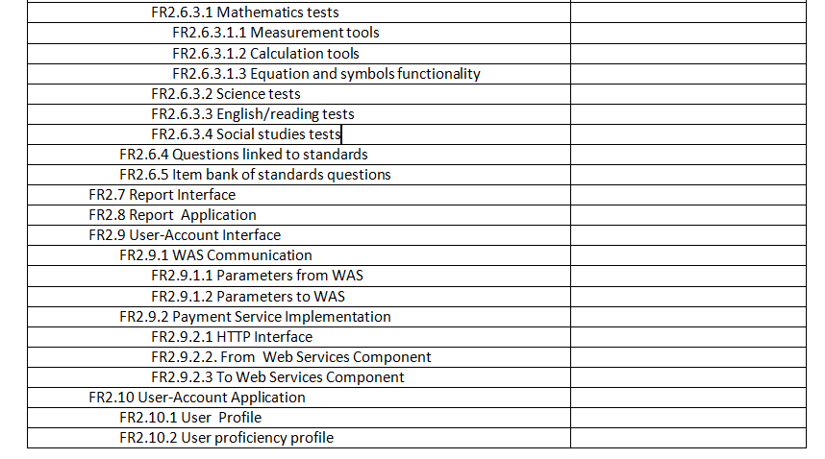
Functional Requirements

Slide 7
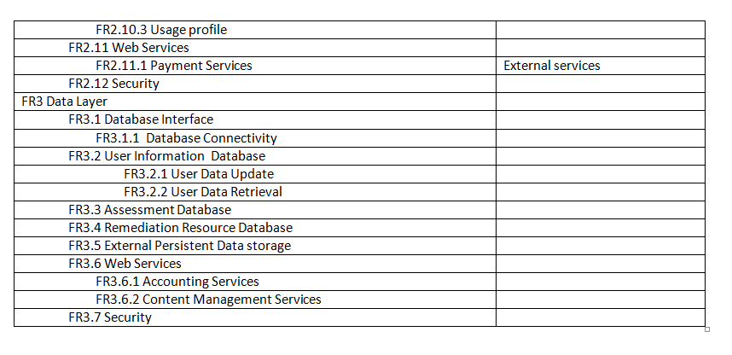
Functional Requirements

Slide 8
Non-functional Requirements
ID | Characteristic | H/M/L | 1 | 2 | 3 | 4 | 5 | 6 | 7 | 8 | 9 | 10 | 11
1 | Accessibility | M |  | 1 |  |  | 1 | 1 |  | 1 | 9
2 | Configurability | M |  |  |  |  | 5 | 2 |  | 8 | 9
3 | Correctness | H |  |  |  |  |  |  | 3 |  |  | 10 | 3
4 | Installation | L
5 | Maintainability | M |  |  |  |  |  | 5 |  | 5 | 9
6 | Portability | M |  |  |  |  |  |  |  | 5 | 9
7 | Reliability | H |  |  |  |  |  |  |  |  |  | 10 | 11
8 | Robustness | M |  |  |  |  |  |  |  |  | 9
9 | Scalability | M
10 | Security | H |  |  |  |  |  |  |  |  |  |  | 10
11 | Usability | H

Slide 9
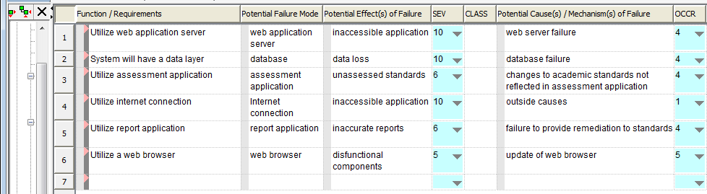
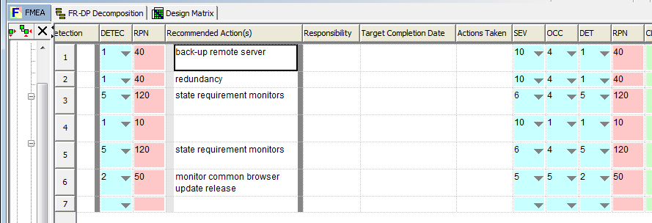
FMEA

