Slide 1
Registered Nurses
Scientific English 331
Faculty of Nursing
School of Nursing
2011 Second Semester

Slide 2
Title: Registered Nurses Enfermera Registrada
Duties:
Treat patients
Educate patients and the public about various medical conditions
Provide advice and emotional support to patients’ family members.
Record patients’ medical histories and symptoms
Help perform diagnostic tests and analyze results
Operate medical machinery
Administer treatment and medications
Help with patient follow-up and rehabilitation

Slide 3
Teach patients and their families how to manage their illnesses or injuries
Promote general health by educating the public on warning signs and symptoms of disease.
Run general health screening or immunization clinics, blood drives, and public seminars on various conditions.
Establish a care plan or contribute to an existing plan.
Provide direction to licensed practical nurses and nursing aides regarding patient care.
Perform diagnostic and therapeutic procedures
May have prescriptive authority.

Slide 4
Registered Nurses
Education and Training in Panama:
Earnings in Panama:
Job outlook:

Slide 5
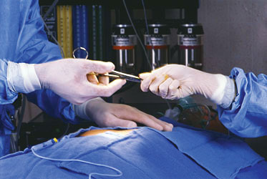
Specialty: Perioperative nurse
Duties:
Location:
Education and Training in Panama:
Earnings:

