Slide 1
First Aid Kit
UNACHI
2011
NURSING

Slide 2
First Aid Kit Content
General
Airway, Breathing and Circulation
Advanced first aid Kits
Trauma Injuries
Personal Protective Equipment
Instruments and Equipment
Medication
Life Saving
Pain Killers
Symptomatic Relief
Poison Treatments
Topical Medications

Slide 3
General
First Aid Kit

Slide 4
General
The International Organization for Standardization (ISO) Symbol

Slide 5
General
The International Committee of the Red Cross Symbol

Slide 6
General
Star of Life Symbol

Slide 7
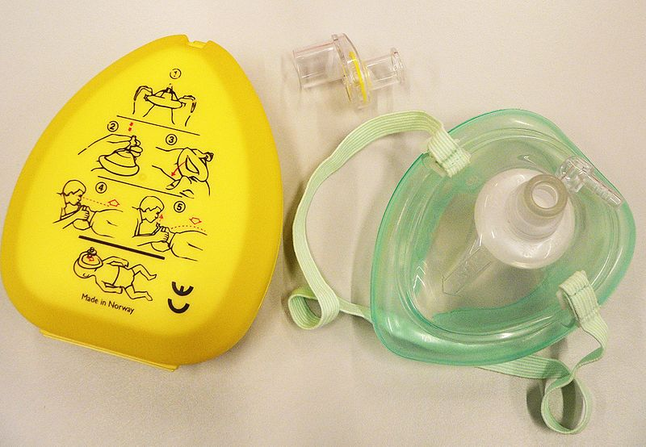
Airway, Breathing and Circulation
Pocket mask, or pocket face mask or CPR mask
Device used to safely deliver rescue breaths during a cardiac arrest or respiratory arrest.
(Mascarilla)

