Slide 1
NEOPLASTICISMO

Slide 2
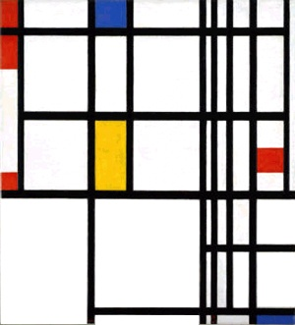
PIET MONDRIAN

Slide 3
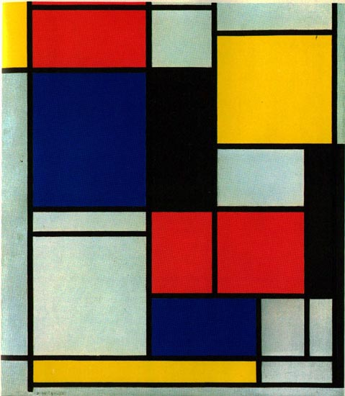

Slide 4
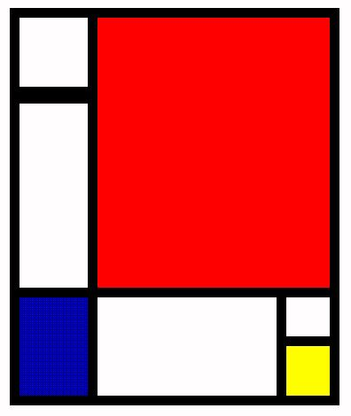

Slide 5
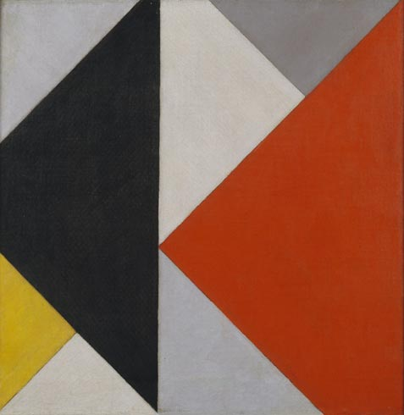
THEO VAN DOESBURG

Slide 6


Slide 7


Slide 8
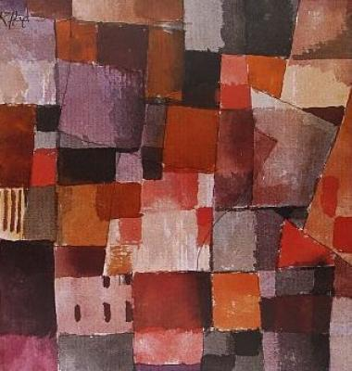
PAUL KLEE

Slide 9
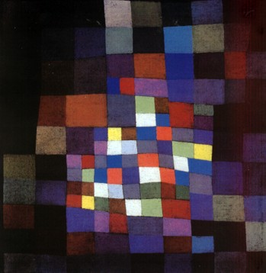

Slide 10
