Slide 1
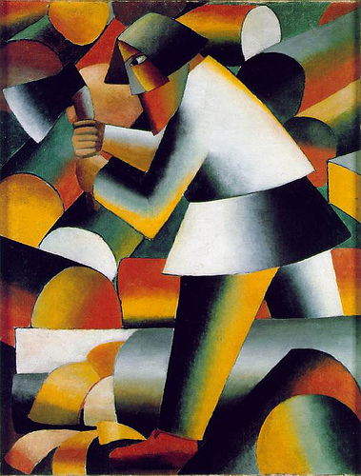
KASIMIR MALEVICH

Slide 2


Slide 3


Slide 4


Slide 5
