Slide 1
It’s all in the rocks…
---A mini lesson in stratigraphy---

Slide 2
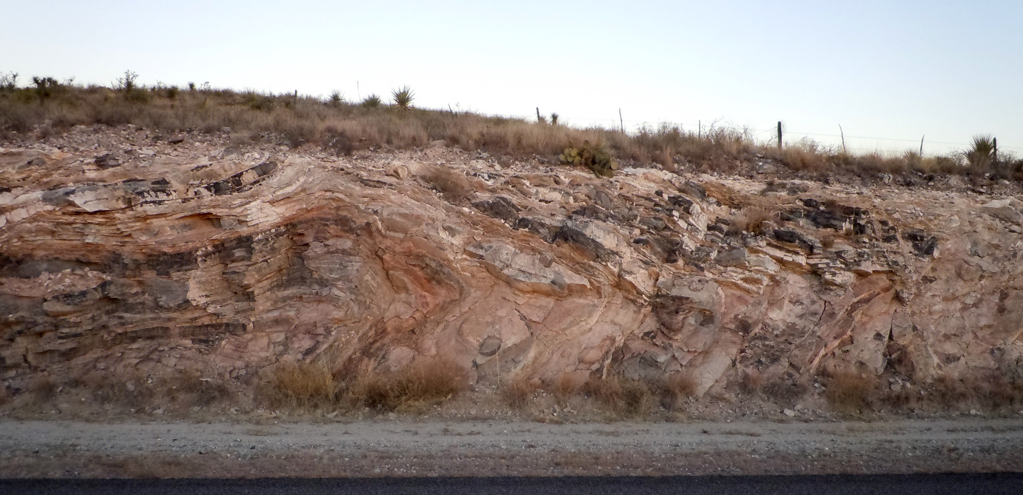
How did these rocks end up like this?

Slide 3
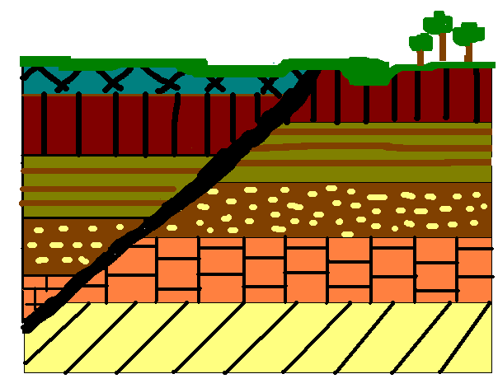
With your group, predict which order these layers were deposited. Remember to work from
oldest to youngest!
D
F
H
A
B
G
E
C

Slide 4
Now it’s your turn!
Create your own stratigraphic column.
Have at least two other people in the class try to figure it out.
You should try and figure out at least 2 others as well.

Slide 5
Now that you have had practice…
How did these rocks end up like this?!

