Slide 1
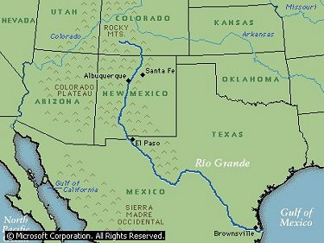
Big Bend, TX
References

Slide 2
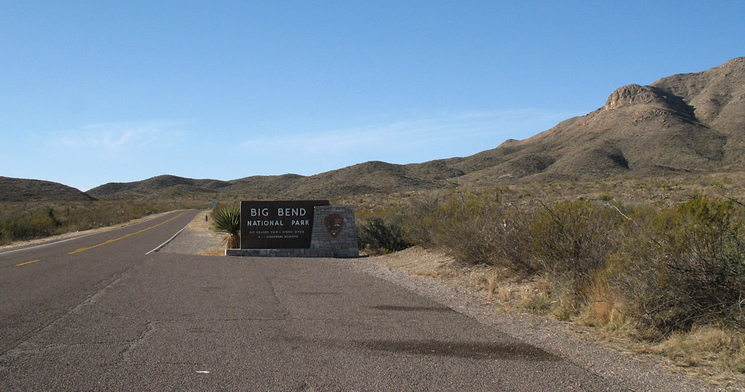
TAKE ME THERE!

Slide 3
Rio Grande River
The river’s course has been determined by the basic geological traits that illustrate the rift valley that splits New Mexico into an east and west. To understand the cause of the river, we must understand the past geologic development.

Slide 4
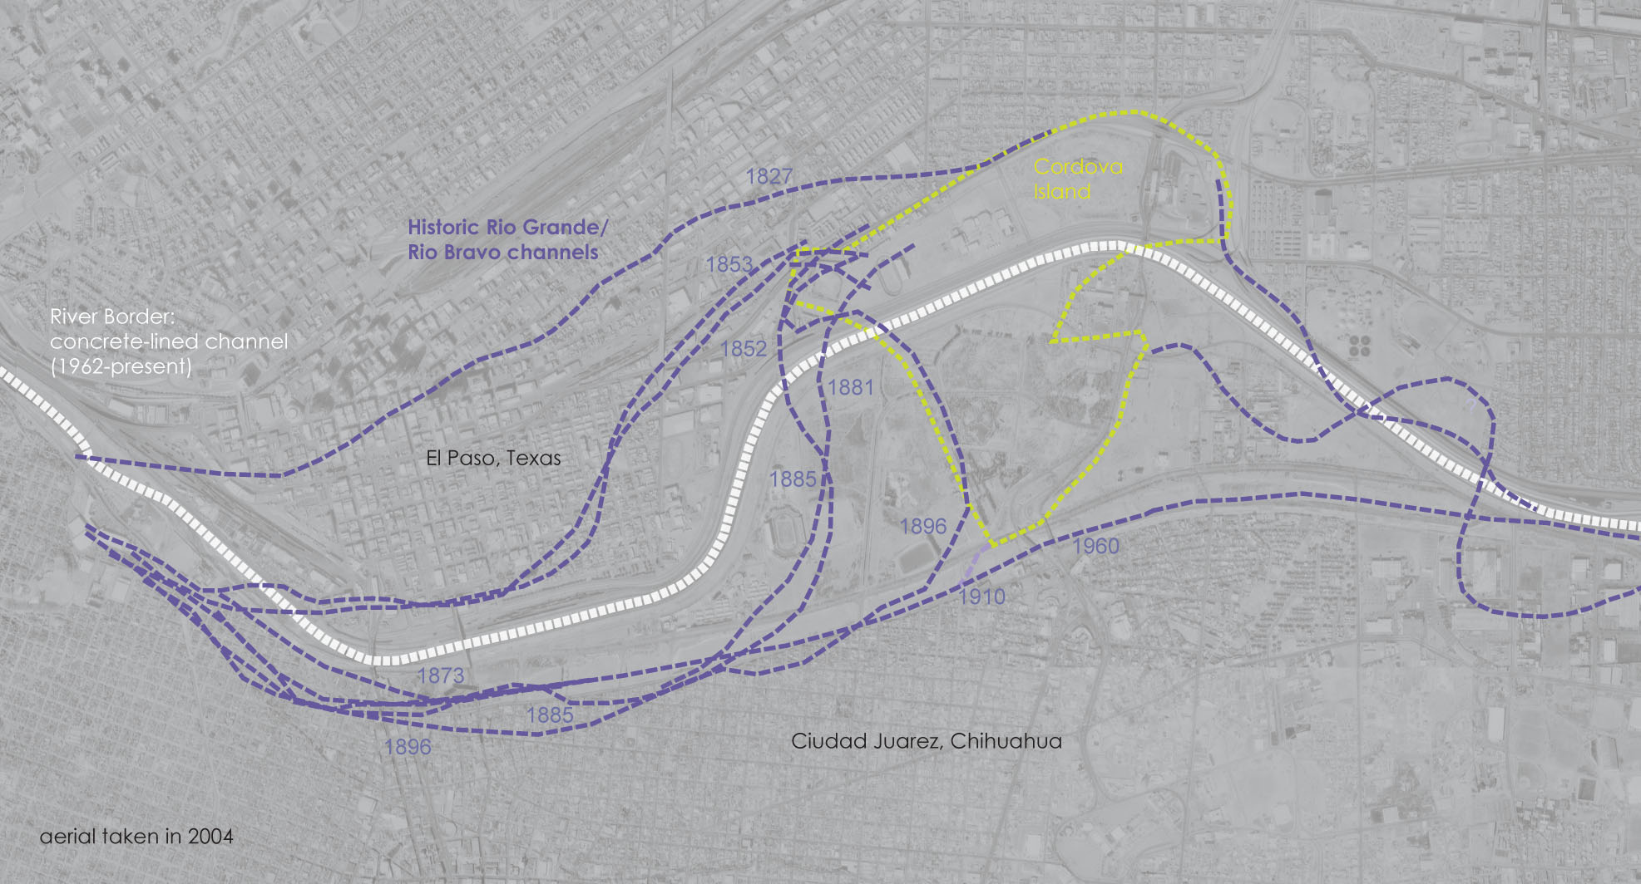
Cordova Island
What am I looking at?

Slide 5
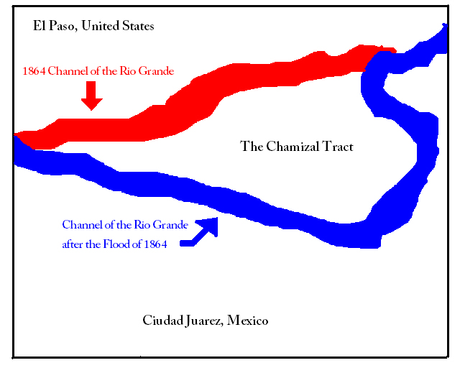
In 1864, the Chamizal Tract went from being on the Mexican side of the river to being on the United States side.

Slide 6
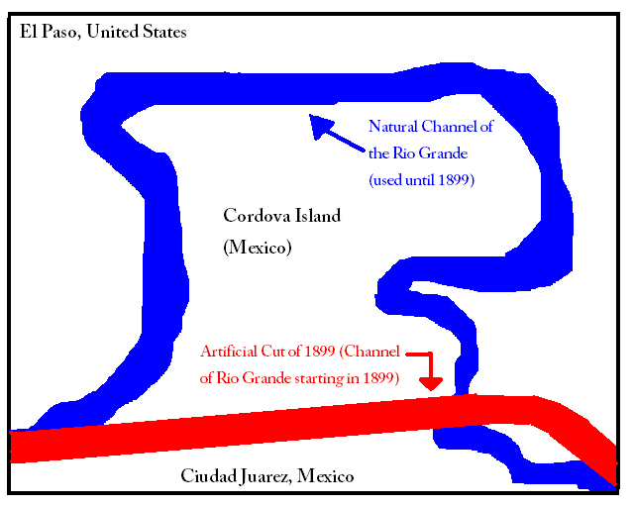
With the completion of the artificial cut in 1899, Cordova Island became a Mexican enclave surrounded on 3 sides by the United States—and there was no definitive international border
anymore.

Slide 7
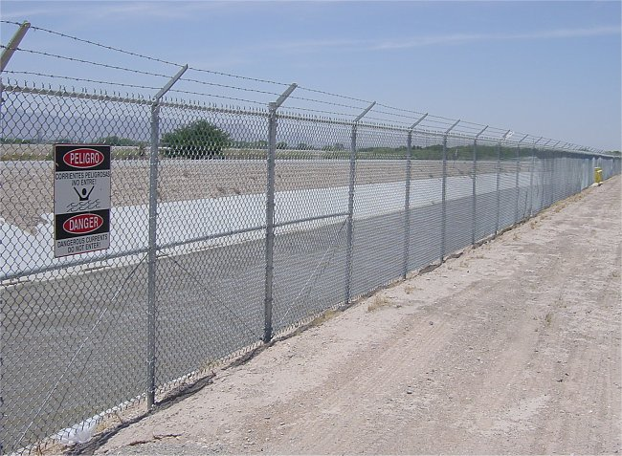
4.1 miles of the riverbed between El Paso and Ciudad Juarez were cemented as part of the Chamizal Convention of 1963.

Slide 8
These courses were created by historical shifts of the border. The landscape is flipped over by releasing the Rio Grande from the concrete channel, allowing flows of the river to meander through the floodplain, constantly changing the exact location and thickness of the border.

Slide 9
  Through time (daily and seasonally) the river shifts, migrates, floods and runs dry. These processes create landscapes of migration in which the ground, ecologies, and human occupation are constantly changing.

Slide 10
What the border is one day is different from what it may be the next. The space becomes a series of events in constant change that will never repeat in the exact same way.

Slide 11
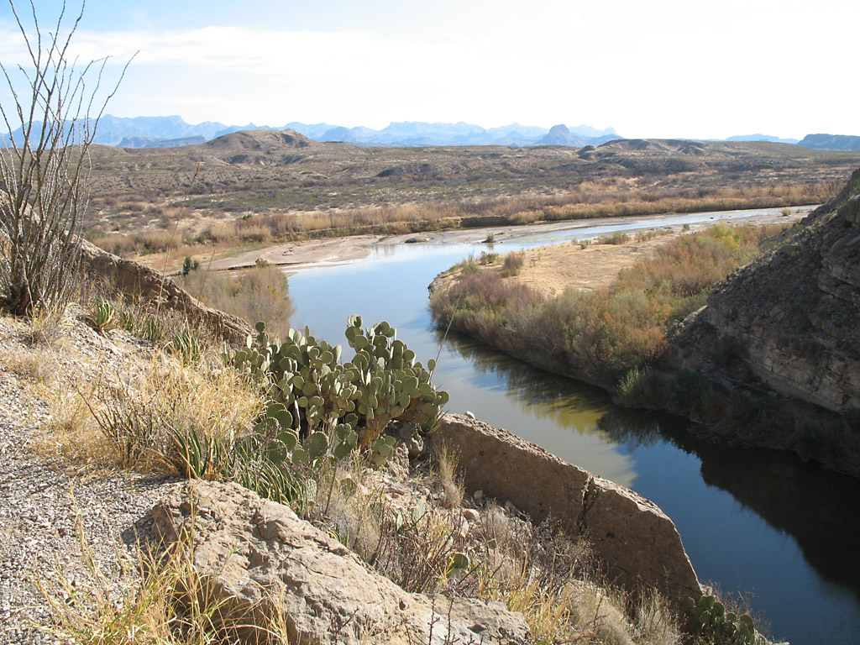
WHAT’S THIS?

Slide 12
The Rio Grande exiting Santa Elena canyon
This sharp bend in the river was formed by movement along the Terlingua fault zone that crosses the park. For many miles upstream the river is trapped beneath the high walls, eventually emerging into a wider valley at the small town of Lajitas.

Slide 13
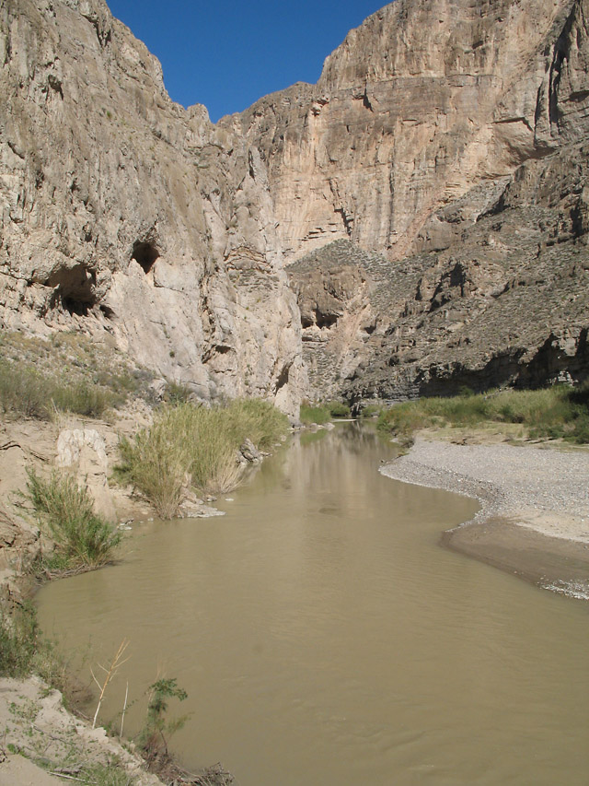
WHAT’S THIS?

Slide 14
Boquillas Canyon
Located in the southeast corner of Big Bend National Park, Boquillas Canyon is composed of high, layered cliffs. A distinctive feature on the Texas side is a large sand drift half way up the cliffs, formed by the prevailing winds blowing sand up from the Rio Grande.

Slide 15
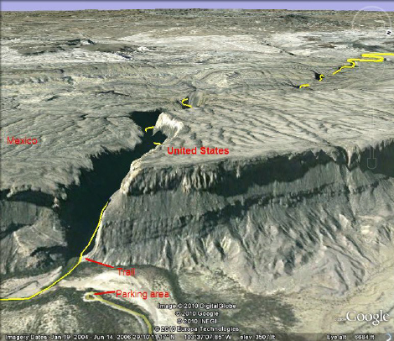
FURTHER UPRIVER
WHAT’S HERE?
What am I looking at?

Slide 16
Santa Elena Canyon as seen by Google Earth. The yellow line is the Rio Grande River which separates Mexico, on the left, and the United States, on the right.

Slide 17
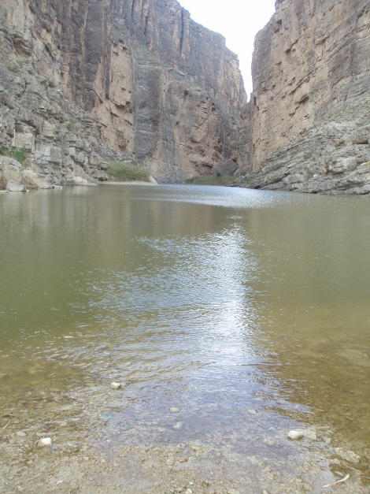
What am I looking at?

Slide 18
Santa Elena Canyon as seen from the bank of the Rio Grande River

Slide 19
References
Slide #2- http://www.care2.com/c2c/groups/disc.html?gpp=219&pst=393537
Slide #3 http://freeassociationdesign.wordpress.com/2009/11/
Slide #4 and #7-http://blog.seattlepi.com/ramblinman/month.asp?blogmonth=1/1/2010
Slides #8 and #10-http://www.houstonfreeways.com/modern/2007-01-08_big_bend.aspx
Slides #5 and #6- http://www.nps.gov/cham/historyculture/rio-grand-floods-and-the-chamizal-issue.htm

