Slide 1
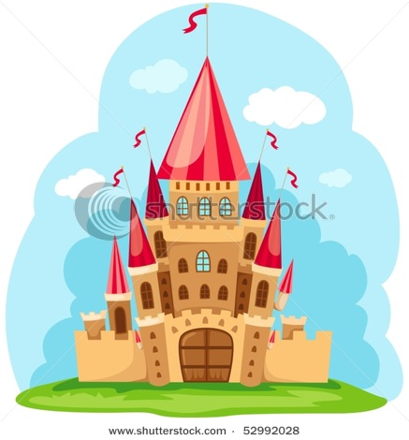
YEIMY ALEXANDRA LÒPEZ
MAYERLY DELGADO

Slide 2
FAIRY TALES FOR KIDS
1.Fairy Tale stories are Fantastic Journies. 2-Fairy Tales are a passing of culture. 3-The most famous fairy tales where penned by people who's intention it was to bring about social and moral growth.

