Slide 1
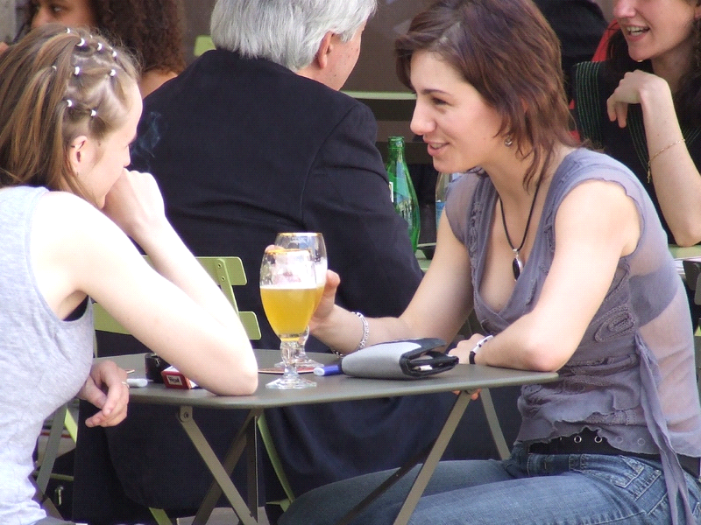
STRATEGIC CONVERSATION
A dialogue between equals:- Relaxed at ease within your own style.
’
Move beyond debate and discussion and into conversation.

Slide 4
MAKE IT SOMETHING I CARE ABOUT
INCLUSIVE
STORY ENABLED
OUTCOME
FOCUSSED
INCLUSIVE
CONNECTED
ENGAGING

Slide 5


STORY ENABLED : FUN, CREDIBLE, AND CONTEXT SPECIFIC
: The Crane and the Crow
Artist: Tex Skuthorpe
CREDIT: TUCKANDEE .COM.AU

Slide 6
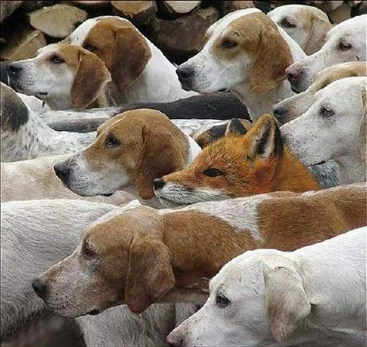
INCLUSIVE HELP ME BELONG TO THIS COMMUNITY

Slide 7
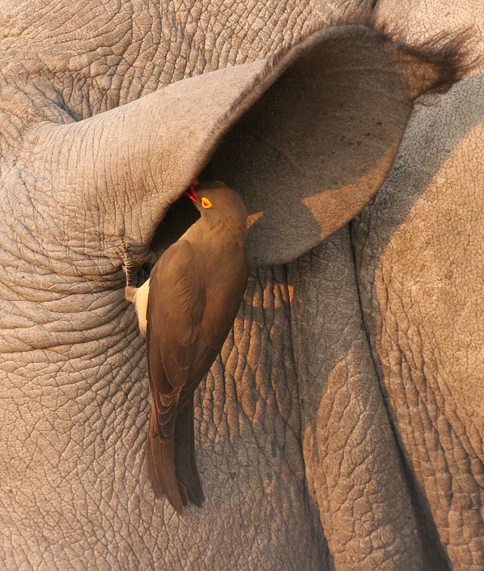
ENGAGING
TELL LESS LISTEN MORE

Slide 8
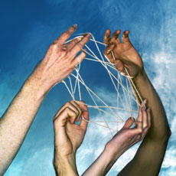
CONNECTED
MAKE IT SOMETHING I CAN EASILY TELL OTHERS

Slide 9

RELATIONSHIPS DRIVEN

Slide 10

OUTCOMES FOCUSSED

Slide 11
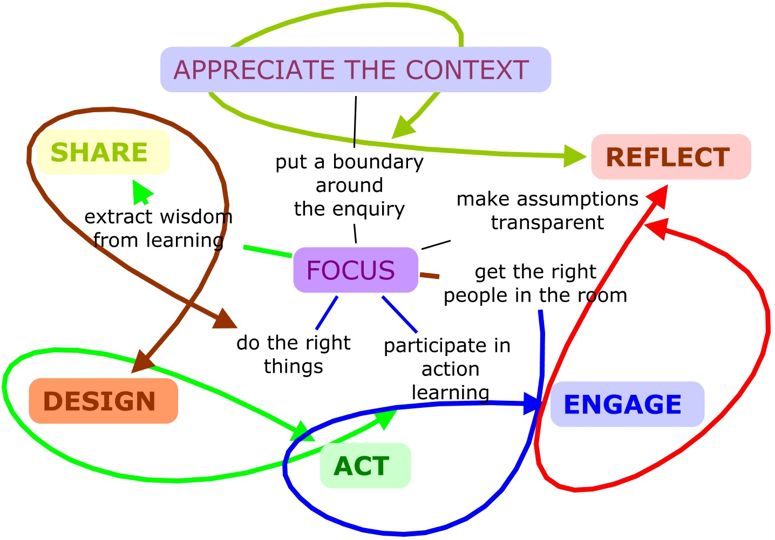

Slide 12
OUR UNIQUE SITUATION
WHY
are we
doing this?
WHO
do we
engage ?
O U R
FOCUS
HOW
are results
delivered ?
WHAT
results
do we want ?

Slide 13
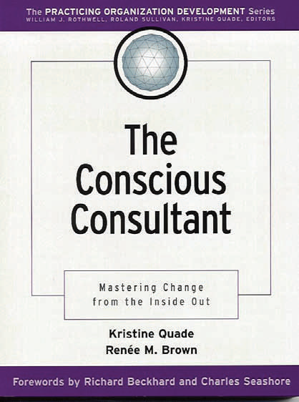
We are the tool. We are the only tool that we bring to the client system.
If we allow ourselves to become rusty, to ignore our worth and our strength, then we have nothing of value to offer our clients.” We are the instrument that is unique, needing to be healthy, balanced; in order to do good work. Therefore, we must charge for this special unique instrument that cannot be replicated.”
Change is accompanied by:
1. shock--this can not be happening.
2. denial--this is not happening.
3. grieving for that which is lost.
4. fear--this may be happening. What will happen to me in the process?
5. resistance--I don't want this, I want that.
6. struggle--there is something important about what I want.
7. possibility of integration, adaptation, or new ideas being born.

Slide 14
Strategic Questioning Manual
Fran Peavey
CHAPTER 1
INTRODUCTION: STRATEGIC QUESTIONS ARE TOOLS OF REBELLION
http://www.thechangeagency.org/_dbase_upl/strat_questioning_man.pdf
CONVERSATIONAL LEARNING
AN EXPERIENTIAL APPROACH TO
KNOWLEDGE CREATION
Ann C. Baker
George Mason University
Patricia J. Jensen
Alverno College
David A. Kolb
Case Western Reserve University
Change is accompanied by:
1. shock--this can not be happening.
2. denial--this is not happening.
3. grieving for that which is lost.
4. fear--this may be happening. What will happen to me in the process?
5. resistance--I don't want this, I want that.
6. struggle--there is something important about what I want.
7. possibility of integration, adaptation, or new ideas being born.
Imagining New Futures: The Simple
Power of Story
Journal of Futures Studies, August 2008, 13(1): 113 - 124
Presented at the Millennia 2015 conference: "Women, Actors of Development for World
Challenges" Liege, Belgium March 2008

Slide 15
4. CHANGE QUESTIONS are concerned with how to get from the present situation towards a more ideal situation.
"What exactly needs to change here?"
"Who can make a difference?"
"What are changes you have seen or read about?“
KEYWORDS: what will it take. . ., how could.
5. CONSIDER THE ALTERNATIVES Try to imagine more than two alternatives (contrary to our cultural training, the world of resistance is not dualistic). Be alert for other alternatives to pop up in other areas of questioning. Do not rule out any alternative.
"What other ways could you imagine meeting your goal of change?"
"What are the consequences of each alternative you see?"
KEYWORDS: alternative ways, imagine, and all the ways imaginable
6. PERSONAL INVENTORY AND SUPPORT QUESTIONS are concerned with identifying one's interests,potential contribution and the support necessary to act.
"What would it take for you to participate in the change?"
"What support would you need to work for this change?"
KEYWORDS: what will it take, part of the change, your part, everyone has a role, etc.
7. PERSONAL ACTION QUESTIONS are those which get down to the specifics of what to do, how and when to do it. The actual plan begins to emerge.
"Who do you need to talk to?"
"How will you get an introduction to them that will establish your credibility?"
"How can you get others together at a meeting to work on this?"

