Slide 1
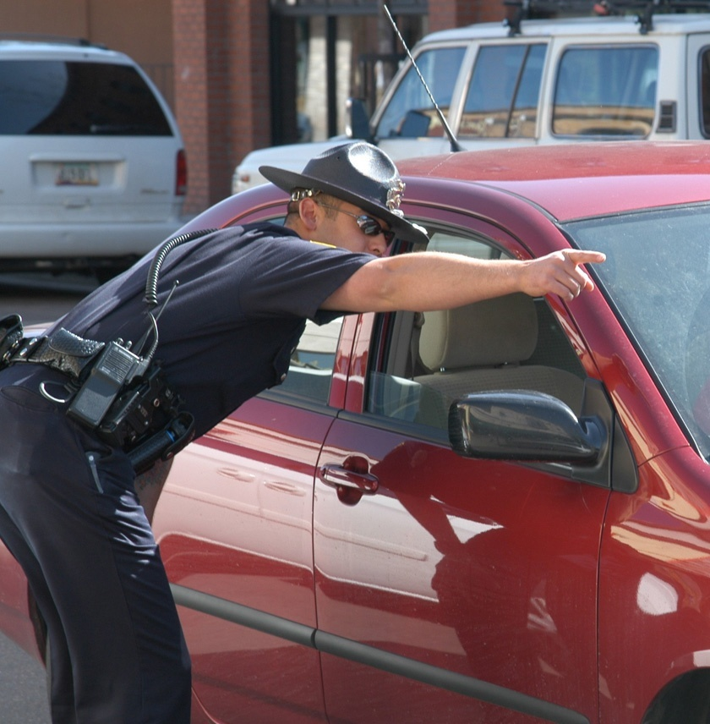
GIVING DIRECTIONS…
Prof. Gisela Almengor

Slide 2
Bank
Hospital
Restaurant
Police

Slide 3
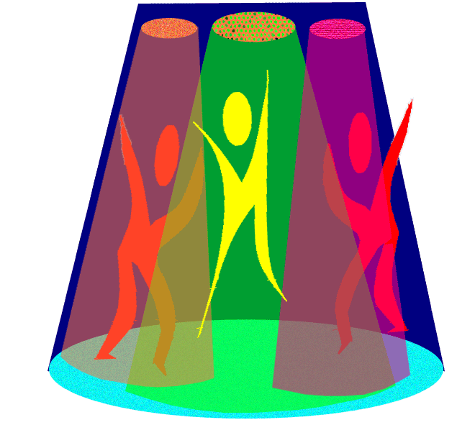
Car Wash
Disco
Hotel

Slide 4
PREPOSITION OF PLACE
Next:
Behind:
Close:
Near:
Between:
Across from:
On:
Cerca
Entre
Al otro lado
en
A lado
Detrás
cerca

Slide 5
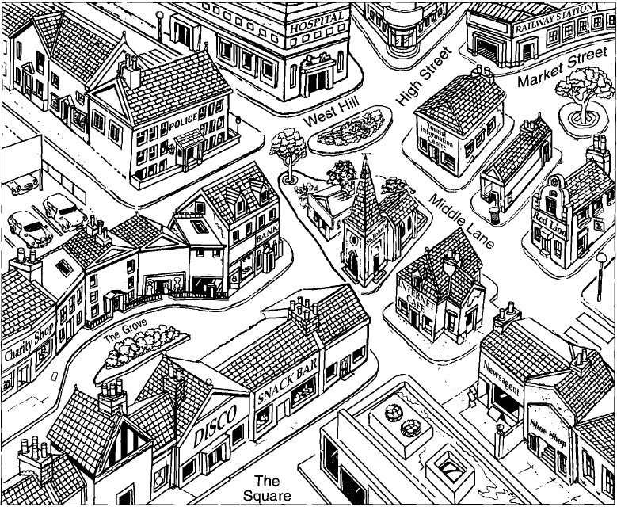
QUIESTION
Where is..
P. OF PLASE
Next:
a lado
Behind:
atrás
Close:
cerca
Near:
cerca
Between:
entre
Across from:
cruzando
On:
en
CAR
WASH
LUNCH
HOTEL
STORE
RESTAURANT
Library

Slide 6
Let´s practice..!
http://www.inglesmundial.com/B13/grammar.htm

Slide 7
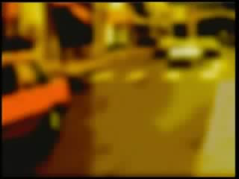
Now let`s see this video…
then…

Slide 8
Now let`s see this video…
then…

