Slide 1
FEMALE REPRODUCTIVE SYSTEM
Nodier Aparicio
Angélica Batista
Kiara Domínguez
Brian Espinoza
Mariana Ramón
PRESENTED BY:

Slide 2
Table of Contents
INTRODUCTION
FUNCTIONS
ORGANS
FEMALE REPRODUCTIVE CYCLES
FERTILIZATION
FETAL
DEVELOPMENT
DISEASES

Slide 3
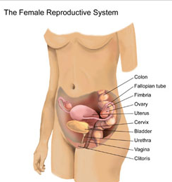
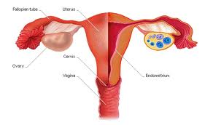
iNTRODUCTION
Female Reproductive System it’s more complex than men, because not only has to produce female gametes eggs it also needs to mature and protect the developing fetus for nine months of gestation

Slide 4
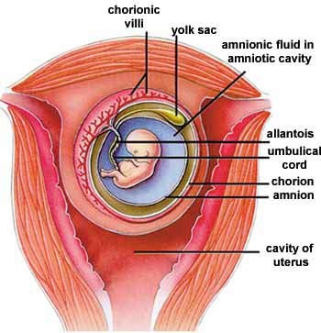
Produce Eggs
Site of Fertilization
Hosting the embryo during development
Protect the input and output to the uterus the baby at birth
Implement the menstrual cycle when fertilization ooccurs.
FUNCTION

Slide 5
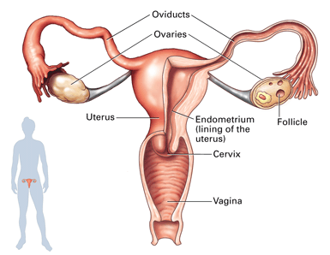
ORGANS
Internal organs
External organs
Accessory glands
Fallopian tube
Labia minora
Labia majora
Breast
Vulvar
vestibule
Clitoris
Ovaries
Mount of Venus
Bartholin's glands
Uterus
Meatus
Hymen
Vagina
Perineum

Slide 6
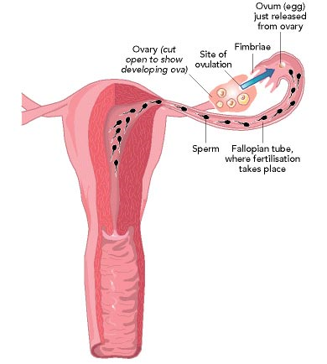
Internal organs
Fallopian Tube
Provides passageway for ovum as it travels from ovary to uterus.
Site of Fertilization.

Slide 7
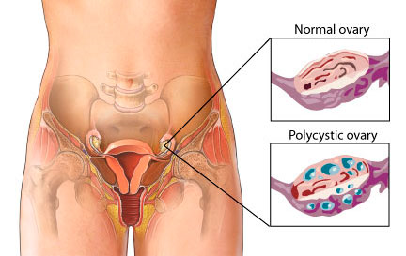
Internal organs
Ovaries
Endocrine glands that secrete estrogen and progesterone.
Containing the eggs in the follicles to mature during the reproductive life of women.

Slide 8
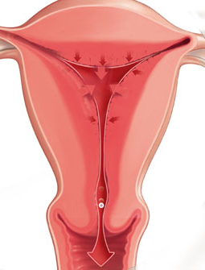
Internal organs
Uterus
House and nourishes fetus until sufficiently mature to function outside the mother’s body.
Uterine muscles propels fetus outside.

Slide 9
Internal organs
Vagina
Passageway of menstrual flow.
Passageway for the fetus during the birth.
Female organ for coitus; receives male penis.

Slide 10
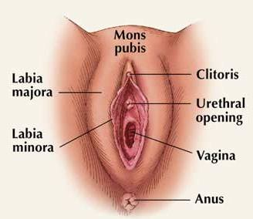
external organs
Labia majora
Each of the two lips that cover the labia minora at the edges of the slit vulvar skin folds of adipose tissue.
Are covered by pubic hair after puberty.

Slide 11
external organs
Labia minora
Are inside the labia majora and go from the clitoral hood to below the vagina around the holes in the vagina and urethra

Slide 12
external organs
Vulvar vestibule
Vulvar depression
located in front of the vagina.

Slide 13
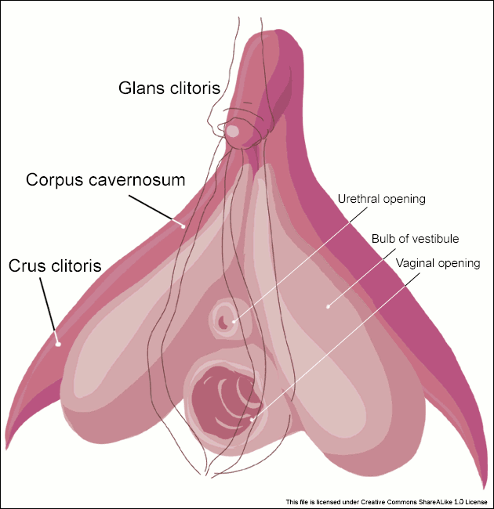
external organs
Clitoris
The clitoris, a small, sensitive protrusion that is comparable to the penis in males.
The clitoris is covered by a fold of skin, called the prepuce, which is similar to the foreskin at the end of the penis.

Slide 14
external organs
Mount of Venus
It is a fat pad that rests on the front of the woman's pubic symphysis.

Slide 15
external organs
Bartholin's glands
Are two glans located slightly posterior and to the left and right of the opening of the vagina. They secrete mucus to lubricate the vagina and are homologous to bulbourethral glands in males.

Slide 16
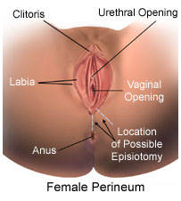
external organs
Meatus
The meatus is located between the clitoris and the vagina in the vulvular vestibule of the female genitalia.
Meatus

Slide 17
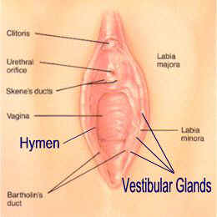
external organs
Hymen
Is a membrane that surrounds or partially covers the external vaginal opening.
The size of the hymenal opening increases with age.

Slide 18
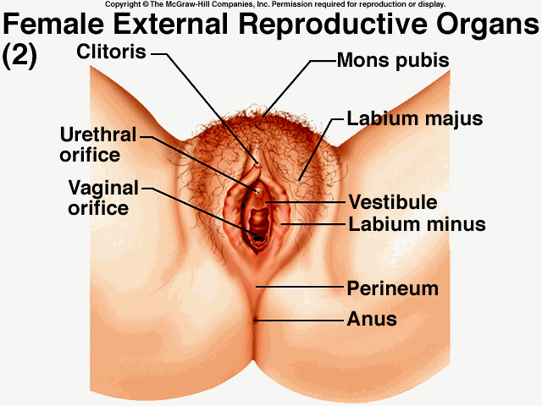
external organs
The perineum is the short stretch of skin starting at the bottom of the vulva and extending to the anus.
Perineum

Slide 19
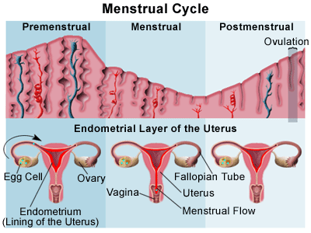
MENSTRUAL CYCLE

Slide 20
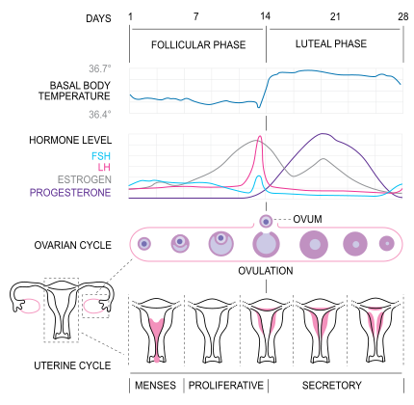
Menstrual Cycle
It´s the scientific term for the physiological changes that can occur in fertile women.
It´s Under the control of the endocrine system is necessary for reproduction.

Slide 21
Follicular Phase
Ovulation
Luteal Phase
PHASES

Slide 22
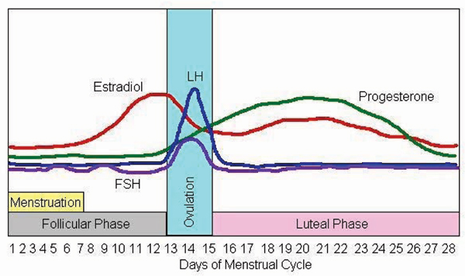
Follicular Phase
Development of follicles in the ovaries.
Phases

Slide 23
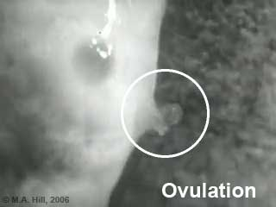
OVULATION
Begins when the level of luteinizing hormone surges.
Phases

Slide 24
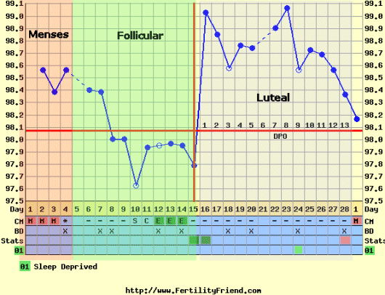
Luteal Phase
The ruptured follicle closes after releasing the egg and forms a structure called a corpus luteum, which produces increasing quantities of progesterone.
Phases

Slide 25
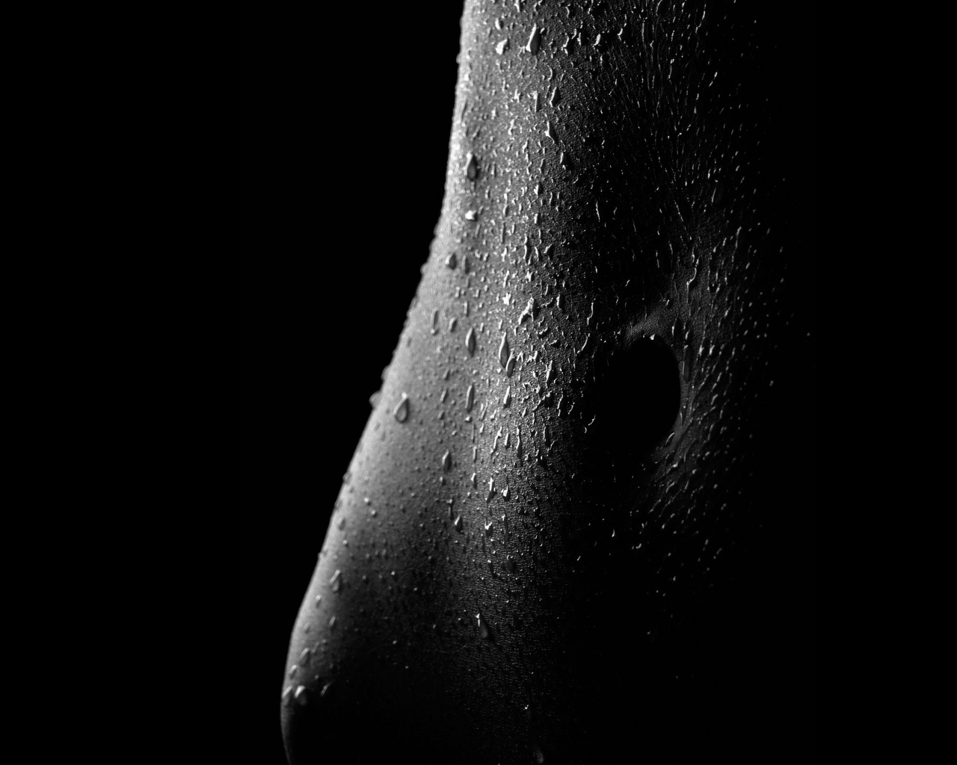
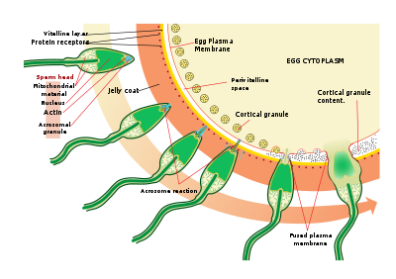
FERTILIZATION
Sperm Capacitation
Sperm Zona Pellucida Binding
The Acrosome Reaction
Penetration of the Zona Pellucida
Sperm Oocyte Binding
Egg Activation and Cortical Reaction
Reaction Zona

Slide 26
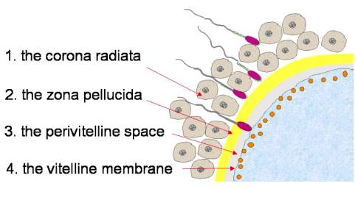
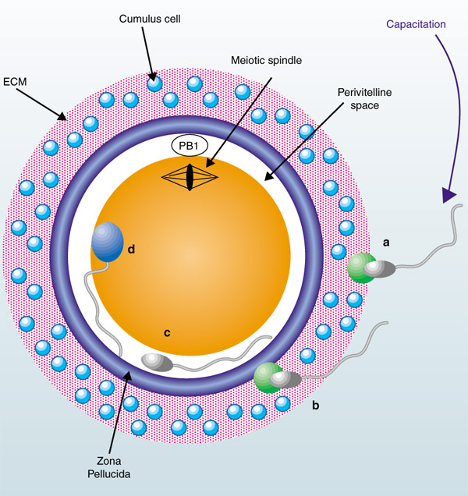
SPERM CAPACITATION
Freshly eyaculate semen undergoes to a series of changes, called capacitation.
This process removes proteins and lipids in the plasma membrane.
SPERM-ZONA PELLUCIDA BINDING
Binding of sperm to the zona pellucida is a receptor-ligand interaction with a high degree of species specificity.
The carbohydrate groups on the zona pellucida glycoproteins function as sperm receptors.

Slide 27
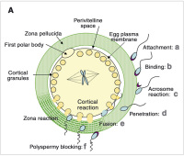
Acrosome Reaction
The acrosome is a modified lysosomal, that contains digestive enzymes in the sperm head, this allows the sperm to penetrate the zona pellucida.
Penetration of The Zona Pellucida
The constant propulsive force from the sperm's flagellating tail, in combination with acrosomal enzymes, allow the sperm to create a tract through the zona pellucida.

Slide 28
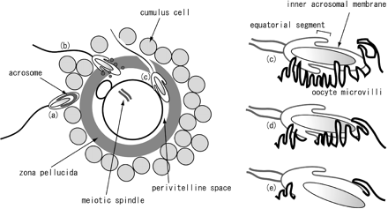
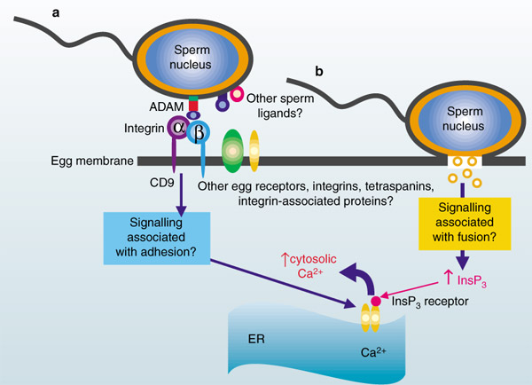
EGG ACTIVATION AND CORTICAL REACTION
Upon binding of a sperm, the egg rapidly undergoes a number of metabolic and physical changes that collectively are called egg activation. Prominent effects include a rise in the intracellular concentration of calcium, completion of the second meiotic division and the so called cortical reaction.
SPERM-OOCYTE BINDING
Occurs after the sperm penetrates the zona pellucida, which binds and fuses with the plasma membrane of the oocyte.

Slide 29
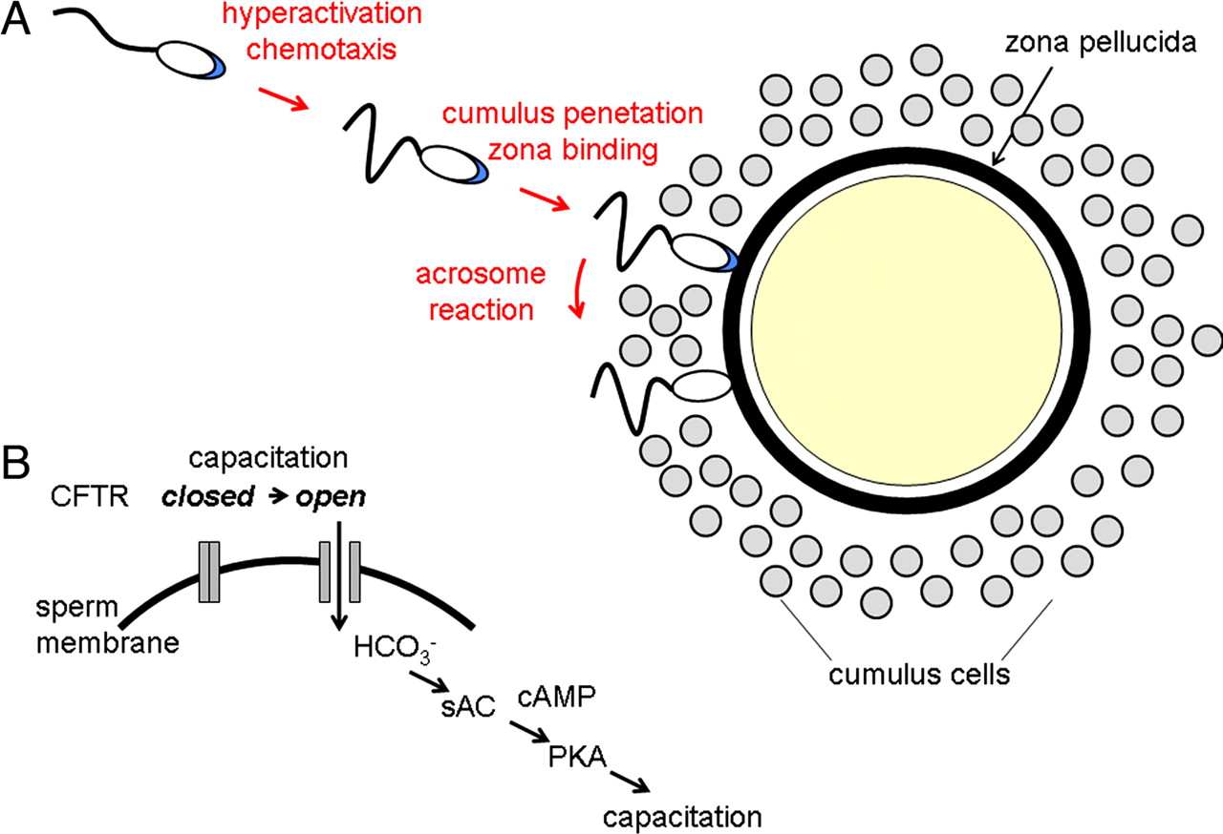
THE ZONA REACTION
The zona reaction refers to an alteration in the structure of the zona pellucida catalyzed by proteases from cortical granules. This effect is the result of two measurable changes induced in the zona pellucida:
1. The zona pellucida hardens
2. Sperm receptors in the zona pellucida are destroyed.

Slide 30
EMBRYONIC DEVELOPMENT
Morula Stage
Gastrula Stage
Neurula Stage
Blastula Stage

Slide 31
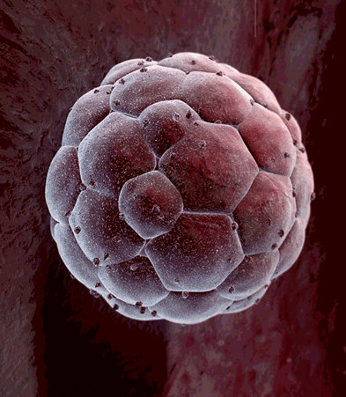
MORULA STAGE
Embryo at an early stage of embryonic development, is produces by the rapidly division of the zygote.

Slide 32
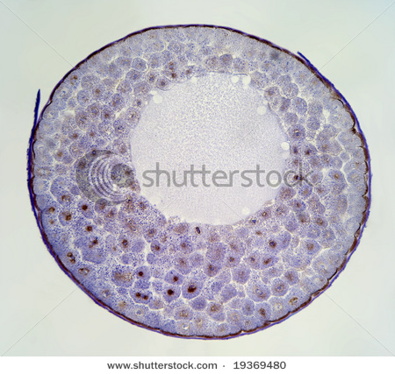
BLASTULA STAGE
Hollow sphere of cells, is created when the zygote undergoes cell division process. It consists of a layer of blastomeres, known as the blastoderm.

Slide 33
GASTRULA STAGE
Phase in wich the blastula is divided into three layers: ectoderm, mesoderm and endoderm

Slide 34
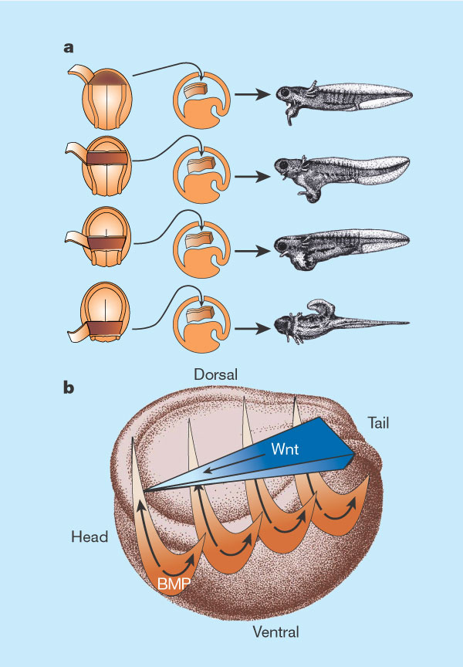
NEURULA STAGE
In this stage the nervous system is formed. Remaining tissue will develop into the spinal cord.

Slide 35
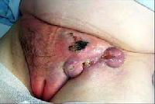
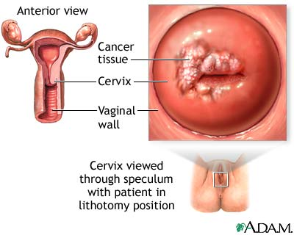
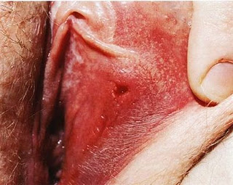
COMMON DISEASES
Vaginal Cancer
Abnormal cancerous growth in the tissue of vagina. Is most common in women whos are between the ages of 60 adn 80.
Cervical Cancer
Cervical cancer is a disease in which cells of the cervix become abnormal forming tumors. The 90% of cases of cervical cancer is caused by the Papillomavirus.
Trichomaniasis
It’s a microscopic parasite. Is one of the most common sexually transmitted diseases, mainly affecting sexual active women.
Herpes
It’s a viral infection , the virus is spread during sexual contact with an infected person who is secreting the virus.

Slide 36
THANKS!!!

