Slide 1
Universidad Autónoma de Chiriquí
Medicine Faculty
Medical Emergencies School
Subject:
Scientific English
Abbreviation:
120B
Instructor:
Marisol Barraza M.Sc.
Students:
Giovana Della Sera 4-764-2423
María Sáenz 4-764-2020
Alvaro Gómez 4-763-152
Angie Cedeño 4-766-585
Presentation group project:
“Bleeding”
Date:
November 14, 2011

Slide 2
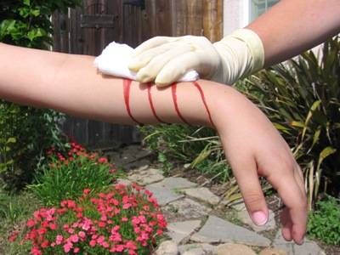
Bleeding
Internal and External Bleeding
(Hemorragias internas y externas)

Slide 3
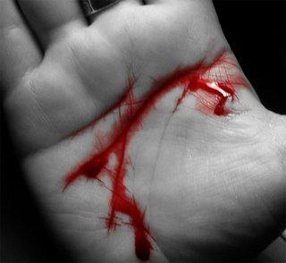
TABLE OF CONTENTS
Glossary
Internal Bleeding:
Definition
Signs and Symptoms
Causes
First Aid Treatment
3. External Bleeding
Definition
Signs and Symptoms
Causes
First Aid Treatment
4. Equipment and medication
5. Bibliography

Slide 4
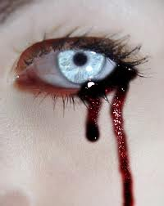
Glossary
Life-Threatening: Amenazan la vida
Blood Vessel: Vaso sanguíneo.
Reassure the victim: Mantener a la victima calmada
Spurts with each beat of the heart: Chorros con cada latidos del corazón
Almost maroon in shade: Tonalidad marrón.
Oozing:.Exudación.
Higher risk: Mayor riesgo
Rag: Trapo.
Steady Flow: Flujo constante
Soaked with blood: Empapado de sangre
While a bandage: Mientras que un vendaje
Such as roll gauze: Tales como rollos de gasas.
Major bleeding: Hemorragia Grave
Swollen: Hinchada
Penetrated the chest or abdomen: Penetró en el pecho o abdomen.
Moist skin: La piel húmeda
Appears to be a simple bruise: Parece ser un simple edema
Loosen Tight-fitting clothing: Afloje la ropa ajustada.
Simple Bruise: simple edema

Slide 5
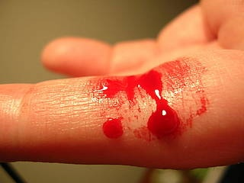
External Bleeding
( Hemorragia externa)

Slide 6
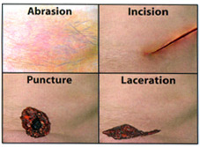
External Bleeding
It is usually associated with wounds.
Serious wounds involve damage to blood vessels.
Damage to an artery is characterized by bright red blood which can spurt with each heartbeat.
Damage to veins appears as a darker red and tends to flow.
Capillary damage is associated with wounds close to the skin and is a bright red and oozes.
A wound is caused when our body tissue is torn or cut.
Types of wounds include: amputations

Slide 7
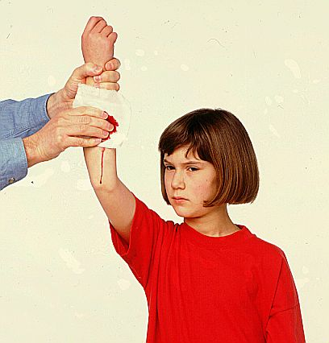
Signs and Symptoms
Recognizing external bleeding is usually easy:
The presence of blood should alert you.
Blood may be underneath or behind a victim.
It may be difficult to find the source of bleeding.
If there is more than 5 cups of bleeding, then the situation is life-threatening.

Slide 8
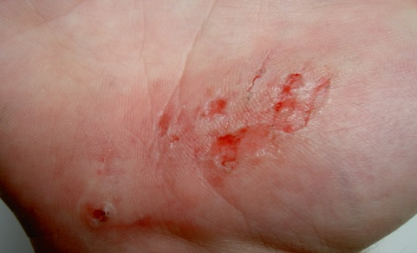
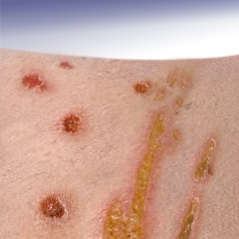
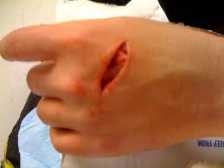
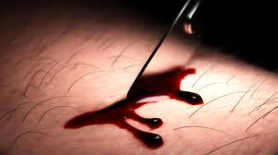
Most common Causes
Abrasion -Caused by superficial damage to the skin,
no deeper than the epidermis.
Excoriation- An injury to a surface of the body caused by trauma, such as scratching, abrasion, or a chemical or thermal burn
Laceration - It may be caused by a tear in the skin
which results from an injury or by blunt impact to
soft tissue.
Incision - Caused by a sharp object, such as a knife.

Slide 9
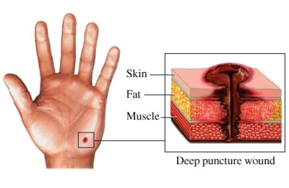
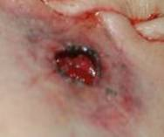
Puncture Wound - Caused by an object penetrated the skin and underlying layers, such as a nail, needle or knife.
Gunshot wounds - Caused by a projectile weapon. There may be two wounds,
one at the site of entry and one at the site of exit.

Slide 10
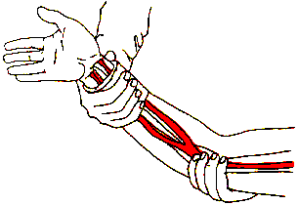
First Aid Treatment
While wearing gloves, remove any obvious dirt from the wound.
Apply pressure directly on the wound until the bleeding stops
Don't remove the gauze or bandage.
Squeeze a main artery if necessary.
Immobilize the injured body part.

Slide 11
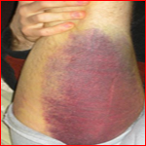
Internal Bleeding
( Hemorragia interna)

Slide 12
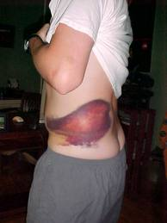
Internal bleeding
It is when damage occurs in an artery or vein to allow blood to escape the bloodstream and accumulate inside the body.
It can be a serious medical emergency depending on where it occurs (e.g. brain, stomach, lungs).
It can potentially cause death and cardiac arrest if proper medical treatment is not received quickly.

Slide 13
Signs and Symptoms
When it does not stop spontaneously, the loss of blood will cause hemorrhagic shock which can lead to brain damage and death.
Bleeding from body cavities.
Vomiting or coughing up blood.
Bruising on neck, chest, abdomen or side.
Abdominal tenderness, possibly accompanied by rigidity or spasm of abdominal muscles.
Blood is in the urine.
Pain over vital organs.

Slide 14
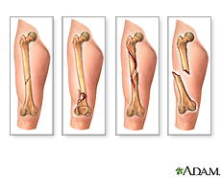
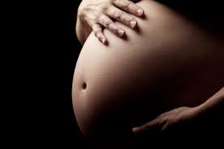
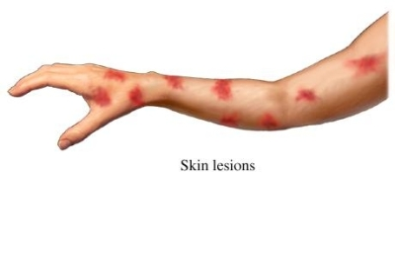
Most common causes
The most common cause of internal bleeding is carcinoma (cancer), either of the gastro-intestinal tract or of the lung, or more rarely of other organs such as the prostate, pancreas or kidney.
Fracture: Bleeding may occur with broken bones.
Pregnancy: Bleeding in pregnancy is never normalis a sign of a potential miscarriage.
Spontaneous bleeding: Occur especially in those
people who take anticoagulation medications.
High speed deceleration in an automobile
accident (contusions)

Slide 15
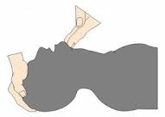
First Aid Treatment
The initial treatment plan of any patient with internal bleeding begins with assessing the patient's stability and making certain the ABCs are well maintained.
Call an ambulance.
Treat for shock.
Assist the victim into the most comfortable position
Monitor ABCs and vitals until the ambulance arrives

Slide 16
First Aid Treatment

Slide 17
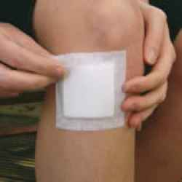
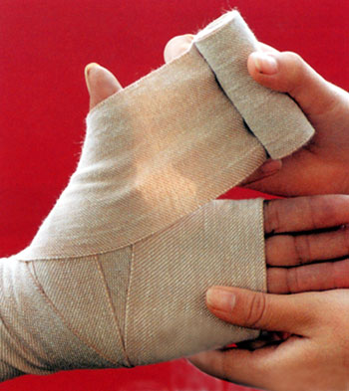
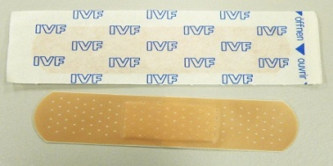
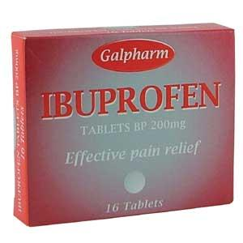
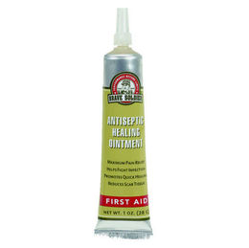
Equipment and Medication (Equipo y medicación)
Dressing: Used for application to a wound to promote healing
and/or prevent further harm.
Bandage: used either to support a medical device such as a dressing or splint, or on its own to provide support to the body.
Adhesive bandage: Used to treat minor injuries.
Acentaminophen or ibuprofen: For pain relief and for
inflammartory the process.
Antiseptic Healing Ointment: Use to clean and prevent
the infection of the wound.

Slide 18
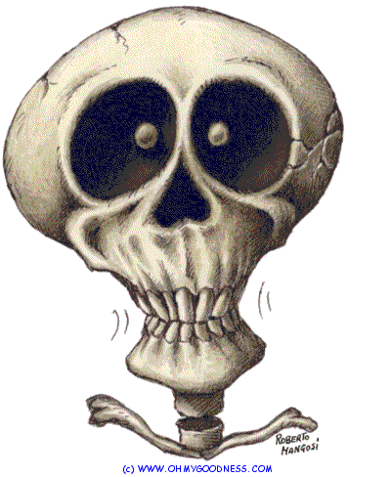

Slide 19
Bibliography
http://www.medicinenet.com/internal_bleeding/article.htm internal bleeding
http://en.wikipedia.org/wiki/Internal_bleeding internal bleeding
http://www.medicinenet.com/internal_bleeding/page5.htm external bleeding
http://en.wikibooks.org/wiki/First_Aid/Internal_Bleeding First aid for treatment.
http://www.medicinenet.com/internal_bleeding/article.htm Causes of internal bleeding
http://firstaid.webmd.com/cuts-or-lacerations-treatment medications for bleeding.

