Slide 1
Diabetic Emergencies ~Emergencias Diabéticas~
Elaborated by:
Espinosa, Richard 4-763-885
Fuentes, Kevin 4-769-2097
Madrid, Yenesis 4-761-289
Serracín, Karina 4-765-1016

Slide 2
Index
Definition of Diabetic Emergencies
Glossary
Types of Diabetic Emergencies
Insulin Reaction (Insulin Shock)
Signs and Symptoms
Causes
Consequences
Diabetic Coma
Signs and Symptoms (hyperglycemia/Hypoglycemia)
Causes
Recognizing Diabetic Emergencies
First Aid Treatment
Equipment and Medication
Bibliography

Slide 3
Definition of a Diabetic Emergency
Occurs when there is a severe imbalance between the amount of insulin and sugar.
People with this condition take insulin to control it.
Is important to recognize between two serious conditions:
Hypoglycemia: low blood sugar
Hyperglycemia: high blood sugar

Slide 4
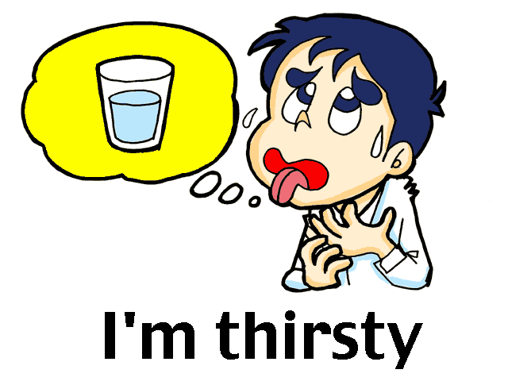
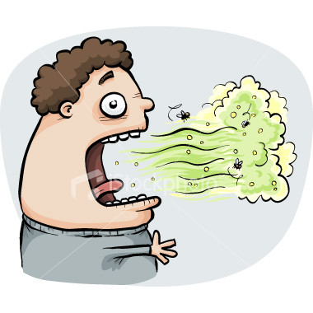
Glossary
Increased thirst:
aumento de sed
Frequent urination:
frecuentes ganas de orinar
Fruity breath odor:
aliento con olor a fruta

Slide 5
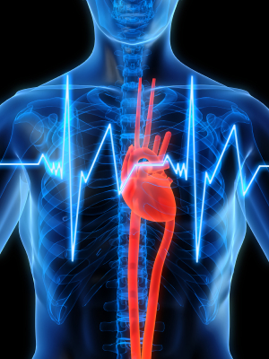
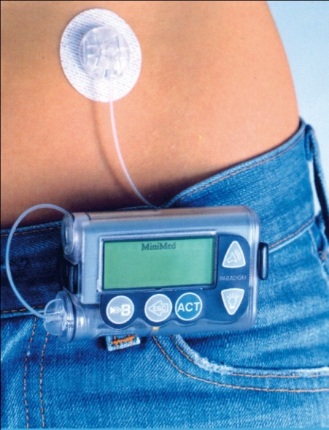
Glossary
An irregular or racing
heartbeat: ritmo cardiaco
irregular-taquicardia
Insulin delivery problems:
problemas de administración
de insulina
Faintness: Debilidad

Slide 6
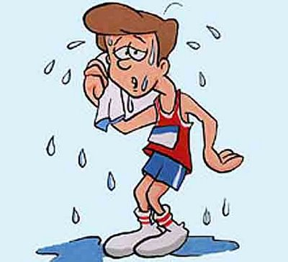
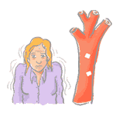
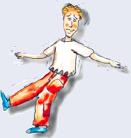
Glossary
Pale: pálido
Sweating: sudoroso
Trembling: tembloroso
Unsteady walk:
Marcha inestable

Slide 7
Types of Diabetic Emergencies
Insulin Reaction (insulin shock)
Diabetic Coma

Slide 8
Insulin Reaction (Insulin Shock)
An insulin reaction occurs when a person with diabeties becomes confused or even unconscious because of :
hypoglycemia (hypo=low + glycol = sugar + emia = in the blood)

Slide 9
Signs and Symptoms
Pale , sweaty skin
Headache, trembling
Fast Breathing
Weakness, drowsiness
Insulin SHOCK
Numbness in hand or feet
Rapid pulse
Hunger
Odorless breath

Slide 10
Causes of Insulin Reaction
Severe hypoglycemia
Little physical exercise
Consequences
Ketoacidosis
Diabetic coma

Slide 11
Diabetic Coma
A life-threatening diabetes complication that causes unconsciousness.
Can be fatal if not taken proper treatment.
Measures should be taken to help prevent diabetic coma, following your diabetes treatment plan.

Slide 12
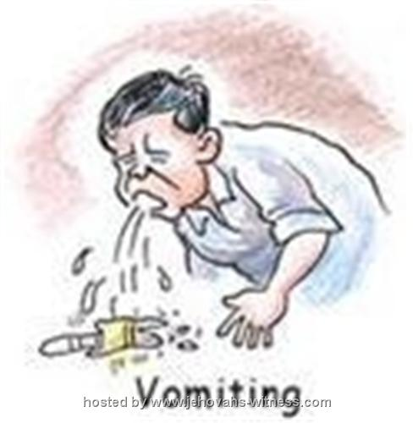
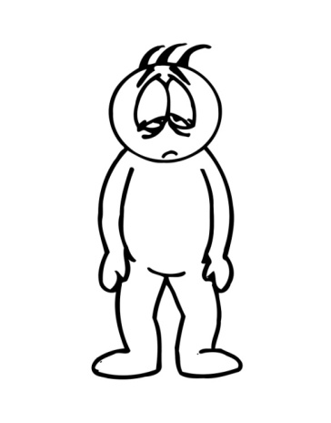
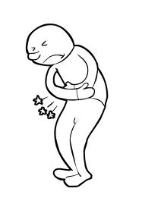
Signs and Symptoms
High blood sugar (hyperglycemia)
Increased thirst
Frequent urination
Shortness of breath
Fruity breath odor
Fast heartbeat
Nausea and vomiting
Fatigue
Stomach pain

Slide 13
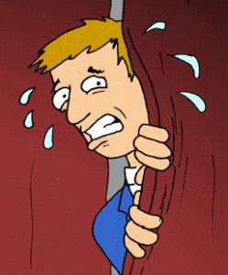
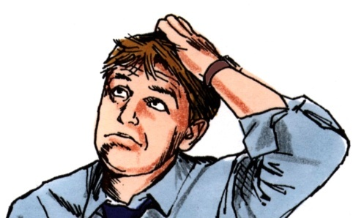
Signs and Symptoms
Low blood sugar (hypoglycemia)
Sweaty
Hungry
Nauseated
An irregular or racing heartbeat
Hostile or aggressive
Confused
Shaky or nervous
Irritable
Tired

Slide 14
Diabetic Coma Causes
Factors that increase the risk of diabetic coma:
A complication in the pipe of the insulin pump.
An illness, trauma or surgery.
Not controlled blood sugar level.
Do not use their insulin.
Drinking alcohol.
Illegal drug use.

Slide 15
Recognizing a Diabetic Emergency
Conscious, the casualty will be able to tell you what’s wrong (may be confused).
Unconscious, the casualty may wear a bracelet or necklace that will tell you that he has diabetes.
Looking at the signs and symptoms.

Slide 16
First Aid Treatment
For both conditions is the same treatment:
Unconscious:
Call 911
Place the person horizontally (on a flat surface)
Check breathing, pulse and circulation (monitor ABC’s)
Administer CPR until the medical professional came
Conscious:
Get him/her sugar or prescribed medication
Give him/her something to eat or drink
Seek medical assistance

Slide 17
Equipment and Medication
Two types of drugs:
oral medications (tablets: Pills for diabetes are insulin.)
injections of insulin.
Currently, all diabetes pills belong to five classes of drugs:
Sulfonylurea
Meglitinidas
Biguanidas
Tazolidinedionas
Alfa-glycosidase inhibitors
They work in different ways to reduce the level of glucose in the blood.

Slide 18
Equipment and Medication
Insulin Pumps (Benefits):
Helps people with diabetes achieve more flexibility in their lifestyles .
Maintain the control of their blood glucose levels.
They administers a basal rate of insulin continuously.

Slide 19
Bibliography
Diabetic Emergencies: http://www.survival-center.com/firstaid/diabetic.htm (Guide)
When to go to the ER: http://diabetes.about.com/od/symptomsdiagnosis/a/emergencycare.htm
What to do in a medical emergency: http://www.emergencycareforyou.org/EmergencyManual/WhatToDoInMedicalEmergency/Default.aspx?id=230
Diabetic Emergencies: http://tcm.health-info.org/Common%20Diseases/diabetes/diabetic-emergencies.htm
Avoiding Diabetic Emergencies: http://www.everydayhealth.com/diabetes/diabetic-emergencies.aspx

