Slide 1
A FLIP CHART
BY: MARISOL BARRAZA

Slide 2
DEFINITION
A flip chart is a collection of large pages which are bound together at the top.
The pages are “flipped” or brought up and to the back as they are used.

Slide 3
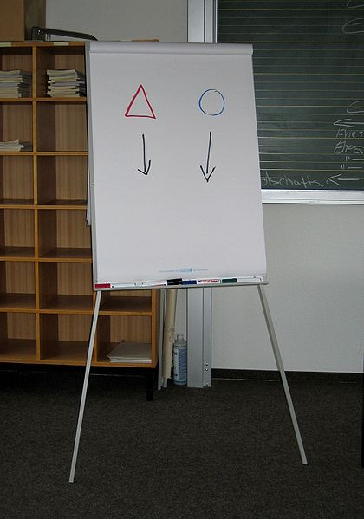

Slide 4
TEACHING
Flip charts are a useful teaching aid.
They are useful in teaching situations where you need to teach a number of people at a time.

Slide 5
WHEN TO USE
No power
Teach a number of students at a time
Books are unavailable, scarce, or too expensive for individuals to have their own copy.
Other media such as overheads and slides are not available.

Slide 6
HOW TO USE
Placed on an easel
Teacher stands beside the flip chart
As each page is finished, the teacher flips it over to the back

Slide 7
ADVANTAGES
Simple, easy to use
Inexpensive
Don´t need electricity
Portable
Can be pre-prepared saving you valuable class time
Allow spontaneity
Can be used to illustrate information so that the students can follow the sequence.
Sheets can be reused, if you store them appropriately

Slide 8
ADVANTAGES
9. Color markers can be used to emphasize information
10. Sheets can be changed easily.
11. Sheets can be removed from the pad and hung around the room, keeping important points in front of the audience or allowing them to continually review information.

Slide 9
DISADVANTAGES
Ink may bleed through sheets, causing waste or creating material that is difficult to read.
Unless the charts are pre-prepared, they can look sloppy.
Sheets are fragile and can be torn easily.
Reused sheets tend to look shabby over time, especially if they're not stored correctly.

Slide 10
WHY USE FLIP CHARTS IN THE CLASSROOM
Discussion outlines
Parts of a lesson
Primers
Songs
Stages of a process
Steps of a procedure
Stories
Textbooks

Slide 11
SUGGESTIONS
Flip chart stand
Make sure the flip charts you use fit the flip chart stand.
Some have different spaced holes at the top.

Slide 12
2. Writing
Design your charts on paper first before drawing them on the actual flip chart pad
Use drawings when possible
Graph the paper before you write (pencil)
Leave 4cm margins
Lightly write your text in pencil first before using the actual flip chart markers.
This will allow you to make any adjustments with text spacing and any figures you will be drawing.

Slide 13
Do NOT use all block letters (UPPER CASE).
Upper case letters should be at least two inches tall.
Using upper and lower case letters makes it easier to read.
Use the 7 x 7 rule. Have no more than 7 words on each line and no more than 7 lines to a sheet.

Slide 14
3. Markers
Use flip chart markers
Will not "bleed" through the paper.
4. Colors
Avoid yellow, pink, or orange
Extremely difficult to see.
Avoid too many colors.
One dark color and two accent color works best.
Use red to high light only
Underline or change colors for emphasis

Slide 15
5. Teacher Notes
Write "lightly in pencil" next to key points you need.
The audience won't be able to see them.
Write what is on the next sheet.
Knowing this will allow you to properly introduce your next sheet.
6. Mistakes
Cover with a double layer of flip chart paper and correct the error.
Pointers
Use a pointer to point to information

Slide 16
8. Blank sheets
Have a blank sheet of paper between each of your text sheets.
This will keep the new information hidden from your students.
9. Storing
Properly store and transport your flip charts in a case or a cardboard box.
This will protect your flip charts and keep them fresh and ready to use each time.

Slide 17
Preparation
Prepare your flip charts in advance
Making "prepared" flip charts can take a considerable amount of time.
Review them and make any changes or corrections before hand.
It takes practice to learn how to print neatly. If you do not have neat printing, ask someone who does prepare them for you.
A poorly prepared flip chart can be very distracting.

Slide 18
DECORATE YOUR FLIP CHARTS
Use:
Brightly color markers (3 per page)
Large stencils
Large stickers

Slide 19
QUESTIONS ?

