Slide 1
kinds of natural phenomena by : Lorena mora

Slide 2
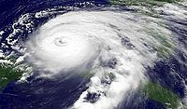
huracane
A hurricane is a storm system cyclical low pressure forms over the oceans. It is caused by the evaporation of sea water rises to become storm. The Coriolis effect causes the storm to turn, becoming a hurricane if it exceeds 110 km / h. In different parts of the world hurricanes are called cyclones or typhoons. The most destructive hurricane was Hurricane Andrew, which hit southern Florida in 1992. In Guatemala there was a collapse of land following the Storm Agatha, in zone 2 capital.

Slide 3
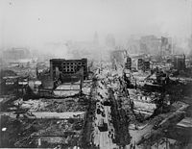
earthquake
It occurs in the tectonic plates of Earth's crust. On the surface, as manifested by movement or shaking of the soil, and can greatly damage poorly constructed structures.
Earthquakes are unpredictable. They are capable of killing hundreds of thousands of people as the Tangshan earthquake of 1976, the Indian Ocean earthquake of 2004 and the great earthquake of Valdivia in 1960 of 9.6 degrees on the richter scale, the most powerful on record.

Slide 4
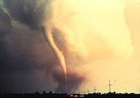
tornado
A tornado is a natural disaster resulting from a storm. Tornadoes are violent currents of wind that can blow up to 500 km / h. They may appear singly or in outbreaks along the storm front line. The tornado crossed fastest on record Moore, Oklahoma on May 3, 1999. The tornado reached gusts of 500 km / h was the hardest ever recorded.

Slide 5

tsunami
A tsunami or tidal wave is a tidal wave of water that reaches the shore with a height greater than 15 meters. It comes from the Japanese words for harbor and wave. Tsunamis can be caused by undersea earthquakes as the Indian Ocean earthquake of 2004, or by landslides such as occurred in Lituya Bay, Alaska. The tsunami produced by the Pacific Ocean earthquake in 2004 broke all records, the most deadly in history.

Slide 6
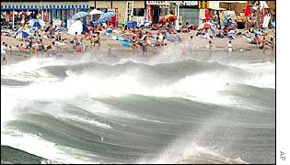
tides
Is the periodic change in sea level, produced mainly by the gravitational force exerted by the Moon and the Sun Other phenomena can cause variations in sea level.

Slide 7
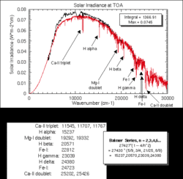
Solar radiation
Solar radiation is the set of electromagnetic radiation emitted by the Sun

Slide 8
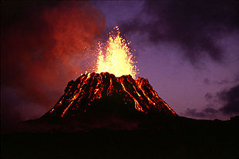
volcanoes
A volcanic eruption is a violent emission at the surface or from another planet, material from inside the volcano. Except for the geyser, which emit hot water, and mud volcanoes which matter, largely organic, comes from hydrocarbon deposits relatively close to the surface, eruptions are due to terrestrial volcanoes.

Slide 9
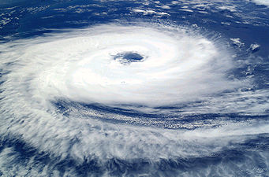
huracan
Is a storm system characterized by a closed circulation around a low pressure center that produces strong winds and heavy rain. Tropical cyclones derive their energy from the condensation of moist air, producing strong winds.

Slide 10
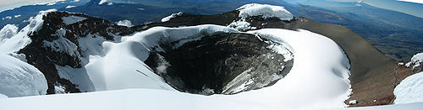
craters
Are the openings or mouths of eruption of volcanoes usually located at their peaks.
The CRATER often takes the form of an inverted cone excavated by eruptions at the top of the volcano

Slide 11
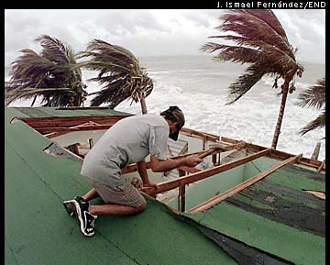
wind
Is the mass movement of air in the atmosphere. Günter D. Roth is defined as compensation of differences in atmospheric pressure between two points

Slide 12
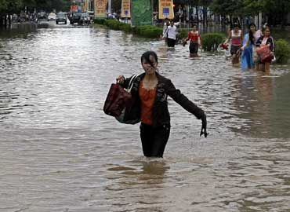
rain or flood
A mist or flood is the "invasions" of water in a territory. Floods happen because of logging and the planting of monocultures, the diversion of rivers, land reclaimed from the sea or lakes, or rivers.

Slide 13
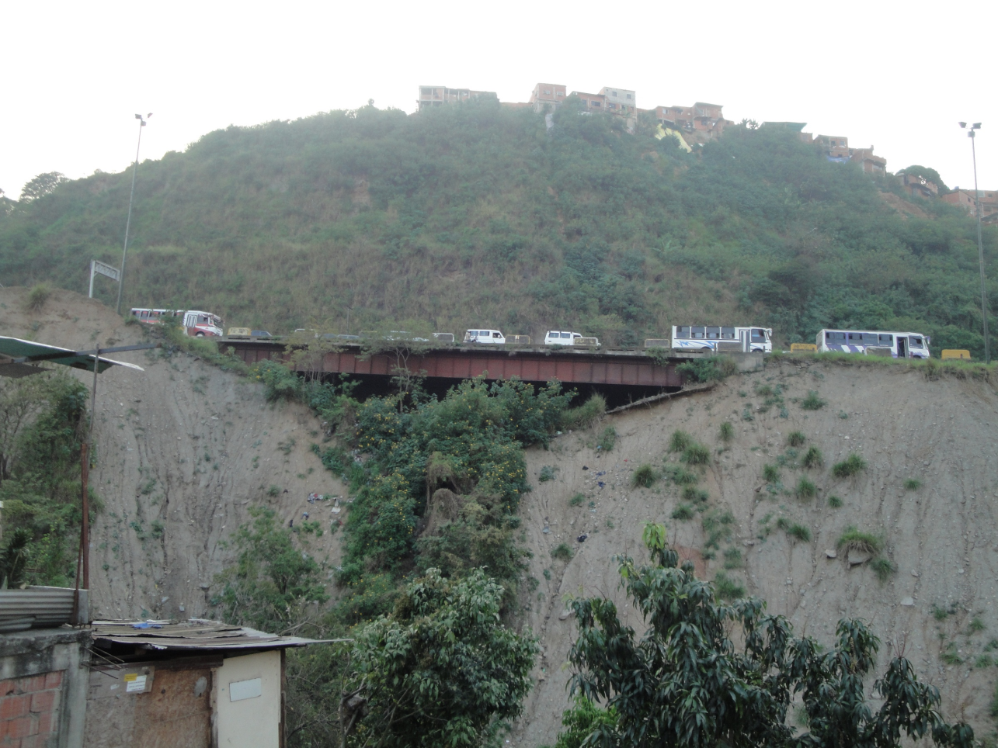
quicksand
Quicksand is a colloid hydrogel consisting of a mixture of finely granular material (such as sand or mud), clay and water.
The shifting sands are fluid at the time that they are not disturbed by an external agent, usually appears as a solid but less change in tension in the sand, causing a sudden drop in viscosity causing any object or person sink

Slide 14
Thanks for your attention
☺….☺….☺….☺

