Slide 1
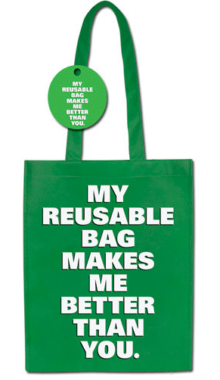
REUSE
Much of the waste can immediately be reused to minimize the strain on the environment and municipal waste management. For example, consumers can refill a purchased bottle of water with water from home to minimize the number of plastic bottles being discarded.

Slide 2
1- Repair is a method of taking an item, which may appear to have lived its useful life, and fixing it so that it can still be productive. 2- Remanufacturing and refurbishing are ways of taking some used components and some new components to "rebuild" an item.
Forms of reusing

Slide 3
Paste here drawings of elements that you consider can be reused:

