Slide 1
She got a body like an hourglass, But I can give it to you all the time She got a booty like a Cadillac, But I can send you into overdrive (oh) (Stop and wait, wait for that, Stop, hold up, swing your bat)

Slide 2
See anybody could be bad to you, You need a good girl to blow your mind, yeah

Slide 3
Bang bang into the room (I know you want it) Bang bang all over you (I’ll let you have it) Wait a minute let me take you there (ah) Wait a minute tell you (ah)

Slide 4
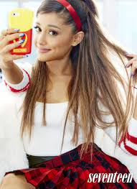
Bang bang there goes your heart (I know you want it) Back, back seat of my car (I’ll let you have it) Wait a minute let me take you there (ah) Wait a minute tell you (ah)

Slide 5
[Ariana Grande] She might've let you hold her hand in school, But I'mma show you how to graduate No, I don't need to hear you talk the talk, Just come and show me what your momma gave (Oooh yeah) (Your love gotta be baby, love but don’t say a thing) See anybody could be good to you, You need a bad girl to blow your mind

Slide 6
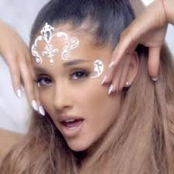
[Jessie J] Bang bang into the room (I know you want it) Bang bang all over you (I’ll let you have it) Wait a minute let me take you there (ah) Wait a minute tell you (ah) Bang bang there goes your heart (I know you want it) Back, back seat of my car (I’ll let you have it) [ De: http://www.dicelacancion.com/letra-bang-bang-jessie-j ] Wait a minute let me take you there (ah) Wait a minute tell you (ah)

Slide 7
[Nicki Minaj] It’s Myx Moscato It’s frizz in a bottle It’s Nicki full throttle It’s oh, oh Swimming in the grotto We winning in the lotto We dipping in the pot of blue foam Kitten so good It's dripping on wood

Slide 8
Get a ride in the engine that could Go, Batman robbin' it Bang, bang, cockin' it Queen Nicki dominant, prominent It's me, Jessie, and Ari If they test me they sorry Riders look like a Harley Then pull off in this Ferrari If he hanging we banging Phone ranging, he slanging It ain’t karaoke night But get the mic ‘cause he singing

Slide 9
[Jessie J] B to the A to the N to the G to the uh B to the A to the N to the G to the hey See anybody could be good to you, You need a bad girl to blow your mind (your mind)

Slide 10
Bang bang into the room (I know you want it) Bang bang all over you (I’ll let you have it) Wait a minute let me take you there (ah) Wait a minute tell you (ah) Bang bang there goes your heart (I know you want it) Back, back seat of my car (I’ll let you have it) Wait a minute let me take you there (ah) Wait a minute tell you (ah)

Slide 11
[Nicki Minaj] Bang, bang, bang, bang, bang, bang, bang...

