Slide 1
The Northern Corridor Partnership Second Forum Tuesday 11th October 2011
Tom McCue & Geoff Timm
Partnership Brokers
Queensland Youth Industry Links

Slide 2
Notes:
The cause of the problem

Slide 3
Notes:
Disproportionate jobs focus on Brisbane. Moreton doesn’t share the growth of Brisbane and Sunshine Coast, because of the 57% that work to the south of the region.
Why doesn’t it keep pace with the Sunshine Coast?? Because, in its own way it is a dormitory region for Brisbane.
As the SC gets ‘ furhter away from Brisbane in travel time, more people seek, and perhaps, find work within the region.

Slide 4
Notes:
Here it is in another guise. Yes. Disproportionate number of jobs in Brisbane. It’s the fact that it is the Economic engine that is creating the issue in the transport corridor

Slide 5
Notes:
Why the development has to be in SEQ . The last sentence is the salient point

Slide 6
Notes:
Two main centres stand out: Inner Brisbane and ATC. Is more infrastructure required NOW? You have all travelled on the Bruce highway and Gateway motorway.. Some of the constraints are, a central river that inhibits transport from the south to ATC, from the west, and a flood of traffic into the CBD each morning from all directions. Try getting into Brisbane central from SC at 7.00am in less than 1.5 hours. It takes 1.75 hours by train from Landsborough not including a 15 min drive from Mooloolaba to get to Roma street. Say 2 hrs, door to door. That is each day. It’s even longer and more difficult to get to the ATC from the north. You can get a train from Roma st to Airport, at $15 each way, and a further 20 min trip.

Slide 7
Notes:
So, what impact do increasing travel times have on job uptake? - what do the figures mean? People like to live within 45 min of work & 15 min from the shops. (or have travel routes that enable them to travel significant distances in a short time, rather than the other way around.)

Slide 8
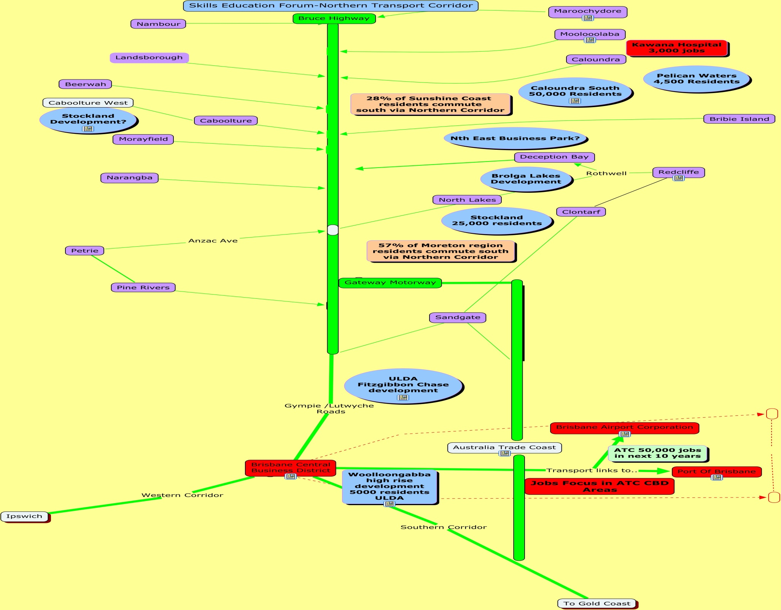
Notes:
Now this is all my own work. Green vertical line is Bruce h’way, towns are in purple, new developments with some indicators of population size are blue and the major areas for employment are in red

Slide 10
To summarise..
Residential development
Sunshine Coast.
Pelican Waters 4,500 new residents
Caloundra South 50,000 new residents
27% of Sunshine Coast residents commute to the South each day
Notes:
Do we think this percentage will increase?

Slide 11
Residential development
Moreton Region.
Caboolture West
Caboolture Central
Further development planned for the Morayfield/Burpengary area
Brolga Lakes
Northlakes 25,000 new residents
57% of Moreton residents commute to the south each day
Notes:
When you talk to council in MBRC, they cannot put a figure yet on the size of the Caboolture Central development.
As a result of the jobs development in Brisbane and the ATC, do we think this percentage will increase?
Population growth says yes. because bris and ATC is where the jobs are.
So, population in SC and Moreton increases, but the bulk of the jobs are in Brisbane.

Slide 12
Expansion of the rail network
rail network extensions from Petrie to Kippa-Ring; Beerwah to Maroochydore
double public transport mode share from 7% to 14%
decrease the share of trips by private vehicles from 83% to 66%
Even by meeting this target the overall number of trips on the road system will grow by 19%
This will add 2.8 million extra trips each day by 2031.

Slide 13
Where will they all park when
they get to their destination?
Notes:
Can you imagine where the Anzac Ave morning bottleneck will start then? Where will they all park when they get to their destination

Slide 14
The current purpose was agreed to be….
‘To work with organizations to effect change, garner support & encourage them to share their knowledge in order to influence other decision makers around economic & livability issues & integrated, sustained growth along the Northern Growth Corridor’.

Slide 15
How do we go about this?
What happens next?

Slide 16
Short term actions & goals
What are you going to do/ want to see and how will it get accomplished?

Slide 17
Long term actions & goals
Timeframes
Responsibilities

Slide 18
Will you conduct a forum at a higher level and what would be its purpose?
Will it make a difference?

