Slide 1
School Business Community Partnership Brokers Program
Moreton Bay Region
Notes:
7.10 am. GT addresses meeting with

Slide 2
Bridgework Employment & Training
Brisbane Catholic Education
Busy @ Work
Caboolture State High School
Caboolture Business Enterprise Centre
Clontarf Beach State High School
Construction Skills Queensland
Dakabin State High School
Department Employment Economic Development and Innovation
St Columbans Catholic College
Department of Education and Training
Department of Education
Morayfield State High School
Moreton Bay Regional Council
MW Training
North Lakes College
Pine Rivers State High School
Redcliffe Community Association
Regional Development Australia
Department of Education, Employment and Workplace Relations
Southern Cross Catholic College
The Hornery institute
The Smith Family
Tullawong State High School
Worklinks
Manufacturing Skills Queensland
Notes:
Geoff to thank all attendees
‘Welcome to Country’
An acknowledgement of full attendance (indication of interest in and support for our important initiative)
A summary of the agenda items
Walks group through the slides 1, 2, 3 &4

Slide 3
Partnership Brokers
National Partnership on Youth Attainment and Transitions
School Business Community Partnership Brokers, Youth Connections
Establishment of the Partnership Brokers program is based on the principle that support for young people is the collective responsibility of governments, education and training providers, business and industry as well as parents and families, and the broader community.
The Partnership Brokers network must build strategic partnerships that deliver outcomes for four key stakeholder groups.
Education and training providers Business and industry | Parents and families Community groups
Notes:
Geoff
Partnership Brokers broker sustainable, strategic partnerships between and among key stakeholders to improve education and transition outcomes and support young people to remain engaged, or reengage, in education or training and realise their full social and economic potential.
Partnership Brokers must also look for opportunities to develop relationships with employer groups and peak bodies which have the capacity to influence their members at a local level and expand successful partnership models across Service Regions.

Slide 4
Partnership Brokers
Queensland Youth Industry Links Inc.
Queensland Youth Industry Links Inc. (QYIL) is effectively using a model that fosters a strategic and whole-of-community approach to supporting young people’s learning and development - optimising the potential to influence leaders to facilitate stakeholder engagement and build capacity within the region. QYIL encourages organisations to collaborate to provide an integrated service delivery model for quality education and transition services across the region.
QYIL are committed to the combining of their experience and expertise to deliver holistic, high level strategic and responsive brokerage services for all young people throughout the region. QYIL is successfully delivering the School Business Community Partnership Brokers program across the Regions of QLD06 Sunshine Coast and QLD 02 Moreton Bay.
"Linking our Community"
Notes:
Geoff

Slide 5
Partnership Brokers
Moreton Region Youth Alliance
(MRYA)
The MRYA is the main point of leverage for achieving change in the region.
High level representatives from key regional, state and national agencies use knowledge of their organisations and a sophisticated understanding the local environment and the youth engagement and transition arena to inform partners of key directions, policies and initiatives.
Notes:
Geoff
The MRYA is the main point of leverage for achieving change in the region.
High level representatives from key regional, state and national agencies are encouraged to attend
Network to share knowledge of their organisations, identifying future directions, priorities, policy, initiatives and programs
Share a sophisticated understanding the local environment and the youth engagement and transition
Representatives have the authority to influence key decision making bodies within their own organisations
Representatives are highly influential within their own “sphere of influence” and the broader local community
Identify where synergies present opportunities or duplication creates challenges for young people and program providers operating at the local level
Identify where systemic change may improve outcomes and cooperatively work towards a seamless, integrated system of provision and support for young people
Influence industry & business to share responsibility for young people’s preparation, capacity and transition outcomes
Grow the capacity of own organisations to contribute effectively to the Federal Government’s education reform and social inclusion agendas
They demonstrate commitment to the Federal Government’s education reform and social inclusion agendas and the goals of the PB by using their authority to influence key decision making bodies within their own organisations. Representatives are highly influential within their own “sphere of influence” and the broader local community
Youth Sector Change Drivers Group – Sunshine Coast
Meetings have been held quarterly and 4 regional partnerships have been created from this engagement. They include:
Parental Engagement Program. Including earlier intervention
Sunshine Coast Regional Council Youth Transition Forums
Identifying and engaging with industry partners within individual school communities
Regional Transition program for re-engaging youth

Slide 6
Partnership Brokers
Overview of Current Partnership Broker Activities
Tom McCue
Regional Engagement Coordinator
Moreton Bay Region
Notes:
Geoff to introduce Tom
While we have a good number of irons in the fire, there are a some readily identifiable potential partnerships that I can briefly describe to you
TM speaks about the programs, projects and partnerships that are currently running, or are about to become reality
The most important partnership is, of course, the one we are all currently involved in ie: the MRYA.

Slide 7
Partnership Brokers
Senior Phase Network
GOAL:
Develop a Regional network to facilitate opportunities for professional capacity building and opportunities for people in the senior phase of learning.
WORKING GROUP:
To facilitate agenda items, presentations and to identify opportunities required for the Region.
Notes:
Tom
describe the senior phase network in detail (will be a flagship partnership with the capacity to drive systemic change, in terms of vocational training, both in and out of schools, with Universities, TAFE and other interested RTO’s, some of whom are present today,) Read the list from the speaking notes.
Survey was sent to all Moreton Region Schools week one this term for expressions of interest to form a Working Group.
Feedback- 16 respondents- with 10 wanting to be a part of the working group – we have coverage from the three areas.
Dakabin State High School Clontarf Beach SHS Southern Cross Catholic College Bribie Island State High School Mueller College The Lakes College Tullawong State High School Morayfield State High School Morayfield State High School Genesis Christian College QUT Caboolture campus Australia Trade College Brisbane North Institute of TAFE Pine Rivers SHS North Lakes State College Redcliff State High School
Targeting enthusiastic practitioners who have identified a gap in access to Professional Development opportunities for Senior Phase in the Region – connects with QYIL as Partnership Broker to turn ideas into actions and organise planned events.
A working group will be established and topics for discussion and actioning will include:
Latest in AQTF compliance Resource Sharing
National Curriculum
Careers Development & Education
Industry needs
QSA initiatives – QCE courses etc
Commonwealth and State initiatives
Funding opportunities
Reporting from Conferences Work Ed & Workplace Practices
Cert III – Exploring Potential
VET Validation
SAT’s
Pathways and transition
Sharing good practice
SET planning
Skill shortages and curriculum resonance with regional needs

Slide 8
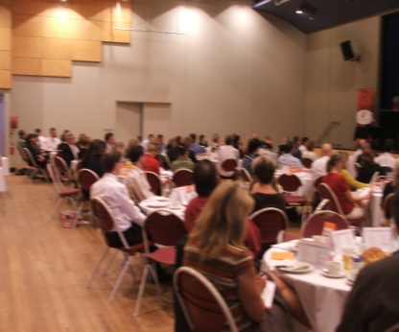
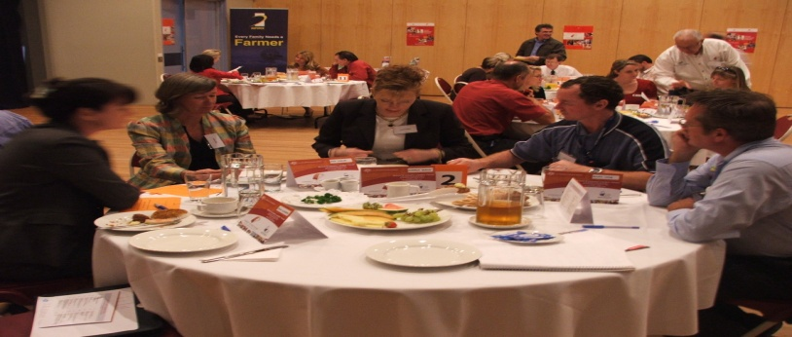
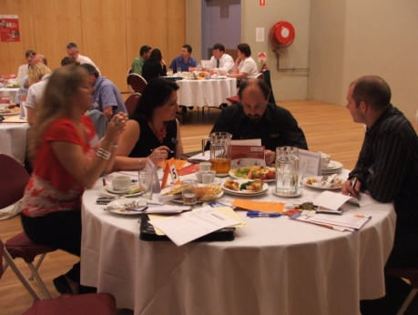
Partnership Brokers
Industry Validation (Senior Phase Network VET Working Group)
Goal :
Maintain currency of Training and Assessment knowledge, improve teaching and assessment strategies and to demonstrate evidence towards some of the professional standards for Queensland teachers
Outcome:
Vocational teachers are invited to meet with industry representatives and other teachers to moderate and validate their Training and Assessment Strategies and two identified assessment instruments
Notes:
Tom
Industry Validation (VET Working Group)
This will be the first of many programs the Senior Phase Network will coordinate with QYILS as the PB
Sandra Harrington (VETNetwork) may facilitate a professional development opportunity for teachers to maintain currency of Training and Assessment knowledge, improve teaching and assessment strategies and to demonstrate evidence towards some of the professional standards for Queensland teachers. The PD will focus on VET news, AQTF 2010, status of Training Packages, planning lessons and designing assessment tools.
Vocational teachers are invited to meet with industry representatives and other teachers to moderate and validate their Training and Assessment Strategies and two identified assessment instruments. Industry representatives have been invited to facilitate industry specific discussion groups. Industry groups will be formed according to needs expressed but are likely to include Business, Hospitality, Recreation, Engineering, Construction, Furnishing, Tourism, Information Technology, Work Education, Visual Art, and Music Industry Skills.
First held Dec 2009 - initiated by small group of practitioners who identified the need – created working group to establish program – activity coordinated and facilitated by QYIL (including promotion, venue, coordination with VET Network, coordination of 20 industry people. Attended by 80 practitioners)
Aim - Industry validation of TAS, Assessment Items (pm)
- Professional development session on validation and AQTF (am)
Areas - Hospitality, Engineering, Work Ed, Vis Arts, Rec, Business, Furnishing, etc
(To be held December 2010 – expecting 80-100 attendees (Sunshine Coast)

Slide 9
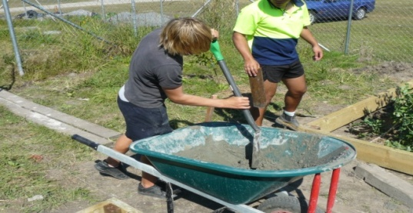
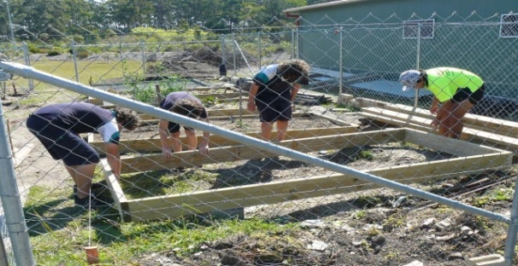
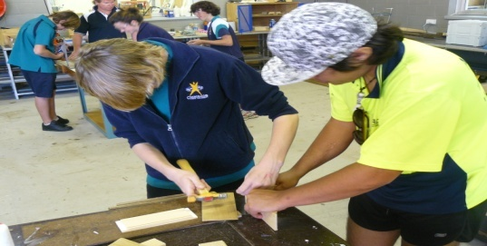
Partnership Brokers
Caboolture – Morayfield High Schools Civil, Building & Construction Partnership
Goal:
To establish a strategy which allows a sustainable partnership or partnerships to be identified and entered into between like minded organizations.
Notes:
Tom
Following the initial forum in August, I was approached by both Brad & Jim and requested to explore the possibility of a trade Pship between Morayfield & Caboolture and other regional schools. After completing some groundwork, we have firmed up support from government organisations, industry and training bodies and a group is working towards some common goals around certification, training for instructors, enterprise based projects and encouraging some strong local industry support. Last week, an MoU was signed at the school which will enable training levels to be identified, allow access to a leading training body to the TTC and will provide enterprise opportunities for students undertaking the course as well supply industrial building materials for student use and training at the school.
This is a great step forward, but has a long way to go in terms of who can access the TTC and how business and industry can support a much broader ’ centre of excellence’ at the TTC in Mfield.
I am sure Brad Fox would appreciate meting anyone interested in contributing to a building and construction partnership after the meeting. He is particularly keen to meet with industry folk who can provide apprenticeships and structured workplace learning and who are interested in utilising the Enterprise model within the construction area .

Slide 10
Partnership Brokers
Try A Trade
Goal :
The purpose of TRY-A-TRADE is to address the skills shortage currently experienced in areas of Moreton Bay Region, by connecting school students with local trades people.
Partners:
Moreton Regional Council Caboolture Plant & Fleet Workshop, Pine Rivers Plant & Fleet Workshop & Moreton Bay High Schools
Manufacturing Industry Schools Partnership (MISP)
Goal:
To educate students on the career possibilities within the manufacturing industry by giving them exposure to cutting edge companies.
Partners:
Moreton Bay Regional Council, DEEDI, MSQ, Morton Bay High Schools, North side Trusses and Frames, Kennedy's Timbers, Atlas Engineering, Hydrapower, AIM Lab, SVM, Monarch Building, Norman Manufacturing etc.
Notes:
Tom
These are programs where local business and industry organisations are working directly with schools to assist with the education and the career transition of our youth.
Try a Trade
MBRC utilises this program for their recruitment of trainees and apprentices in the Plant & Fleet Workshop’s
MISP
Local schools, Local and state government departments with local business partnering to development aspirations in the field of manufacturing.

Slide 11
Indigenous Careers and Employment Expo
Goal:
The Indigenous Employment, Jobs and Career expo was held at the Narangba Community Centre on Wednesday 30 June 2010. The Expo had a NAIDOC theme and the theme for NAIDOC week in 2010 is “Unsung Heroes – Closing the Gap by Leading the Way”.
Partners:
Moreton Bay Regional Council, Murri Network, DEEDI, DEEWR, MEGT, Skills Tech Aust, Journey Forward
LIFEmpower
Goal:
To present an array of interactive presentations, workshops and mentoring to year 10 and 11 students covering the areas of law, finance and Information technology.
Partners:
BPW, Fiducian Financial Services, Web-Sta, Lember and Williams, Caboolture Area Schools
Notes:
Tom
Indigenous Careers and Employment Expo - completed
With a 100 jobs on the board, 67 vacancies filled, 39 exhibitors and approximately 300 participants attending the day it was deemed a great success. Not only did the intended Indigenous youth attend but they brought their family members and friends with them to enjoy the day.
LIFEmpower – in process
A group of local business woman have come together to create and deliver real life programs in IT, Leal and Financial Management for students, with a view of creating a Business Professional Woman's Association for mentoring young woman in their career development.

Slide 12
Regional Career Expo
Goal:
To bring together business, industry and all fields of further education & training
Partners:
Regional Development Australia, Moreton Bat Regional Council
Moreton Bay Labs
Goal:
Involve disengaged students in a Social Media Program
Partners:
Regional Libraries, Youth Network Foundation, RTO’s, Schools, Youth Connections
Links into Australia Trade Coast
Goal:
Recruitment for Brisbane Airport Corporation Development
Partners:
BAC Precinct Businesses, RTO;s, Schools
Notes:
Tom
Regional Career Expo
To gather industry, business, schools for a Regional Expo
Moreton Bay Labs
This Partnership will deliver Certificates in Business (Social Media Marketing)
Links into Aust Trade Coast
Function is to identify jobs at ATC – this will deliver curriculum change inside schools that reflects Workforce Development in MB
45,000 jobs in the next 15years

Slide 13
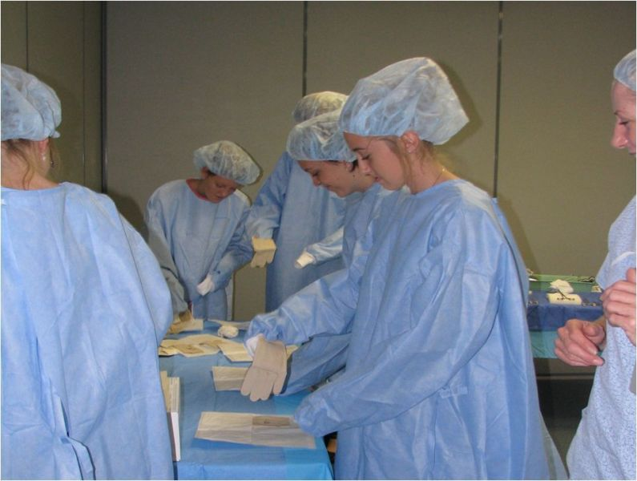
Partnership Brokers
Sunshine Coast High School Health Care Engagement Program
The HSHCEP is a local workforce development strategy aimed at building a sustainable future workforce for the Sunshine Coast. It is a multidisciplinary contemporary alternative to work experience that offers School Based Traineeships and addresses the workforce development needs for the Health Industry on the Sunshine Coast
High potential to duplicate this in the Moreton Bay Region
Notes:
Tom
The HSHCEP is a local workforce development strategy aimed at building a sustainable future workforce for the Sunshine Coast. It is a multidisciplinary contemporary alternative to work experience that offers School Based Traineeships and addresses the workforce development needs for the Health Industry on the Sunshine Coast. The program is also a long term tracking of student career choices and destinations in the Industry
The aim of this program is to provide local youth with an informed opportunity to commit to health care as a career option by engaging them in:
simulated work environments including life support, blood pressure, taking blood, suturing, anaesthetics and peri-op, blood cross matching, simulated laparoscopy, nursing, surgery, pathology, intensive care, critical care, allied health, midwifery, infection control, wound management, confidentiality hands on experiences within a Health facility engagement with highly skilled health clinicians professionals
Rotations with clinicians enthusiastically engaging with youth hands on relationship-based learning interesting rotations

Slide 14
Partnership Brokers
Guest Speaker
Dennis Chiron
Caboolture Business Enterprise Centre
(CBEC)
Dennis pioneered Enterprise Centres and Business Incubators in Australia.
He was part of the original Nicholas Clarke & Assoc. steering committee to examine the Enterprise Centres overseas experience and make recommendations to Government.
Notes:
Tom to Introduce Dennis
As evidence of our commitment to link business and industry with education, we have invited as our keynote speaker, Dennis of CBEC ……..

Slide 15
Partnership Brokers
Summary of Action Planning
Feedback from Forum 30th August 2010
Regional issues affecting Youth Engagement and Transition that were identified by Forum
Addressing needs of the Region and supporting Key Advisory Groups
Notes:
Geoff
Forum held earlier this year

Slide 16
Partnership Brokers
General Discussion
Stakeholder Contributions
Select a priority area
1. Regional Skill Shortages
2. Increasing level of low social- economic population
3. Parents and Family Engagement
4. Business and Industry Engagement
5. Career Development Curriculum
6. Young People at Risk
7. Fully Integrated VET Programs
Notes:
Geoff – 7 points identified at Forum
1. Regional Skill Shortages: Promotion and awareness, Mapping, Regional network, Industry Skills council. Solution (MRYA).
2. Increasing level of low social- economic
3. Parents and Family Engagement: Career awareness Solution (MRYA – Parent reps, PACTS forums. Senior Phase Network)
4. Business and Industry Engagement - Partnership Development: Creating and maintaining partnerships Solution (MRYA and Senior Phase Network)
5. Career Development Curriculum: (Senior Phase Network)
6. Young People at Risk: Coordination of networks, information and awareness. Solution (MRYA)
7. Fully Integrated VET Programs - SAT’s: Issues and solution (Joe Proctor DEDT Training PD in schools and senior Phase Network)
Geoff to intro Tom

Slide 17
http://cmapspublic.ihmc.us/rid=1HSKFZD5N-1BHBL9H-11HG/MRYA%20presentation%20Oct%202010.cmap

Slide 18
Partnership Brokers
General Discussion
Questions:
1 What can my organisation bring to Partnerships in the Region
2 How can my Organisation benefit by helping to solve Regional Issues
3 Identify what Partnerships can contribute to achieving productive results and outcomes for youth.
Notes:
Tom to Introduce Annette
QYIL
30mins
Inside Pack is:
Regional Issue Doc - 1-6 with Summary of issue Not Fully Integrated VET Program
- Questions listed
- Action Process
- Group Member list
- A3 Sheet
How to contribute
Each person to contribute the discussion
Answer each question
Summarise the information discussed at table

Slide 19
Partnership Brokers
Outcomes from Discussion
Actions
Time Lines
Responsibilities
Potential Partnerships
Programs
QYIL will provide High Facilitation Support to emergent potential partnerships as a result of today's discussion
Notes:
Annette
2 Mins each
Summarise Key Advisory Groups Response with identifying for their Regional Issue Group
Prompts
Action- What action
Time Lines- When
Responsibilities- Who
Potential Partnerships- Who, What - QYIL will commit and organise meeting and other potential partners
Programs- that can shared with others- info that QYIL can dissimulate
From the information gathered here today QYIL will compile and share all Potential Partnerships, Time Lines (All information) and we will also create the opportunities for the potential partnership identified to be realised, by inviting the proposed partners, research, organising the meetings and so on.
QYIL will compile and share all information gathered as well identify future partnerships for this region

Slide 20
Partnership Brokers
QYILS Support
High Facilitation will include:
QYIL offers secretarial service including taking minutes, disseminating minutes, calendar updates, meeting schedules. Chair and meeting venue may change from meeting to meeting.
QYIL is the independent partnership broker involved for the process of maintaining the partnership in the initial stages until ongoing sustainability has been achieved
QYIL will identify additional stakeholders that can contribute to successful partnership sustainability where appropriate
Notes:
Annette -Show slide as teams delivering 2 min feedback
Geoff – to take discussion and explain High Facilitation

Slide 21
Partnership Brokers
On behalf of the QYIL team I would like to extend
our appreciation and thanks to you
for sharing your valued time and knowledge.
We thank you for your commitment to our
Key Advisory Groups
and the future activities of the Moreton Region Youth Alliance (MRYA)
Geoff Timm
Regional Engagement Manager
Notes:
Geoff to close Forum

